Slide 1
Black History Month: Still I Rise
To understand how Maya Angelou displays black pride in ‘Still I Rise’.
Pride
Uplifting
Resilient
What is a metaphor?
What is a dynamic verb?
What do we call a group of lines in a poem?
What is ‘Black History Month’?

Slide 2
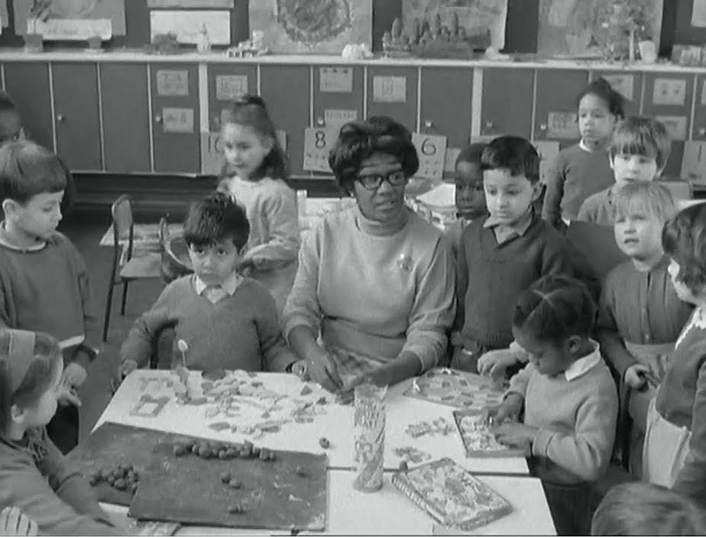
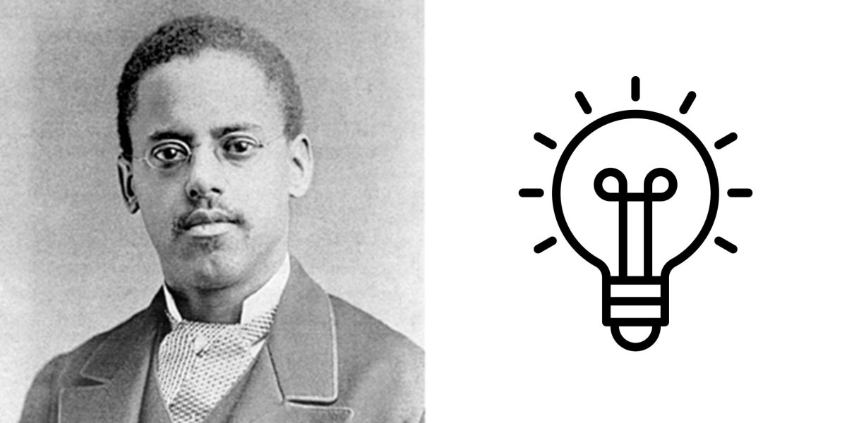
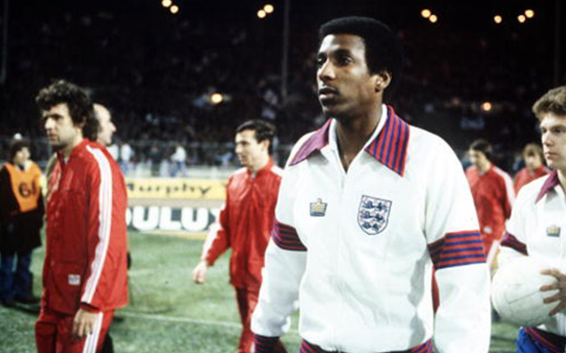
Look at the images below. How are they connected with Black History Month?
Discuss in your pairs for 90 seconds and be ready to share with the class.
Notes:
In 1969 Yvonne Conolly became Britain's first female black headteacher.
Viv Anderson – England’s first black international player
Lewis Latimer who completed pioneering work on the lightbulb

Slide 3
Uplifting
Inspiring emotions of happiness or hope
Uplifting stories help to improve our mood during lockdown.
An uplifting story that I have read is…because…

Slide 4
Resilient
Able to withstand or recover from difficult conditions
His resilient attitude meant that he never took failure too personally.
Resilience leads to success because…

Slide 5
‘Still I Rise’: Context
Complete the ‘If this is the answer, what is the question?’ activity below.
Maya Angelou was an actor, actress, author, screenwriter, a dancer, and a poet. She was born with the name Marguerite Annie Johnson. Maya Angelou didn't have the average childhood. Her parents split apart when she was very young. Her and her older brother Bailey were sent to live with their father’s mother, Anne Henderson, in Stamps, Arkansas. Because Maya was an African American girl, she suffered from racial prejudices and discrimination in Arkansas. She also experienced suffering at a young age. Maya suffered at the age of 7 when she was abused by her mother's boyfriend when she went to visit her. Being abused caused Angelou to become traumatized. She completely stopped talking for about 5 years. She than returned to Arkansas and continued to be mute. Through this whole time, Maya kept her grandmother's words in her head. She always taught Maya to be a positive woman, and live life to the fullest.
Her work embodies this positive and uplifting attitude, depicting speakers who rise above difficult or traumatic experiences to find happiness and success. Her work is also influenced by Christianity, using images of resurrection to express ideas about fresh starts and overcoming suffering.
Question | Answer
 | Racial prejudices
 | Aged 7
 | Her grandmother
 | Positive and uplifting
 | Images of Christianity

Slide 6
Now we have read the poem, complete the TRUE or FALSE activity in your pairs.
STATEMENT | TRUE | FALSE
The speaker is unapologetic about being seen as sassy.
The speaker is overwhelmed by her previous suffering.
This poem is not particularly uplifting.
The speaker is addressing the reader directly.
The speaker is not a resilient person.

Slide 7
Now you are going to use the vocabulary you were introduced to at the start of the lesson to write about Maya Angelou’s poem. Use the following writing structure to help you.
Complete this process twice for each word: ‘resilient’ and ‘uplifting’.
In ‘Still I Rise’, Maya Angelou displays an [insert one e.g. of new vocabulary] | when she writes [insert a quote from the poem] | because [explain in 1 sentence why this is either uplifting or resilient]. | Contextually, [explain what you know about Angelou’s life and how she has learnt to have this attitude]

