Slide 1


Top 10 tips to support your child through their exams

Slide 2

What is Prepare to Perform?
Staying calm, feeling good, being effective
A toolkit to help your child control different aspects of their life to help them perform better when it comes to exam time
It will allow them to focus, set themselves a plan and work towards being prepared in the best possible way

Slide 3

How can you help your child
and prepare them to perform?
Being a role model
Help them set goals
Keep them active
Healthy eating
Time out
Sleep patterns
Unplugging
Staying cool & calm
Belief
Be supportive
Each day you can support your child to make choices which can impact how they perform during the exam period

Slide 4

1. Being a role model
Set a good example by modelling the behaviour you want your child to adopt…
Planning for the week
Eating healthily and well
Keeping hydrated
Leading an active life
Staying calm
Being organised
Good sleep habits

Slide 5

2. Goal Setting
Encourage them to keep their goals planner visible – e.g. printed and displayed on their bedroom wall
Help focus them and talk to them about their goals regularly
Give positive reinforcement
Connect with them about ‘why’ and ‘what’ they want to achieve

Slide 6

60 minutes per day
3. Keeping Active
Encourage them to keep active on a daily basis
Carry out exercise in manageable chunks e.g. 3 x 20 min sessions throughout the day
Plan to do active things together on a weekend
Go out for a walk together and get some fresh air
Help them plan out their weekly exercise schedule in advance
After exercise your brain functions well, so encourage a revision session afterwards

Slide 7
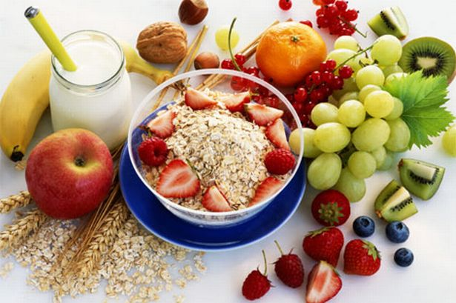
4. Healthy Eating
Plan your family meals for the week – breakfast, snacks, lunches and evening meals
Carry out a weekly food shop and make sure you write a list
Avoid high sugary and fatty foods or drinks
Aim to eat clean, fresh and healthy foods
Have a couple or ‘treat’ meals / or meals out per week
Use the Mark Lloyd recipes and meal planner as guidance
Encourage them to eat breakfast everyday
Hydration is key to brain functioning so make sure your child carries a bottle of water with them

Slide 8
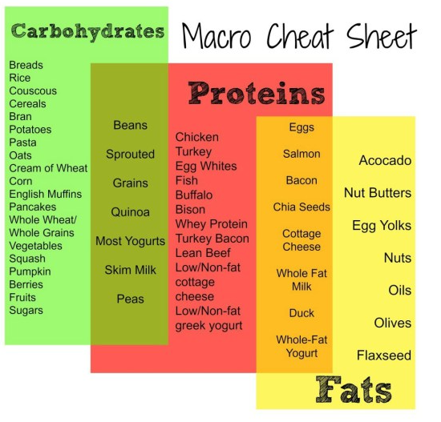
Eating the right food and drink can energise your system, improve alertness and sustain your child through the long exams
4. Healthy Eating
A BALANCING ACT
Keep your sugar levels under control.
UP THE B’S & OMEGA 3’S
B vitamins are directly involved in creating energy at a cellular level & will give you an energy boost
Green vegetables
Asparagus / Spinach
Broccoli
Yoghurt
Chicken / Salmon
Whole Grains / Brown rice
Almonds / Pecans
Eggs
MIGHTY MAGNESIUM
Magnesium is involved in over 1000 enzymatic reactions in the body. It's vitally important in providing our cells with energy
Green vegetables
Nuts
Pulses
Fish
Bananas

Slide 9


5. Time Out
Encourage them to build in opportunities to take some time out every week, away from study. For example:
Going out for food
Seeing friends
Having a bath
Listening to music
Reading a book
Doing a hobby
Going shopping
Going to the cinema

Slide 10

6.Sleep Patterns
Young people need between 8 – 9 hours sleep per night
Help your child create a relaxing evening routine
Make sure they don’t eat too late at night
Avoid giving them caffeine or sugary drinks late at night
Make sure they don’t work or revise too late before going to bed
Encourage them to switch off from social media / technology at least an hour before bedtime

Slide 11

7. Unplugging
Encourage them to unplug from technology everyday
Help them switch off from technology at least 30 mins- 1 hr before going to sleep
Support your child to appreciate the world around them rather than being governed by their phone
Make sure they put their phone away, & on silent, while they are concentrating on tasks / revision / homework
Help them learn to have the control to not be obsessed with their phone
Choose some time each day/week to switch off and unplug from technology with them

Slide 12

8. Staying Cool & Calm
Set a good example by staying calm yourself
Create a relaxing environment for your child
Help them plan out coping strategies to deal with their stress
Give them positive distractions away from studying
Help them understand their stress & to focus on controlling the controllables
Promote a balance of their academic studies & other activities during the week

Slide 13


9. Belief
Give them positive reinforcement
Boost their confidence daily
Celebrate any successes and reward them e.g. if they have achieved their mini-goals
Try not to set your expectations too high
Show them how proud of them you are
Highlight things to make them feel good
Give them the belief in themselves to help them achieve

Slide 14

10. Be Supportive
Be a good listener
Be approachable
Encourage them to take breaks in between revision
Show some understanding of what they are going through
Help them deal with their emotions & feelings
Offer caring advice
Just be there for them!

