Slide 1
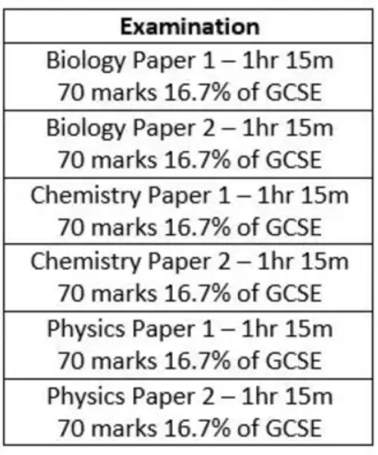
Physics Paper 1
Exam: Thursday 9th June
Topic 1: Energy
Topic 2: Electricity
Topic 3: Particle Model of Matter
Topic 4: Atomic Structure

Slide 2
Topic 1: Energy
Topic | Slide number | Booklet page number | Revision Guide Pages
Energy changes in systems | 3 - 59 | 6-24 | 167-172
Conservation and dissipation of energy | 60-69 | 25-28 | 168, 173-174
National and global energy resources | 70-93 | 29-38 | 175-179

Slide 3
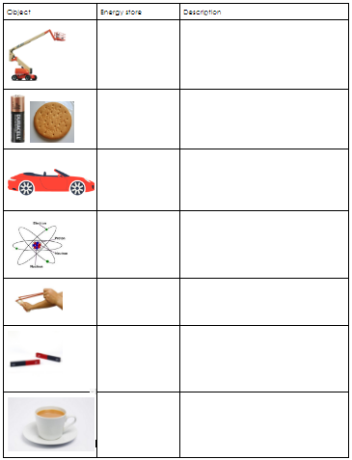
Energy Stores
Complete the table with the name of each store and a description.

Slide 4

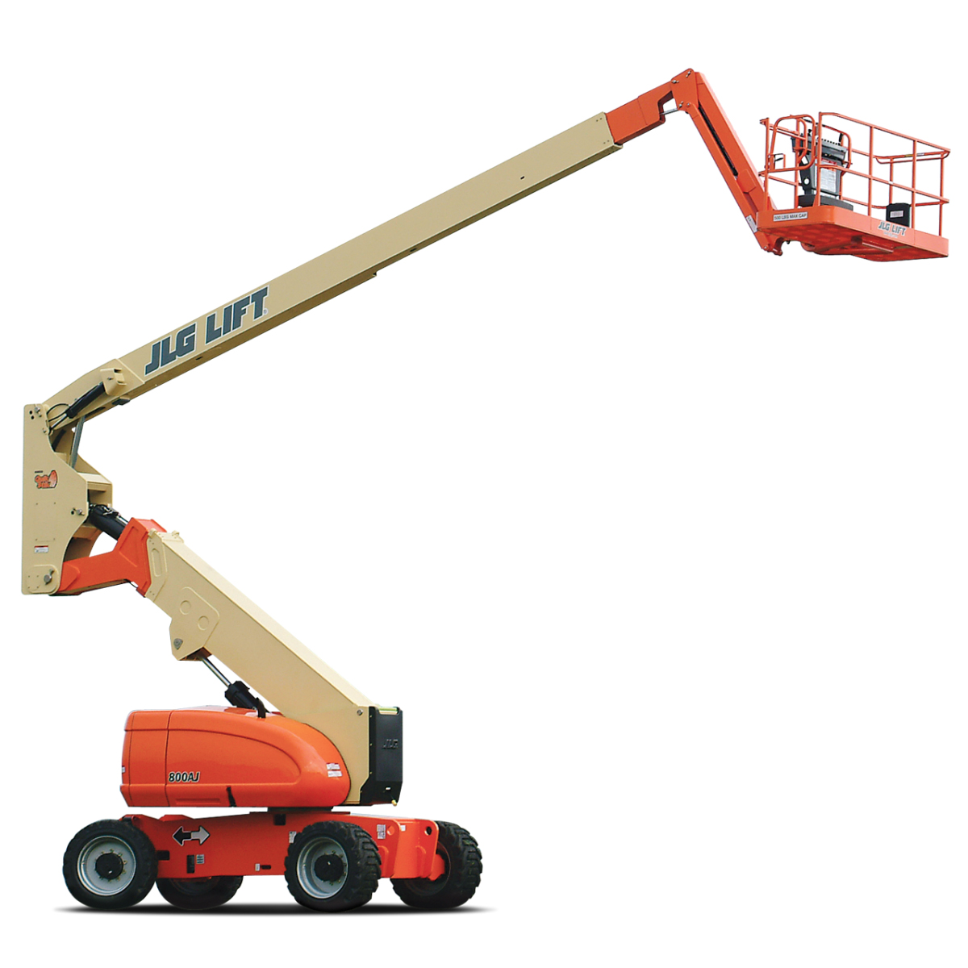
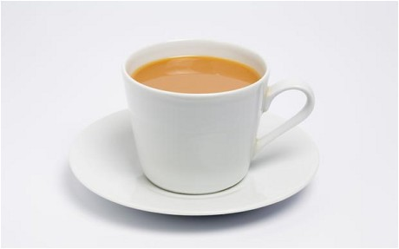
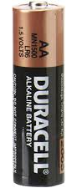
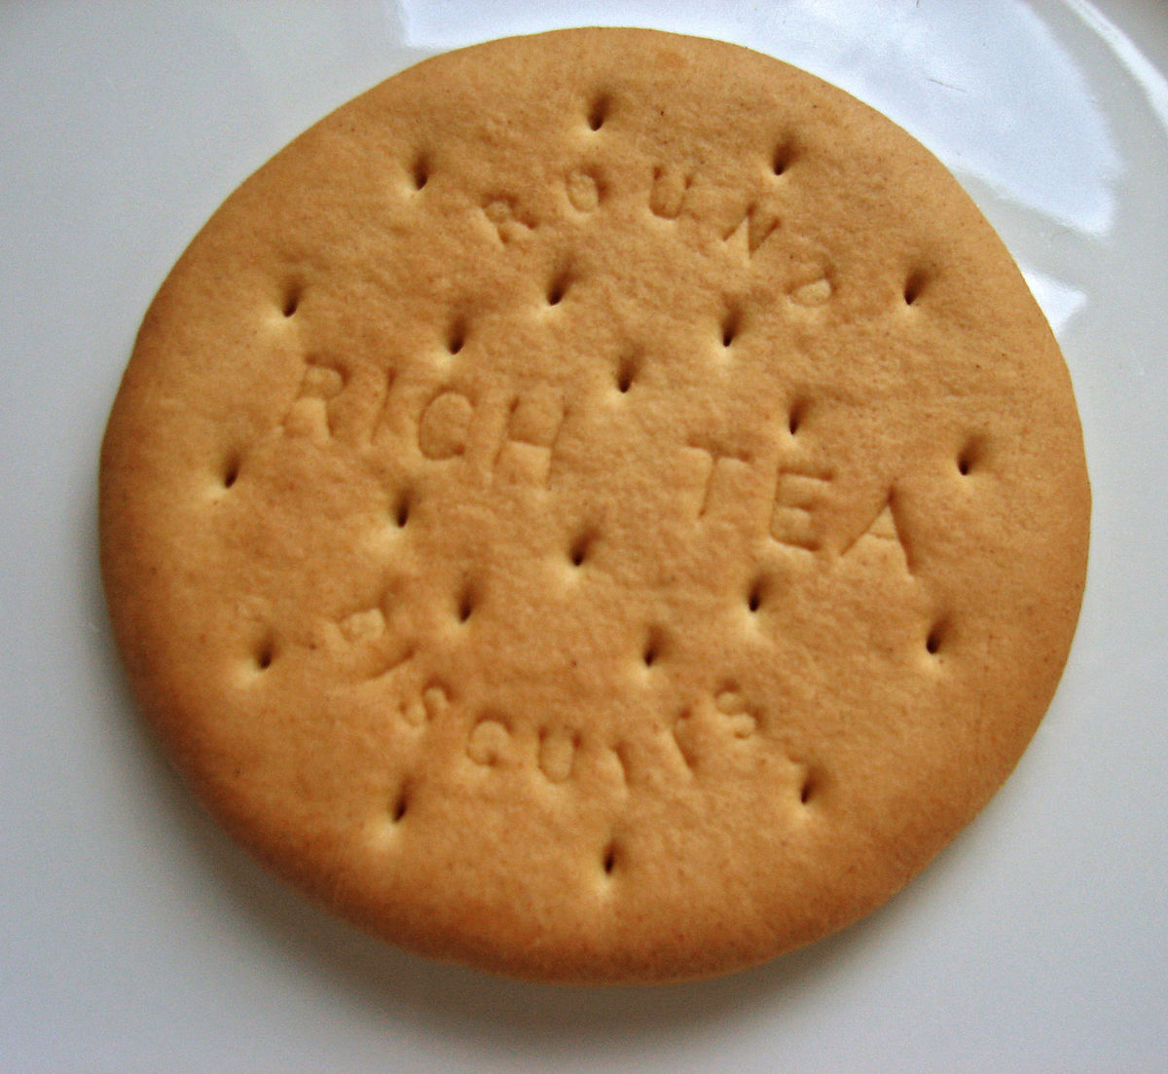
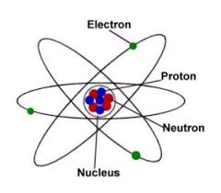

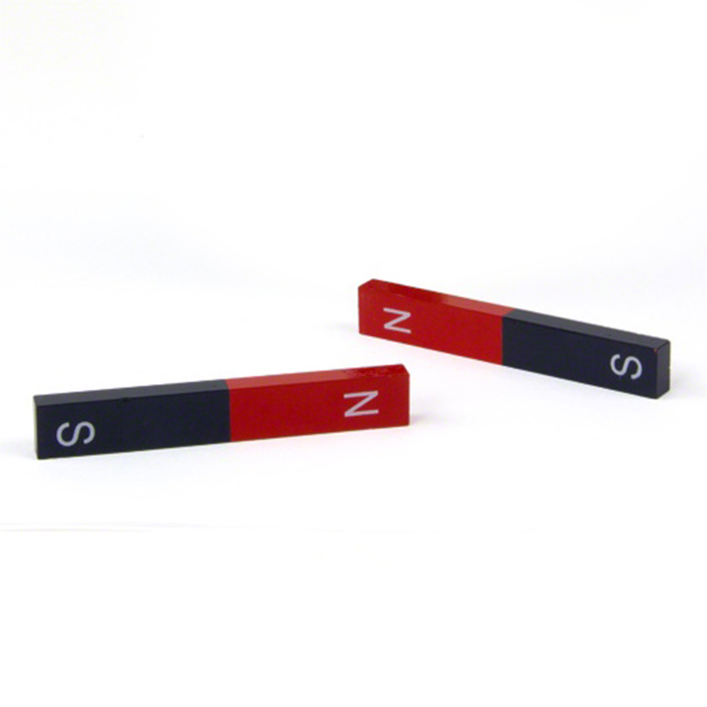
Check your answers…. (pg 6)
Kinetic energy store - The energy stored in an object which is moving
Gravitational energy store - The energy stored in an object which has been lifted up
Thermal energy store - The energy stored in something which is hot
Chemical energy store - The energy stored in fuel, food or a battery
Nuclear energy store - In the forces between particles in the nucleus of an atom
Elastic Potential energy store - The energy stored in something which has been stretched or squashed
Magnetic energy store - In the forces between magnets

Slide 5
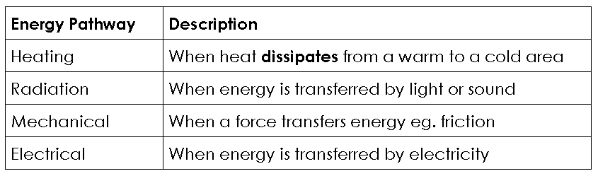
Energy Pathways (pg 7)
Energy can move between stores in an object. We call this energy transfer.
There are four ways that energy can be transferred - we call these pathways

Slide 6
Describing Energy Transfers (pg 7)
We always use boxes to show stores of energy and arrows to show pathways. This is called an energy flow diagram. These diagrams show how the energy is being transferred from one store to another
The energy flow diagram for a car speeding up is:
Petrol
Moving car
Chemical store
mechanical
Kinetic
store
Notes:
Foundation

Slide 7
Describing Energy Transfers (pg 7)
The energy flow diagram for a car speeding up is:
Petrol
Moving car
Chemical store
mechanical
Kinetic
store
Energy is transferred from the chemical store of the petrol to the kinetic store of the car, along the mechanical pathway.
Notes:
Foundation

Slide 8
Energy flow diagrams (pg 8)
Now complete the other energy flow diagrams in your booklet for these examples:
A ball being thrown upwards
A ball being dropped
A car braking to slow down
A car hitting a wall
Boiling water in an electric kettle.
Notes:
foundation

Slide 9
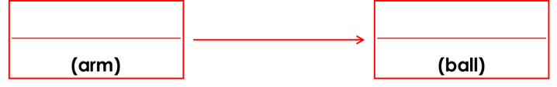
Energy flow diagrams (pg 8)
A ball being thrown upwards
Energy is transferred from the ___________________ store of the _____________ to the _________________ store of the _________, along the _________________ pathway.
chemical
kinetic
mechanical
chemical
arm
kinetic
ball
mechanical
Notes:
foundation

Slide 10
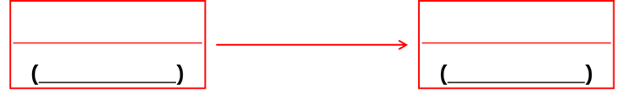
Energy flow diagrams (pg 8)
A ball being dropped
Energy is transferred from the ___________________ store of the _____________ to the _________________ store of the _________, along the _________________ pathway.
gravitational potential
kinetic
(ball)
mechanical
(ball)
gravitational potential
ball
kinetic
ball
mechanical
Notes:
foundation

Slide 11
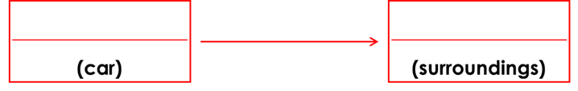
Energy flow diagrams (pg 8)
A car braking to slow down
Energy is transferred from the ___________________ store of the _____________ to the _________________ store of the ____________________, along the _________________ pathway.
kinetic
thermal
mechanical
kinetic
car
thermal
surroundings
mechanical
Notes:
foundation

Slide 12
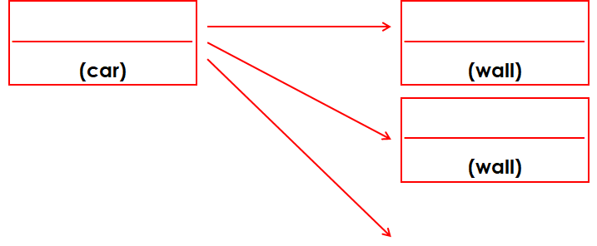
Energy flow diagrams (pg 9)
A car hitting a wall
Energy is transferred from the ___________________ store of the _____________ to the _________________ store of the _________, along the _________________ pathway. Energy is also transferred away as sound waves along the radiation pathway.
kinetic
mechanical
thermal
mechanical
elastic potential
radiation
(sound waves)
kinetic
car
thermal/elastic
wall
mechanical
Notes:
foundation

Slide 13
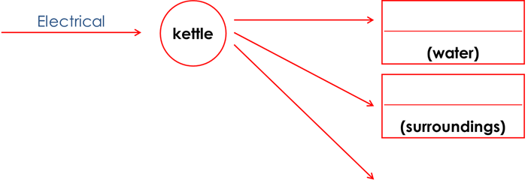
Energy flow diagrams (pg 9)
Boiling water in an electric kettle
Energy from the ________________ pathway is transferred to the _______________ stores of the water and surroundings along the ________________ pathway. Energy is also transferred away as ___________________ along the __________________ pathway.
heating
thermal
heating
thermal
radiation
(sound waves)
electrical
thermal
heating
sound waves
radiation
Notes:
foundation

Slide 14
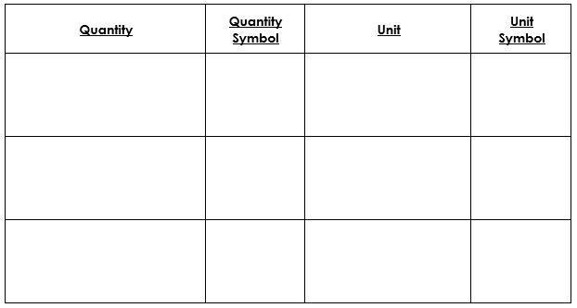
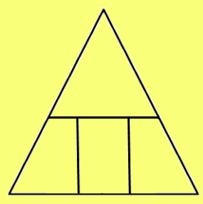
Calculating Kinetic Energy (pg 10)
Kinetic Energy = ½ x mass x velocity²
E_{K} = ½ mv²
Kinetic Energy
E_{K}
joules
J
E_{K}
mass
m
kilograms
kg
½
m
v²
velocity (speed)
v
metres per second
m/s

Slide 15

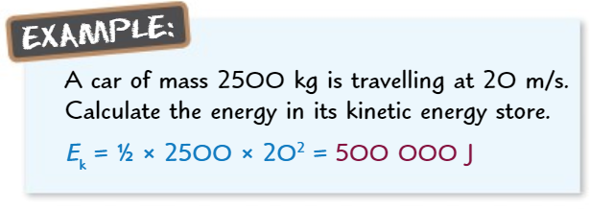
Calculating Kinetic Energy (pg 10)
Common Conversions:
kilograms
grams
kilojoules
joules

Slide 16
Calculating Kinetic Energy (pg 11)
Calculate the kinetic energy of a runner who has a mass of 80 kg and is running at a velocity of 8 m/s.
A cricketer swings a bat which has a mass of 1400g at a velocity of 15 m/s. How many joules of kinetic energy are transferred to the ball?
A golf-pro swings her driver at a velocity of 60 m/s. She transfers 1350 J of energy to the kinetic store of the driver, what is the mass of the driver?
A car has a mass of 1500 kg, it transfers 147,000 J of energy. Calculate the velocity of the car.
A 400g ball is thrown across a field. 80 J of energy are transferred to the ball’s kinetic store. What is the velocity of the ball?

Slide 17
Calculating Kinetic Energy (pg 11)
Calculate the kinetic energy of a runner who has a mass of 80 kg and is running at a velocity of 8 m/s.
E_{k} = ½ mv²
E_{k} = ½ x 80 x 8²
E_{k} = 2560 J
A cricketer swings a bat which has a mass of 1400g at a velocity of 15 m/s. How many joules of kinetic energy are transferred to the ball?
Conversion: 1400 g = 1.4 kg
E_{k} = ½ mv²
E_{k} = ½ x 1.4 x 15²
E_{k} = 158 J (3sf)

Slide 18
Calculating Kinetic Energy (pg 11)
A golf-pro swings her driver at a velocity of 60 m/s. She transfers 1350 J of energy to the kinetic store of the driver, what is the mass of the driver?
m = E_{k} ÷ (½ x v²)
m = 1350 ÷ (½ x 60²)
m = 0.75 kg
A car has a mass of 1500 kg, it transfers 147,000 J of energy energy. Calculate the velocity of the car.
v² = E_{k} ÷ (½ x m)
v² = 147000 ÷ (½ x 1500)
v² = 196
v = √196
v = 14 m/s

Slide 19
Calculating Kinetic Energy (pg 11)
A 400g ball is thrown across a field. 80 J of energy are transferred to the ball’s kinetic store. What is the velocity of the ball?
Conversion: 400 g = 0.4 kg
v² = E_{k} ÷ (½ x m)
v² = 80 ÷ (½ x 0.4)
v² = 400
v = √400
v = 20 m/s

Slide 20

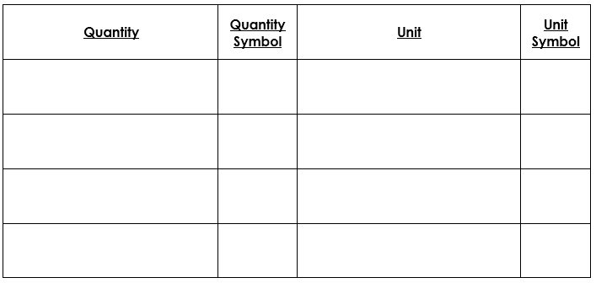
Calculating Gravitational Potential Energy (pg 12)
Gravitational Potential Energy = mass x gravitational field strength x height
E_{P} = mgh
Gravitational Potential Energy
E_{P}
joules
J
E_{P}
mass
m
kilograms
kg
gravitational field strength
g
newtons per kilogram
N/kg
m
g
h
height
h
metres
m

Slide 21
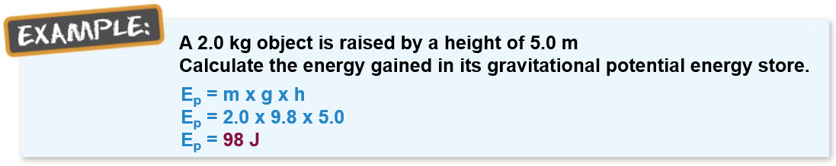
Calculating Gravitational Potential Energy (pg 12)
Common Conversions:
metres
centimetres
kilojoules
joules
kilograms
grams

Slide 22
Calculating Gravitational Potential Energy (pg 13)
A ball is thrown 10 m into the air. It has a mass of 0.5 kg, what is its maximum gravitational potential energy?
What is the gravitational potential energy store of a 800 g book resting on top of a 6.5 m shelf?
What is the mass of a bowling ball that is stationary at the top of a 450 m hill, with a gravitational potential energy store of 10,000 J?
A space rover has landed on a 100 m high hill on Mars. It has a mass of 210 kg and a store of 77700 J of gravitational potential energy. What is the gravitational field strength on this planet?
A 250 g glass is put onto a table, it has 2.35 J of energy in its gravitational potential store. What is the height of the table?

Slide 23
Calculating Gravitational Potential Energy (pg 13)
A ball is thrown 10 m into the air. It has a mass of 0.5 kg, what is its maximum gravitational potential energy?
E_{p} = mgh
E_{p} = 0.5 x 9.8 x 10
E_{p} = 49 J
What is the gravitational potential energy store of a 800 g book resting on top of a 6.5 m shelf?
Conversion: 800 g = 0.8 kg
E_{p} = mgh
E_{p} = 0.8 x 9.8 x 6.5
E_{p} = 51.0 J (3sf)

Slide 24
Calculating Gravitational Potential Energy (pg 13)
What is the mass of a bowling ball that is stationary at the top of a 450 m hill, with a gravitational potential energy store of 10,000 J?
m = E_{p} ÷ (g x h)
m = 10000 ÷ (9.8 x 450)
m = 2.3 kg (3sf)
A space rover has landed on a 100 m high hill on Mars. It has a mass of 210 kg and a store of 77700 J of gravitational potential energy. What is the gravitational field strength on this planet?
g = E_{p} ÷ (m x h)
g = 77700 ÷ (210 x 100)
g = 3.7 N/kg

Slide 25
Calculating Gravitational Potential Energy (pg 13)
A 250 g glass is put onto a table, it has 2.35 J of energy in its gravitational potential store. What is the height of the table?
Conversion: 250 d = 0.25 kg
h = E_{p} ÷ (m x g)
h = 2.35 ÷ (0.25 x 9.8)
h = 0.96 m (2sf)

Slide 26
Calculating Elastic Energy (pg 14)
Elastic Potential Energy = ½ x spring constant x extension²
E_{e} = 1/2 ke²
Elastic Potential Energy
E_{e}
joules
J
E_{e}
Spring Constant
k
newtons per metre
N/m
½
k
e²
extension
e
metres
m

Slide 27
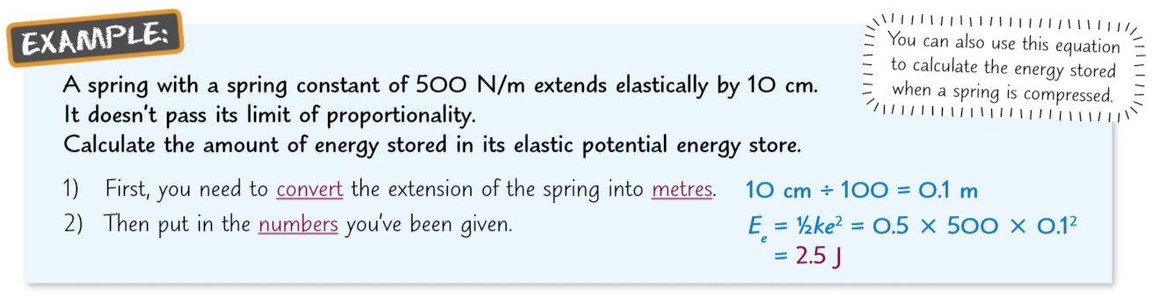
Calculating Elastic Energy (pg 14)
Common Conversions:
metres
centimetres
kilojoules
joules

Slide 28
Calculating Elastic Energy (pg 15)
How much energy is stored in a spring with a spring constant of 20 N/m, when extended 0.5m?
A spring with a spring constant of 42 N/m has been stretched by 52 cm. Calculate the elastic potential store of energy.
A bungee rope stores 500 J of energy in its elastic potential store when stretched by 12m. What is its spring constant?
A spring with a spring constant of 800N/m is storing 50 J of energy, how much is it compressed by?
A spring with a spring constant of 140N/m has been extended by 25cm. Calculate the elastic potential energy store.

Slide 29
Calculating Elastic Energy (pg 15)
How much energy is stored in a spring with a spring constant of 20 N/m, when extended 0.5m?
E_{e} = ½ ke²
E_{e} = ½ x 20 x 0.5²
E_{e} = 2.5 J
A spring with a spring constant of 42 N/m has been stretched by 52 cm. Calculate the elastic potential store of energy.
Conversion: 52 cm = 0.52 m
E_{e} = ½ ke²
E_{e} = ½ x 42 x 0.52²
E_{e} = 5.7 J (2sf)

Slide 30
Calculating Elastic Energy (pg 15)
A bungee rope stores 500 J of energy in its elastic potential store when stretched by 12m. What is its spring constant?
k = E_{e} ÷ (½ x e²)
k = 500 ÷ (½ x 12²)
k = 6.9 N/kg (2sf)
A spring with a spring constant of 800N/m is storing 50 J of energy, how much is it compressed by?
e² = E_{e} ÷ (½ x k)
e² = 50 ÷ (½ x 800)
e² = 0.125
e = √0.125
e = 0.35 m (2sf)

Slide 31
Calculating Elastic Energy (pg 15)
A spring with a spring constant of 140N/m has been extended by 25cm. Calculate the elastic potential energy store.
Conversion: 25 cm = 0.25 m
E_{e} = ½ ke²
E_{e} = ½ x 140 x 0.25²
E_{e} = 4.4 J (2sf)

Slide 32
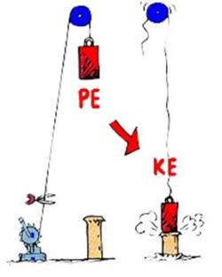
Falling Objects (pg 16)
When an object falls, all the energy it had in its GPE store will be transferred to its kinetic store.
Example
A box with a mass of 5kg falls from a ladder which is 4m high. How much energy will be in its kinetic store just before it hits the ground?
GPE = mgh
GPE = 5 x 9.8 x 4
GPE = 196 J
Energy is transferred from the box’s GPE store to its KE store, so energy in kinetic store = 196J
Notes:
Example - falling object - link to KE

Slide 33
Falling Objects (pg 16)
A ball with a mass of 2kg falls from a building which is 25m high. How much energy will be in its kinetic store just before it hits the ground?
A paperclip with a mass of 1g falls from a desk which is 1.2m high. How much energy will be in its kinetic store just before it hits the ground?
A ball with a mass of 1.5kg is thrown upwards. At the start of the throw, it has a velocity of 5m/s. How much energy will be in the GPE store of the ball at its highest point before it starts to fall again?
How high will the ball go?
Notes:
Example - falling object - link to KE

Slide 34
Falling Objects (pg 16)
A ball with a mass of 2kg falls from a building which is 25m high. How much energy will be in its kinetic store just before it hits the ground?
GPE = mgh
GPE = 2 x 9.8 x 25
GPE = 490 J
Energy is transferred from the ball’s GPE store to its KE store.
Energy in kinetic store = 490J
A paperclip with a mass of 1g falls from a desk which is 1.2m high. How much energy will be in its kinetic store just before it hits the ground?
Conversion: 1 g = 0.001 kg
GPE = mgh
GPE = 0.001 x 9.8 x 1.2
GPE = 0.012 J (2sf)
Energy is transferred from the paper clip’s GPE store to its KE store.
Energy in kinetic store = 0.012 J
Notes:
Example - falling object - link to KE

Slide 35
Falling Objects (pg 16)
A ball with a mass of 1.5kg is thrown upwards. At the start of the throw, it has a velocity of 5m/s. How much energy will be in the GPE store of the ball at its highest point before it starts to fall again?
E_{k} = ½ mv²
E_{k} = ½ x 1.5 x 5²
E_{k} = 18.75 J
Energy is transferred from the ball’s KE store to its GPE store.
Energy in gravitational potential store = 18.75 J
How high will the ball go?
h = E_{p} ÷ (m x g)
h = 18.75 ÷ (1.5 x 9.8)
h = 1.3 m (2sf)
Notes:
Example - falling object - link to KE

Slide 36
Power (pg 17)
energy
Power is the rate of ___________ transfer. We can also say it is the rate of _________ _________.
This means that more powerful objects will transfer energy ______________ than a less _______________ object.
Power is measured in _____________
1 watt is the same thing as saying 1 __________ of energy is transferred per ____________
work
done
faster
powerful
watts
joule
second

Slide 37
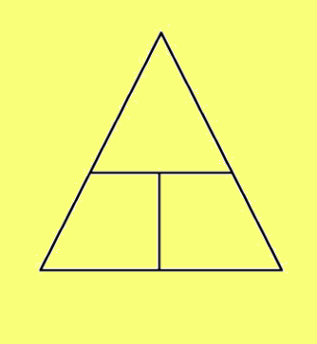
Power (pg 17)
Power = Energy (or work done) ÷ time
P = E ÷ t
or
P = W ÷ t
Energy
E
joules
J
E/W
Work done
W
joules
J
P
t
Power
P
watts
W
time
t
seconds
s

Slide 38
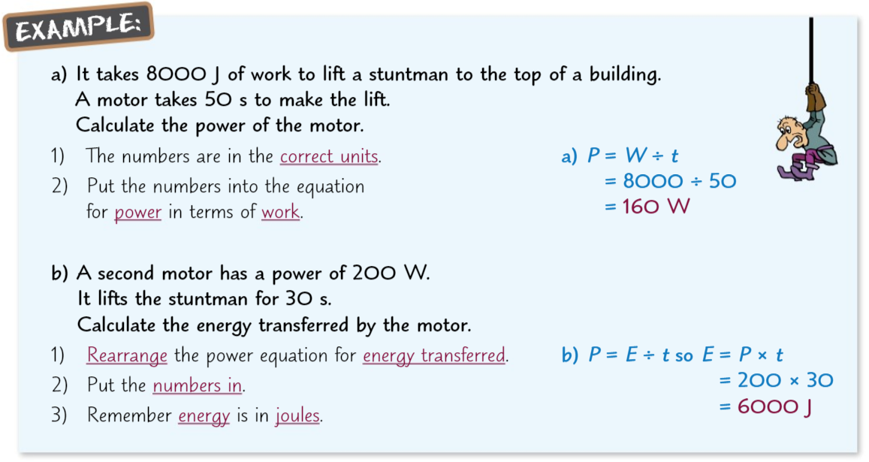
Power (pg 18)
Common Conversions:
minutes
X 60
seconds
kilojoules
joules
÷ 60

Slide 39
Power (pg 19)
A bird uses 200J of energy to fly to its nest in 15 seconds. Calculate the power of the bird.
A crane does 8 kJ of work to lift a crate. It takes 30 s to make the lift. Calculate the power of the crane.
A motor with a power rating of 500W uses 9000J of energy to lift a box. How long did it take to life the box?
A weightlifter takes 1.2 seconds to lift a barbell with a power of 1200W. How much work has he done?
It takes 2 minutes for a lift with a motor with a 5kW rating to reach the 42nd floor of a building. How much energy was required?

Slide 40
Power (pg 19)
A bird uses 200J of energy to fly to its nest in 15 seconds. Calculate the power of the bird.
P = E ÷ t
P = 200 ÷ 15
P = 13.3 W (3sf)
A crane does 8 kJ of work to lift a crate. It takes 30 s to make the lift. Calculate the power of the crane.
Conversion: 8 kJ = 8000 J
P = W ÷ t
P = 8000 ÷ 30
P = 267 W (3sf)

Slide 41
Power (pg 19)
A motor with a power rating of 500W uses 9000J of energy to lift a box. How long did it take to life the box?
t = E ÷ P
t = 9000 ÷ 500
t = 18 s
A weightlifter takes 1.2 seconds to lift a barbell with a power of 1200W. How much work has he done?
W = P x t
W = 1200 x 1.2
W = 1440 J

Slide 42
Power (pg 19)
It takes 2 minutes for a lift with a motor with a 5kW rating to reach the 42nd floor of a building. How much energy was required?
Conversion: 2 minutes = 120 seconds
Conversion: 5 kW = 5000 W
E = P x t
E = 5000 x 120
E = 600 000 J
OR 600 kJ

Slide 43
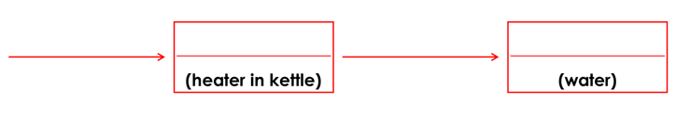
Energy Transfers During Heating (pg 20)
electrical
thermal
heating
thermal
electrically
Energy is transferred ____________ to the _________ energy store of the kettle’s heating element.
Energy is the transferred by __________ to the water’s __________ energy store.
So the temperature of the water ______________.
thermal
heating
thermal
increases

Slide 44
Specific Heat Capacity (pg 20)
On a hot day at the beach, the sand can feel very hot, but the sea feels ___________. This is because different materials need different amounts of _______________ to heat them up.
Materials which need a lot of energy to heat up (like the sea) can ______________ a lot of energy and can also ________________ a lot of energy when they cool down.
The amount of energy stored or released during a temperature change depends on the _______________ __________ ________________ of the material.
The specific heat capacity is the amount of ____________ needed to heat ___________ of a material by ___________.
cold
energy
absorb
release
specific
heat
capacity
energy
1 kg
1 ℃

Slide 45
Specific Heat Capacity (pg 21)
Energy change = mass x specific heat capacity x change in temperature
E = mcΔ𝛳
Energy Change
E
joules
J
E
mass
m
kilograms
kg
Specific heat capacity
c
Joules per kilogram degree celsius
J/kg°C
m
c
Δ𝛳
temperature
Δ𝛳
degree celsius
°C

Slide 46
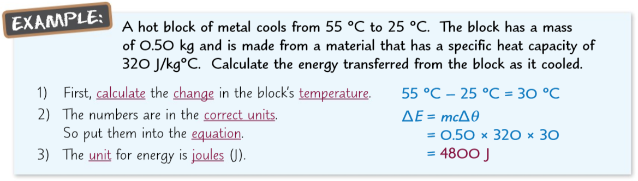
Specific Heat Capacity (pg 21)
Common Conversions:
kilogram
grams
kilojoules
joules

Slide 47
Specific Heat Capacity (pg 22)
1.5 kg of water is heated, increasing its temperature by 10℃. How much energy has been added to the water? The specific heat capacity of water is 4200 J/kg℃
An 800g block of copper cools down by 50℃. How much energy has been released from the copper? The specific heat capacity of copper is 390 J/kg℃
150J of energy is given to a block of 0.5kg of a material which causes it to heat up from 15℃ to 20℃. What is the specific heat capacity of the material?
Water has a specific heat capacity of 4200 J/kg℃. If it takes 1.8kJ of energy to heat some water by 50℃, what mass of water do you have?
Glass has a specific heat capacity of 840 J/kg℃. A 2 kg sheet of glass is at 20℃. If it absorbs 5.8 kJ of energy, what will its final temperature be?

Slide 48
Specific Heat Capacity (pg 22)
1.5 kg of water is heated, increasing its temperature by 10℃. How much energy has been added to the water? The specific heat capacity of water is 4200 J/kg℃
E = mcΔ𝛳
E = 1.5 x 4200 x 10
E = 63 000 J
An 800g block of copper cools down by 50℃. How much energy has been released from the copper? The specific heat capacity of copper is 390 J/kg℃
Conversion: 800 g = 0.8 kg
E = mcΔ𝛳
E = 0.8 x 390 x 50
E = 15 600 J

Slide 49
Specific Heat Capacity (pg 22)
150J of energy is given to a block of 0.5kg of a material which causes it to heat up from 15℃ to 20℃. What is the specific heat capacity of the material?
Change in temperature = 20℃ -15℃ = 5℃
c = E ÷ (m x Δ𝛳)
c = 150 ÷ (0.5 x 5)
c = 60 J/kg℃
Water has a specific heat capacity of 4200 J/kg℃. If it takes 1.8kJ of energy to heat some water by 50℃, what mass of water do you have?
  Conversion: 1.8 kJ = 1800 J
  m = E ÷ (c x Δ𝛳)
m = 1800 ÷ (4200 x 50)
m = 0.0086 kg (2sf)
This is 8.6 g if you prefer.

Slide 50
Specific Heat Capacity (pg 22)
Glass has a specific heat capacity of 840 J/kg℃. A 2 kg sheet of glass is at 20℃. If it absorbs 5.8 kJ of energy, what will its final temperature be?
    Conversion: 5.8 kJ = 5800 J
    Δ𝛳 = E ÷ (m x c)
    Δ𝛳 = 5800 ÷ (2 x 840)
    Δ𝛳 = 3.5℃ (2sf)
    This is the change in temperature.
    Start temperature = 20℃
    Final temperature = 20℃ + 3.5℃ = 23.5℃

Slide 51
Energy Supplied by the Heater (pg 23)
To calculate the power of a heater, just multiply the potential difference and current in the circuit together.
Then, to calculate the energy given out by the electrical heater multiply the power of the heater by the time it has been on for (in seconds).
Example: Calculate how much energy is supplied when a heater in a circuit with a potential difference of 12V and a current of 2.5A is left on for 2 minutes.
Calculate Power: Power = potential difference x current
Power = 12 x 2.5
Power = 30W
Now Energy: Energy = power x time
Energy = 30W x 120 seconds
Energy = 3600 J

Slide 52
Energy Supplied by the Heater (pg 23)
Calculate how much energy is supplied to a heater in a circuit with a current of 4A and a potential difference of 8V and is left on for 200 seconds.
Calculate how much energy is supplied to a heater in a circuit with a potential difference of 10V and a current of 3A is left on for 5 minutes.
Calculate how much energy is supplied to a heater with a current of 150mA and a potential difference of 12V. The heater is left on for 3 minutes.

Slide 53
Energy Supplied by the Heater (pg 23)
Calculate how much energy is supplied to a heater in a circuit with a current of 4A and a potential difference of 8V and is left on for 200 seconds.
Calculate Power: Power = potential difference x current
Power = 8 x 4
Power = 32W
Now Energy: Energy = power x time
Energy = 32W x 200 seconds
Energy = 6400 J

Slide 54
Energy Supplied by the Heater (pg 23)
Calculate how much energy is supplied to a heater in a circuit with a potential difference of 10V and a current of 3A is left on for 5 minutes.
Calculate Power: Power = potential difference x current
Power = 10 x 3
Power = 30 W
Now Energy: Energy = power x time
Energy = 30 W x 300 seconds
Energy = 9000 J

Slide 55
Energy Supplied by the Heater (pg 23)
Calculate how much energy is supplied to a heater with a current of 150mA and a potential difference of 12V. The heater is left on for 3 minutes.
Convert units: 150 mA = 0.150A
Calculate Power: Power = potential difference x current
Power = 12 x 0.150
Power = 1.8 W
Now Energy: Energy = power x time
Energy = 1.8 W x 180 seconds
Energy = 324 J

Slide 56
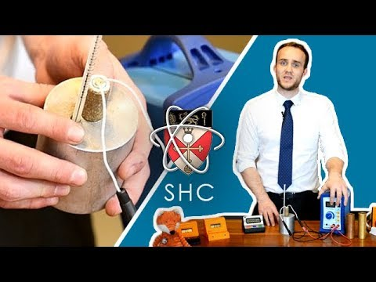
Specific Heat Capacity (pg 24)
What goes in the two holes in the top of the block?
Why are a few drops of water added to the thermometer hole?
What will we be recording?
What is the equation to calculate specific heat capacity?
Why don’t we need to measure the mass of the block?
How will we calculate the power of the heater most accurately?
What do we use to measure the current? How about the potential difference?
Once we know the power, how do we calculate energy?
Why is the number calculated for SHC in the experiment usually higher than the correct value?
What can we do to get more accurate results?

Slide 57
Specific Heat Capacity (pg 24)
What goes in the two holes in the top of the block?
Heater and thermometer
Why are a few drops of water added to the thermometer hole?
Otherwise there will be an air gap and you won’t get an accurate reading
What will we be recording?
Record the temperature every minute for 10 minutes
What is the equation to calculate specific heat capacity?
SHC = Energy change ÷ (mass x change in temperature)
Why don’t we need to measure the mass of the block?
The blocks are manufactured to be 1kg

Slide 58
Specific Heat Capacity (pg 24)
How will we calculate the power of the heater most accurately?
Measure the current and the potential difference and multiply them together
What do we use to measure the current? How about the potential difference?
Current - ammeter, potential difference - voltmeter
Once we know the power, how do we calculate energy?
Energy = power x time in seconds
Why is the number calculated for SHC in the experiment usually higher than the correct value?
The block is not insulated and some energy is lost to the surroundings. It looks like we need more energy that we actually do to heat the block so the number is higher
What can we do to get more accurate results?
To use foam to insulate the block.

Slide 59
P1: Energy changes in systems
Complete the exam questions on pages 4-10 of the exam question booklet

Slide 60
Conservation of Energy (pg 25)
The conservation of energy principle is that energy is never ___________ or ________________, it can only be stored, ________________ or _____________________.
Dissipated means that energy is transferred to the ____________________ in a way that is not _____________.
Energy can be __________________ between stores.
For example, when you use a battery operated toy car, energy is transferred usefully from the __________________ store of the battery to the __________________ store of the car. Some energy is dissipated. For example, the surroundings will _________ ________ and ______________ waves will be produced.
created
destroyed
transferred
dissipated
surroundings
useful
transferred
chemical
kinetic
heat
up
sound

Slide 61
Dissipating Energy (pg 25)
What happens during energy transfers which is not helpful?
Which store does energy usually dissipate to?
What is another name for this dissipated energy?
Why is friction not helpful in many situations?
What can we do to reduce friction?
If we said a material had a ‘high thermal conductivity’ what would we mean?
What is another name for a material with a low thermal conductivity?
How can we use these materials to reduce the amount of energy which is dissipated from our homes?

Slide 62
Dissipating Energy (pg 25)
What happens during energy transfers which is not helpful?
Energy is dissipated to the surroundings is a way which means it is wasted
Which store does energy usually dissipate to?
Thermal store of the surroundings
What is another name for this dissipated energy?
Wasted energy
Why is friction not helpful in many situations?
Friction can cause energy to be dissipated to the surroundings which is often unwanted

Slide 63
Dissipating Energy (pg 25)
What can we do to reduce friction?
Use a lubrication such as oil to reduce friction
If we said a material had a ‘high thermal conductivity’ what would we mean?
It can transfer a lot of energy in a short amount of time
What is another name for a material with a low thermal conductivity?
An insulator
How can we use these materials to reduce the amount of energy which is dissipated from our homes?
We can add insulation to the walls or the loft to reduce energy losses. We can also build the walls out of materials with low thermal conductivity.

Slide 64

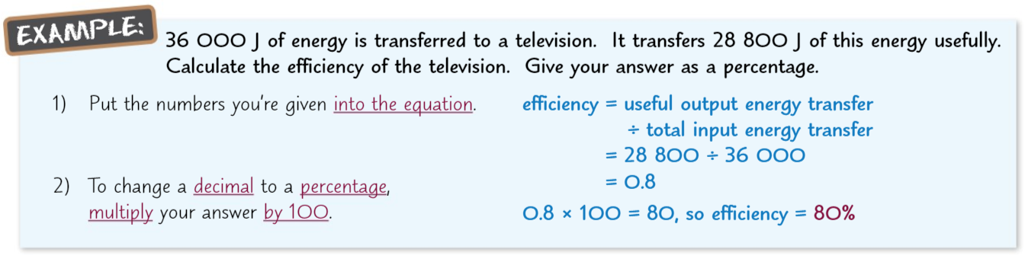
Efficiency (pg 27)
The efficiency of an energy transfer is a measure of the amount of energy that ends up in the useful energy store.

Slide 65

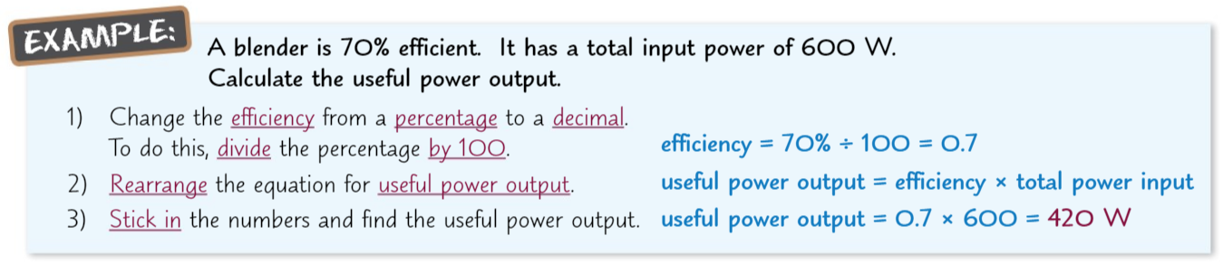
Efficiency (pg 27)
The efficiency of an energy transfer is a measure of the amount of energy that ends up in the useful energy store.

Slide 66
Efficiency (pg 28)
A motor in a remote-controlled car transfer 300J of energy into the car’s energy stores. 225J are transferred to the car’s kinetic store. Calculate the efficiency of the motor.
250,000 J of energy is transferred to a computer. It dissipates 50,000 J to the surroundings.
  Calculate the amount of energy transferred to the useful energy store.
  Calculate the efficiency of the computer.
A machine has a useful power output of 900 W and an efficiency of 0.75. Calculate the total power input to the machine.
A microwave has an efficiency of 0.75. It has a total input of 800W. Calculate the useful power output.

Slide 67
Efficiency (pg 28)
A motor in a remote-controlled car transfer 300J of energy into the car’s energy stores. 225J are transferred to the car’s kinetic store. Calculate the efficiency of the motor.
Efficiency = useful energy transfer = 225 = 0.75
total energy input 300
250,000 J of energy is transferred to a computer. It dissipates 50,000 J to the surroundings.
  Calculate the amount of energy transferred to the useful energy store.
Energy transferred usefully = 250 000 - 50 000 = 200 000 J
  Calculate the efficiency of the computer.
Efficiency = useful energy transfer = 200 000 = 0.80
total energy input 250 000

Slide 68
Efficiency (pg 28)
A machine has a useful power output of 900 W and an efficiency of 0.75. Calculate the total power input to the machine.
Efficiency = useful power transfer
total power input
total power input = useful power transfer = 900 = 1200W
efficiency 0.75
A microwave has an efficiency of 0.75. It has a total input of 800W. Calculate the useful power output.
Efficiency = useful power transfer
total power input
useful power transfer = efficiency x total power input
= 0.75 x 800
= 600W

Slide 69
P1: Conservation and dissipation of energy
Complete the exam questions on pages 11-16 of the exam question booklet

Slide 70
Renewable and Non Renewable Resources (pg 29)
Give 4 examples of non renewable energy resources?
What do we mean by ‘non-renewable’?
What do we mean by a renewable energy resource?
State the names of the 7 renewable energy resources which you need to know about.
Give examples of the ways non renewable energy resources are used in transport.
Give an example of the way a renewable energy resources are used in transport.
How are non renewable energy resources used to heat things such as your home?
How are renewable energy resources used to heat your home?

Slide 71
Renewable and Non Renewable Resources (pg 29)
Give 4 examples of non renewable energy resources?
Coal, oil, gas and nuclear energy
What do we mean by ‘non-renewable’?
It will run out faster than we are able to replace it
What do we mean by a renewable energy resource?
The source will not run out
State the names of the 7 renewable energy resources which you need to know about.
Wind, solar, geothermal, hydroelectricity, wave, tidal and biofuel
Give examples of the ways non renewable energy resources are used in transport.
Petrol and diesel are both created from oil. Coal is burned in steam trains to boil water and make steam

Slide 72
Renewable and Non Renewable Resources (pg 29)
Give an example of the way a renewable energy resources are used in transport.
Some vehicles use biofuels and some cars are now electric and the electricity can be generated using renewable energy resources
How are non renewable energy resources used to heat things such as your home?
Gas is used to heat water in a boiler. The water is used in radiators. Electric heaters sometimes use electricity generated from non renewable sources
How are renewable energy resources used to heat your home?
Biofuels work like gas boilers. A geothermal pump uses hot water from the ground to pump into radiators. Solar heaters can also be used to heat water. Electric heaters sometimes use electricity generated from non renewable sources

Slide 73
Wind, Solar and Geothermal (pg 30)
How do wind turbines work?
Why can we say they are ‘non-polluting’?
Why are they unreliable?
How do solar panels work?
What is the problem with making solar panels?
Why are they not useful as the only source of electricity?
Suggest a suitable location for solar panels
How does geothermal power work?
What are the 2 uses of geothermal power?
Why is geothermal power so reliable?

Slide 74
Wind, Solar and Geothermal (pg 30)
How do wind turbines work?
When the wind blows, the blades of the turbine spin and electricity is generated.
Why can we say they are ‘non-polluting’?
Nothing is burned so no harmful gases are released
Why are they unreliable?
They do not always rotate as sometimes it is not windy enough
How do solar panels work?
They absorb energy from the sunlight and generate electricity
What is the problem with making solar panels?
A lot of energy is needed to build them and this energy often comes from non-renewable energy resources

Slide 75
Wind, Solar and Geothermal (pg 30)
Why are they not useful as the only source of electricity?
It is not sunny during the night so electricity cannot be generated at night
Suggest a suitable location for solar panels
A sunny country. Maybe a desert.
How does geothermal power work?
Water is pumped under the Earth’s surface and the thermal energy store of the hot rocks is used to heat the water and turn it into steam. This steam can be used to turn a turbine
What are the 2 uses of geothermal power?
To generate electricity or heat buildings
Why is geothermal power so reliable?
The underground rocks are always hot

Slide 76
Hydro-electric, waves and tides (pg 32)
Why are hydroelectric power stations damaging to the environment, even though no fossil fuels are burned?
What are the main benefits of using hydroelectric power?
How do wave turbines work?
What are tidal barrages and how do they work?
Why are tidal barrages so reliable?
Why can they be said to be damaging to the environment?

Slide 77
Hydro-electric, waves and tides (pg 32)
Why are hydroelectric power stations damaging to the environment, even though no fossil fuels are burned?
The valley is usually flooded so plants rot and release greenhouse gases which contribute to global warming. Also the habitats of animals and plants can be destroyed.
What are the main benefits of using hydroelectric power?
It is reliable and can respond straight away when there is extra demand for electricity.
How do wave turbines work?
Water waves turn turbines and electricity is generated

Slide 78
Hydro-electric, waves and tides (pg 32)
What are tidal barrages and how do they work?
They are big dams which are built across rivers. They have turbines in them which turn when the tides move in and out. This generates electricity
Why are tidal barrages so reliable?
It is easy to predict the tides for many years into the future
Why can they be said to be damaging to the environment?
They change the habitat of the wildlife and fish can be killed when they swim through the turbine

Slide 79
Biofuels (pg 33)
What are biofuels made from?
How can they be used?
Why can we say that biofuels do not contribute to greenhouse gases being added to the atmosphere?
Why can biofuels be damaging to the environment?
Why are they so reliable?

Slide 80
Biofuels (pg 33)
What are biofuels made from?
Animal dung or plants
How can they be used?
They can be burnt to produce electricity or can be made into biofuels to run cars
Why can we say that biofuels do not contribute to greenhouse gases being added to the atmosphere?
Although they release CO₂ when they are burnt, the plants took in CO₂ while they were growing. This means that overall, no extra CO₂ will be released after burning biofuels

Slide 81
Biofuels (pg 33)
Why can biofuels be damaging to the environment?
Forests have been cleared to make room to grow plants for biofuels. This means that animals have lost their habitats. There is a loss of biodiversity as only one type of plant is grown for biofuel.
Why are they so reliable?
They can be constantly produced by growing new plants and can also be stored.

Slide 82
Non-Renewable Resources (pg 34)
Why do we use fossil fuels so heavily?
What is the problem if we do not find alternatives to fossil fuels
Why do fossil fuels cause global warming?
Why do fossil fuels cause acid rain?
Describe other environmental issues of using fossil fuels.
Why could it be argued that nuclear power is good for the environment?
Why could it be argued that nuclear power is damaging to the environment?

Slide 83
Non-Renewable Resources (pg 34)
Why do we use fossil fuels so heavily?
They are very reliable sources of energy. We have enough of these fuels to meet the demand at the moment. Fossil fuel power stations can also respond quickly if there is more demand for electricity, in a way that renewable energy resources cannot.
What is the problem if we do not find alternatives to fossil fuels
These fossil fuels will eventually run out. We need to find alternatives before this happens
Why do fossil fuels cause global warming?
They release carbon dioxide when burnt which is a greenhouse gas and contributes to global warming
Why do fossil fuels cause acid rain?
When sulfur in the fuel is burned, it makes sulfur dioxide which causes acid rain.

Slide 84
Non-Renewable Resources (pg 34)
Describe other environmental issues of using fossil fuels.
Coal mining can damage the landscape. If oil is spilled, sea creatures are harmed and the oceans are polluted
Why could it be argued that nuclear power is good for the environment?
Nothing is burnt so no harmful greenhouse gases are released.
Why could it be argued that nuclear power is damaging to the environment?
Radioactive waste is dangerous for a long time and is difficult to dispose of safely. There is also the risk of a nuclear power station accident which could release a lot of radiation. Eg Fukushima or Chernobyl

Slide 85
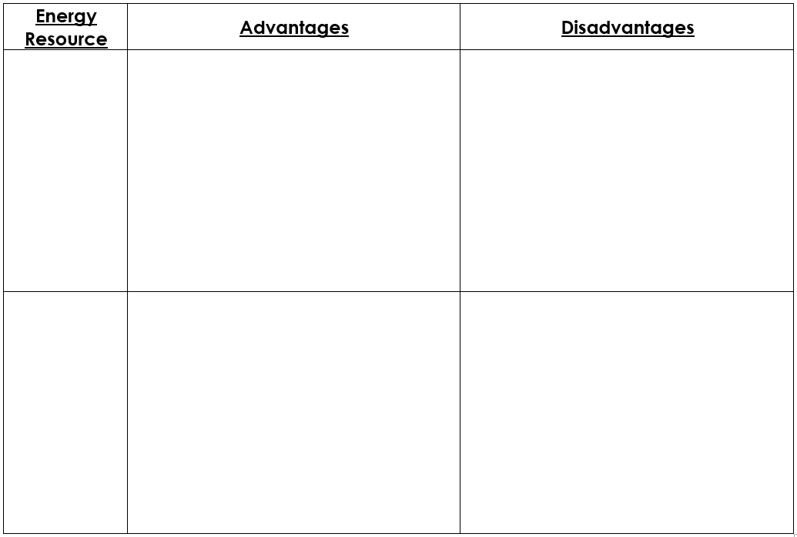
Renewable and Non Renewable Resources (pg 35)
Produce no pollution once built
No permanent damage to landscape - they could be taken down
Not reliable - if there is no wind, the turbines will not turn
If the wind is too strong, they may be damaged
If there is extra electricity demand, turbines cannot help
Wind
Produce no pollution once built
Very reliable in sunny countries
A lot of energy is needed to build them
Solar power can only be generated through the day
If there is extra electricity demand, solar panels cannot help
Solar

Slide 86
Renewable and Non Renewable Resources (pg 35)
Very reliable - the rocks are always hot
Low environmental impact - nothing is burned and no gases are released
There are only a few places on Earth where it is possible to use geothermal energy
Geothermal
Very reliable in rainy countries
No polluting gases when it is running as nothing is burned
It can respond straight away when there is extra demand
The valley is flooded so animals and plants lose their habitats
When the valley is flooded, plants rot and release carbon dioxide into the atmosphere, causing global warming
Hydroelectric

Slide 87
Renewable and Non Renewable Resources (pg 35)
No polluting gases as nothing is burned
They disturb the sea bed and the habitats of animals
They are unreliable as there are no waves if it isn’t windy
Wave
Very reliable as we can predict the tides far into the future
They do not cause any pollution
Wildlife habitats are changed
Fish can be killed when swimming through the turbine
Tidal

Slide 88
Renewable and Non Renewable Resources (pg 35)
They produce carbon dioxide when they are burned, but take in the same amount when they are growing, so they do not add extra CO₂
They are reliable - can be constantly made and stored
Large areas of forest have been cleared to make space to grow crops for biofuels. This had reduced biodiversity and destroyed the habitat of many animals and plants
Biofuels
Reliable - always available
There is enough available to meet demand at the moment
Fuel is available so power stations can quickly generate electricity if demand increases
Release CO₂ - causes global warming
Releases sulfur dioxide - causes acid rain
Coal mining damages landscape
Oil spills damage marine life and pollute oceans
Fossil Fuels

Slide 89
Renewable and Non Renewable Resources (pg 35)
Reliable
No greenhouse gases are released - nothing is burnt
A lot of energy is released per gram of fuel
Fuel is available so power stations can quickly generate electricity if demand increases
Radioactive waste is dangerous for thousands of years and is difficult to dispose of safely
If there was an explosion or accident at a nuclear power station, radiation could contaminate a very wide area.
Nuclear

Slide 90
Switching to Renewables
Why did we start to use a lot more electricity in the 1900s?
Why is the amount of electricity we use starting to fall?
Why do many people want to move to using renewable energy as soon as possible?
What are governments doing to help?
What are car companies doing to help?
What is the main reasons we are not yet using renewable energy only?
Who will fund the cost of switching to renewable energy?
Why do governments not want to do this?
Why are some people opposed to switching to renewable energy only?

Slide 91
Switching to Renewables (pg 37)
Why did we start to use a lot more electricity in the 1900s?
We started to use more appliances which need electricity and the population increased
Why is the amount of electricity we use starting to fall?
We are trying harder to be energy efficient and save energy
Why do many people want to move to using renewable energy as soon as possible?
We know that non-renewables have environmental problems like global warming or radioactive waste and they will eventually run out
What are governments doing to help?
Introducing targets for using renewable energy so that more money is spent by companies on building renewable energy power stations
What are car companies doing to help?
They are producing electric cars which can be charged using electricity from renewable energy

Slide 92
Switching to Renewables (pg 37)
What is the main reasons we are not yet using renewable energy only?
It is limited by money. It costs money to build renewable power stations. Also, renewables are not yet seen as reliable enough for all our energy needs. Electric cars are also more expensive to buy.
Who will fund the cost of switching to renewable energy?
The public will - by paying more taxes or higher energy bills
Why do governments not want to do this?
This is unpopular with the public, so they may not vote for the government in the next election
Why are some people opposed to switching to renewable energy only?
Some people don’t want to pay, or can’t afford to. Also, a lot of people do not want the new power stations to be built near their houses.

Slide 93
P1: National and global energy resources
Complete the exam questions on pages 17-23 of the exam question booklet

Slide 94
Topic 2: Electricity
Topic | Slide number | Booklet page number | Revision guide page
Circuit electricity | 95-144 | 39-58 | 180-187
Domestic electricity supply and safety | 145-178 | 59-61, 69-70 | 188 and 191
Electrical energy transfers | 153-172 | 62-68 | 189-191

Slide 95
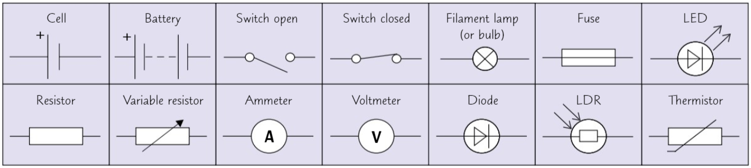
Circuit Symbols (pg 39)

Slide 96
Current, Potential Difference and Resistance (pg 39)
What is electric current?
What are the units of current?
What are the units of charge?
What has to happen to make a charge flow around a circuit?
What is potential difference?
What are the units of potential difference?
What is another name for potential difference?
What is resistance?
What are the units of resistance?
What can be always true about the current in a single loop circuit?
If the current is increased, what happens to the flow of charge
If the resistance of a circuit increases, what happens to the current? (assuming the potential difference stays the same)

Slide 97
Current, Potential Difference and Resistance (pg 39)
What is electric current?
A flow of charge
What are the units of current?
Amps, A
What are the units of charge?
Coulombs, C
What has to happen to make a charge flow around a circuit?
There has to be something providing a potential difference, like a battery
What is potential difference?
The force that pushes the current around a circuit
What are the units of potential difference?
Volts, V

Slide 98
Current, Potential Difference and Resistance (pg 39)
What is another name for potential difference?
voltage
What is resistance?
Anything that slows down the flow of charge
What are the units of resistance?
Ohms, Ω
What can be always true about the current in a single loop circuit?
The current is the same at all points in the circuit
If the current is increased, what happens to the flow of charge
The flow of charge will increase as well
If the resistance of a circuit increases, what happens to the current? (assuming the potential difference stays the same)
A smaller current will flow

Slide 99
Charge Flow, Current and Time (pg 41)
Charge flow = current x time
Q = It
Charge Flow
Q
coulombs
C
Q
Current
I
amps
A
I
t
Time
t
seconds
s

Slide 100
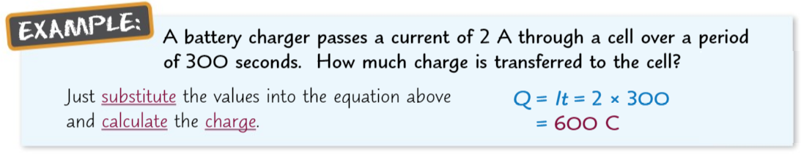
Charge Flow, Current and Time (pg 41)
Common Conversions:
minutes
X 60
seconds
÷ 60
amps
milliamps

Slide 101
Charge Flow, Current and Time (pg 42)
A battery passes a current of 5A through a circuit for 30 seconds. How much charge flows during this time?
What is the charge when a current of 3.2 A flows for 5 minutes?
If a charge of 0.5 C takes 20 seconds to be transferred, what is the current in the circuit?
How long has a circuit been connected for if 60C of charge has been transferred by a current of 2A?
If a charge of 200 C takes 8 minutes seconds to be transferred, what is the current in the circuit?
How long has a circuit been connected for if 3C of charge has been transferred by a current of 5 mA?

Slide 102
Charge Flow, Current and Time (pg 42)
A battery passes a current of 5A through a circuit for 30 seconds. How much charge flows during this time?
Q = It
Q = 5 x 30
Q = 150 C
What is the charge when a current of 3.2 A flows for 5 minutes?
Conversion: 5 minutes = 300 seconds
Q = It
Q = 3.2 x 300
Q = 960 C

Slide 103
Charge Flow, Current and Time (pg 42)
If a charge of 0.5 C takes 20 seconds to be transferred, what is the current in the circuit?
I = Q ÷ t
I = 0.5 ÷ 20
I = 0.025 A
How long has a circuit been connected for if 60C of charge has been transferred by a current of 2A?
t = Q ÷ I
t = 60 ÷ 2
t = 30 s

Slide 104
Charge Flow, Current and Time (pg 42)
If a charge of 200 C takes 8 minutes to be transferred, what is the current in the circuit?
Conversion: 8 minutes = 480 seconds
I = Q ÷ t
I = 200 ÷ 480
I = 0.42 A (2sf)
How long has a circuit been connected for if 3C of charge has been transferred by a current of 5 mA?
Conversion: 5 mA = 0.005 A
t = Q ÷ I
t = 3 ÷ 0.005
t = 600 s (10 minutes)

Slide 105
Potential Difference, Current and Resistance (pg 43)
Potential Difference = Current and Resistance
V = IR
Potential Difference
V
volts
V
V
Current
I
amps
A
I
R
Resistance
R
ohms
𝛀

Slide 106
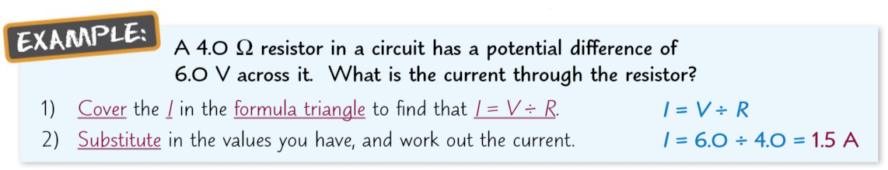
Potential Difference, Current and Resistance (pg 43)
Common Conversions:
kiloohms
ohms
amps
milliamps
megavolts
x 1,000,000
volts
÷ 1,000,000

Slide 107
Potential Difference, Current and Resistance (pg 43)
The current through a 12Ω resistor in an electric circuit is 1.5 A. Calculate the potential difference across the resistor.
The resistance of a thermistor is 34Ω and the current through it is 300 mA. What is the potential difference across the thermistor?
The potential difference across a 50 Ω resistor is 6 V. What is the current through the resistor?
The resistance of an ipod shuffle is 3 kΩ and the current through it is 0.04 A. What is potential difference of its power source?
The potential difference across a woman when she is struck by lightning is 33 MV and the resistance of a human being is around 1 kΩ. What current flows through the woman?

Slide 108
Potential Difference, Current and Resistance (pg 44)
The current through a 12Ω resistor in an electric circuit is 1.5A. Calculate the potential difference across the resistor.
V = IR
V = 1.5 x 12
V = 18 V
The resistance of a thermistor is 34Ω and the current through it is 300 mA. What is the potential difference across the thermistor?
Conversion: 300 mA = 0.3 A
V = IR
V = 0.3 x 34
V = 10.2 V

Slide 109
Potential Difference, Current and Resistance (pg 44)
The potential difference across a 50 Ω resistor is 6 V. What is the current through the resistor?
I = V ÷ R
I = 6 ÷ 50
I = 0.12 A
The resistance of an ipod shuffle is 3 kΩ and the current through it is 0.04 A. What is potential difference of its power source?
Conversion: 3 kΩ = 3000 Ω
V = IR
V = 0.04 x 3000
V = 120 V

Slide 110
Potential Difference, Current and Resistance (pg 44)
The potential difference across a woman when she is struck by lightning is 33 MV and the resistance of a human being is around 1 kΩ. What current flows through the woman?
Conversion: 33 MV = 33 000 000 V
Conversion: 1kΩ = 1000 Ω
I = V ÷ R
I = 33 000 000 ÷ 1000
I = 33 000 A

Slide 111
Ohmic and Non-Ohmic Conductors (pg 45)
The V=IR equations only works with ohmic conductors. What is an ohmic conductor?
Give 2 examples of ohmic conductors?
For an ohmic conductor at a fixed temperature, the current is directly proportional to the potential difference. What does this mean?
What is a non ohmic conductor?
Give 2 examples of non ohmic conductors.
What happens to the resistance of a filament lamp if more current is added?
What is a diode?
How does it work?

Slide 112
Ohmic and Non-Ohmic Conductors (pg 45)
The V=IR equations only works with ohmic conductors. What is an ohmic conductor?
An ohmic conductor has a constant resistance, as long as their temperature does not change
Give 2 examples of ohmic conductors.
Wires and resistors
For an ohmic conductor at a fixed temperature, the current is directly proportional to the potential difference. What does this mean?
This means that if you double the potential difference across the ohmic conductor, the current will also double
What is a non ohmic conductor?
A component which has a changing resistance

Slide 113
Ohmic and Non-Ohmic Conductors (pg 45)
Give 2 examples of non ohmic conductors.
Filament lamp and diode
What happens to the resistance of a filament lamp if more current is added?
The filament will heat up as more current goes through it. This makes the temperature on the filament increase. The increase in temperature makes the resistance greater.
What is a diode?
A component which only lets current flow through it in one direction
How does it work?
It has a very high resistance in the reverse direction which stops the current from flowing.

Slide 114
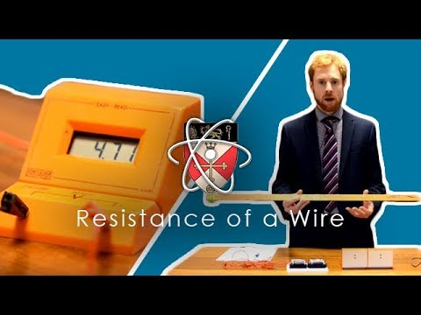
Resistance of a Wire (RP) (pg 46)
Why do we tape down the wire?
What do we use to measure the current and potential difference?
Why do we stop at 30cm?
Why is it important to make sure the wire is taut (kept flat)?
What happens to the resistance as the length of wire gets shorter?
How do we calculate the resistance?
Why do we disconnect the circuit during the experiment?
Notes:
Why do we tape down the wire? – to hold it in place
What do we use to measure the current and potential difference? – ammeter and voltmeter
Why do we stop at 30cm? – the resistance would be too small, the current would get too high and the wire will get too hot – affecting our results.
Why is it important to make sure the wire is taut(kept flat)? – so we can measure the length accurately and not introduce errors
What happems to the resistance as the length of wire gets shorter? – decreases
How do we calculate the resistance? – potential difference / current
Why do we disconnect the circuit during the experiment? – to prevent over heating

Slide 115
Resistance of a Wire (RP) (pg 46)
Why do we tape down the wire?
To hold it in place
What do we use to measure the current and potential difference?
We use an ammeter to measure current, a voltmeter to measure potential difference
Why do we stop at 30cm?
A shorter wire would have a resistance which is small. This means the current would increase and the wire will become very hot. This increase in temperature will affect our results.
Why is it important to make sure the wire is taut (kept flat)?
So we can measure the length accurately and not introduce errors

Slide 116
Resistance of a Wire (RP) (pg 46)
What happens to the resistance as the length of wire gets shorter?
It decreases
How do we calculate the resistance?
Resistance = potential difference ÷ current
Why do we disconnect the circuit during the experiment?
To prevent the wire from overheating

Slide 117
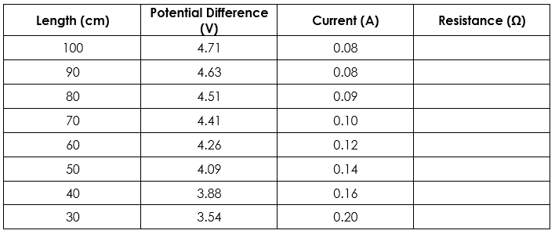
Resistance in a Wire RP (pg 47)
Complete the table below, calculating the resistances to 2 significant figures.
59
58
50
44
36
29
21
18

Slide 118
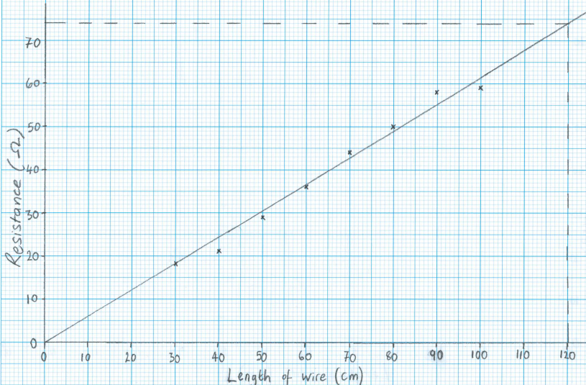
Resistance in a Wire RP (pg 47)

Slide 119
Resistance in a Wire RP (pg 47)
Write a conclusion for the experiment. Include the key word: directly proportional.
The resistance of a wire is directly proportional to its length. This means that if the length of the wire doubles, the resistance of the wire will double as well
How can we tell this from your graph?
The graph is a straight line which passes through the origin
Use the graph to calculate the resistance at a length of 120 cm
74 Ω

Slide 120
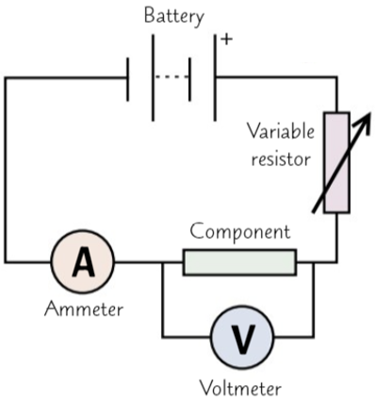
Investigating IV Characteristics (pg 49)
Draw a circuit diagram to show how to investigate I-V characteristics of a component.
Include:
Battery
Variable resistor
Ammeter
Component

Slide 121
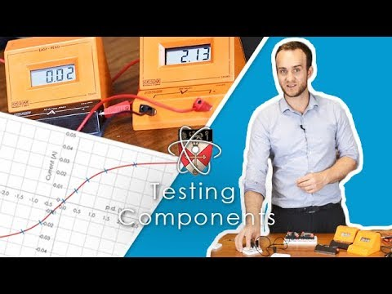
Investigating IV Characteristics (RP) (pg 49)
How do we connect the ammeter?
How do we connect the voltmeter?
What do you have to do to change
the direction of the current?
What goes on the x-axis (across)?
What goes on the y-axis (down)?
For the resistor, what can we conclude about the resistance?
For the lamp, what can we conclude about the graph?
As the current increases, why does the temperature of the wire increase?
For the diode, why do we have a current of 0A at negative potential differences?
Notes:
How do we connect the ammeter? – series
How do we connect the voltmeter? – parallel
What do you have to do to change the direction of the current? – switch the wires around at the power pack
What goes on the x-axis (across)? – potential difference (volts)
What goes on the y-axis (down)? – current (amps)
For the resistor, what can we conclude about the resistance? – constant resistance
For the lamp, what can we conclude about the graph? – curves at the ends of the graph, tells us that resistance is not constant. At the end of the graph, the resistance increases as current increases
As the current increases, why does the temperature of the wire increase? Electrons that are flowing collide with the ions in the metal, as the ions get hotter, they move more. This makes it harder for the electrons to flow.
For the diode, why do we have a current of 0A at negative potential differences? – diode has a high resistance in one direction.

Slide 122
Investigating IV Characteristics (RP) (pg 49)
How do we connect the ammeter?
In series
How do we connect the voltmeter?
In parallel
What do you have to do to change
the direction of the current?
Switch the wires around at the power pack
What goes on the x-axis (across)?
Potential difference (in volts)
What goes on the y-axis (down)?
Current (in amps)
For the resistor, what can we conclude about the resistance?
The resistance of a resistor always stays constant (it is an ohmic conductor)

Slide 123
Investigating IV Characteristics (RP) (pg 49)
For the lamp, what can we conclude about the graph?
It curves at the ends of the graph. This tells us that resistance is not constant. At the end of the graph, the resistance increases as current increases
As the current increases, why does the temperature of the wire increase?
Electrons that are flowing collide with the ions in the metal. When the wire gets hotter, the ions move more. This makes it harder for the electrons to flow so the resistance has increased
For the diode, why do we have a current of 0A at negative potential differences?
The diode has a high resistance in the reverse direction

Slide 124
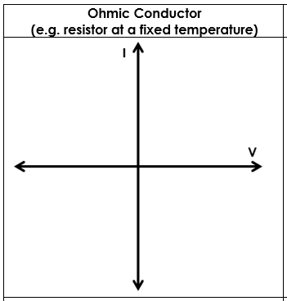
Investigating IV Characteristics (RP) (pg 51)
Ohmic Conductor
Current is _____________ ________________ to potential difference. This means if you double the potential difference, then the _______________ will ____________. The graph will have a _______________ line.
directly
proportional
current
double
straight

Slide 125
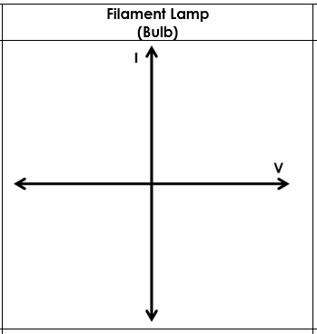
Investigating IV Characteristics (RP) (pg 51)
Filament Lamp
As the current ___________, the temperature of the wire _____________. This means that the resistance will _______________ as well. This makes it more difficult for the ____________ to flow, so the current doesn’t increase as much as it should and the line on the graph ___________________.
increases
increases
increase
current
curves

Slide 126
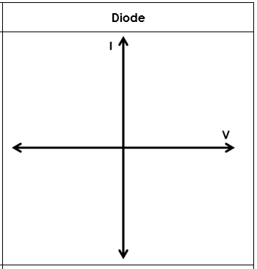
Investigating IV Characteristics (RP) (pg 51)
Diode
The ________________ can only flow in one direction. This is because the diode has a very high ________________ in the __________________ direction.
current
resistance
reverse

Slide 127
LDRs and Thermistors (pg 52)
What does LDR stand for?
What affects the resistance of an LDR?
What happens to the resistance in bright light? What effect does this have on current?
What happens to the resistance in dim light? What effect does this have on current?
Give 3 uses of LDRs.
What affects the resistance of a thermistor?
What happens to the resistance in hot conditions? What effect does this have on current?
What happens to the resistance in cool conditions? What effect does this have on current?
Give 3 uses of thermistors.

Slide 128
LDRs and Thermistors (pg 52)
What does LDR stand for?
Light Dependent Resistance
What affects the resistance of an LDR?
The intensity of the light
What happens to the resistance in bright light? What effect does this have on current?
In bright light, the resistance will decrease, which will make the current increase
What happens to the resistance in dim light? What effect does this have on current?
In dim light, the resistance will increase, which will make the current decrease
Give 3 uses of LDRs.
Automatic night lights, outdoor lighting and burglar detectors

Slide 129
LDRs and Thermistors (pg 52)
What affects the resistance of a thermistor?
The temperature
What happens to the resistance in hot conditions? What effect does this have on current?
In hot conditions, the resistance will decrease so the current will increase
What happens to the resistance in cool conditions? What effect does this have on current?
In cool conditions, the resistance will increase so the current will decrease
Give 2 uses of thermistors.
Car engines and central heating thermostats

Slide 130
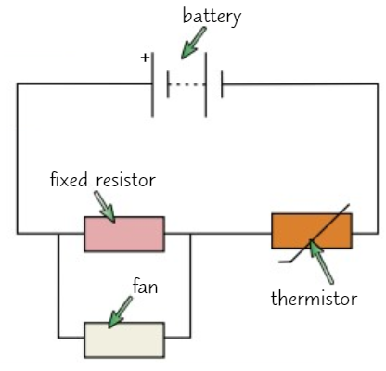
Sensing Circuits (pg 52)
Explain how the circuit is used to make a fan spin faster when the room is hotter.
As the room gets hotter, the __________________ of the thermistor _______________. This means it takes a _____________ share of the potential difference, so the PD across the fixed resistor _________.
The PD of the fixed resistor is ____________ ______ the PD of the fan.
This means the PD of the fan _________________ which means the fan will go _________________.
resistance
decreases
smaller
rises
equal
to
rises too
faster

Slide 131
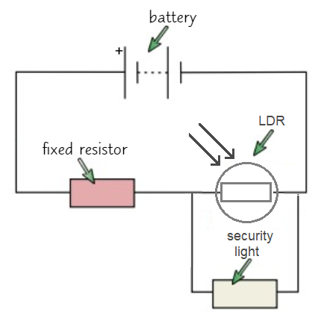
Sensing Circuits (pg 52)
Explain how the circuit is used to make the security light come on when it gets dark.
As it gets darker, the __________________ of the LDR _______________. This means it takes a _____________ share of the potential difference.
The PD of the security light is ____________ ______ the PD of the LDR.
This means the PD of the security light ______________ which means the light will ___________ ______.
resistance
increases
larger
equal
to
increases
switch
on

Slide 132
Series Circuits (pg 53)
How are components in a series circuit connected?
What happens if one component breaks?
What can you say about the current in a series circuit?
What happens to the potential difference in a series circuit?
How do you find the total resistance of 2 resistors in a series circuit?
What happens to the current in a series circuit if more resistors are added?

Slide 133
Series Circuits (pg 53)
How are components in a series circuit connected?
All in a single loop
What happens if one component breaks?
The circuit is broken so all the components stop working
What can you say about the current in a series circuit?
It is the same at all points in the circuit
What happens to the potential difference in a series circuit?
It is divided between components
How do you find the total resistance of 2 resistors in a series circuit?
Add them together
What happens to the current in a series circuit if more resistors are added?
The current will decrease

Slide 134
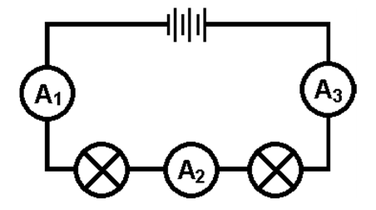
Series Circuits - Current (pg 54)
If the reading on ammeter A₁ is 6A, what will the reading be on A₂ and A₃?
A₃ - 6A
A₃ = 6A
(same all the way round the circuit)
If the reading on ammeter A₁ is 0.5A, what will the reading be on A₂ and A₃?
A₃ - 6A
A₃ = 6A
(same all the way round the circuit)

Slide 135
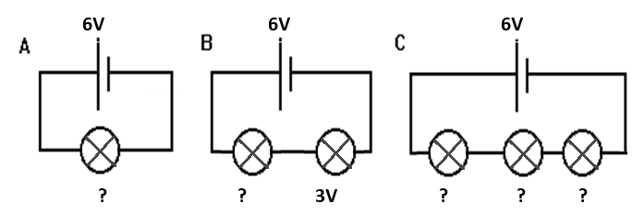
Series Circuits - Potential Difference (pg 55)
Assuming each bulb is the same, what will the potential difference across each bulb be?
A: _______________________________
B: _______________________________
C: _______________________________
6 V
3 V across each bulb
2 V across each bulb

Slide 136
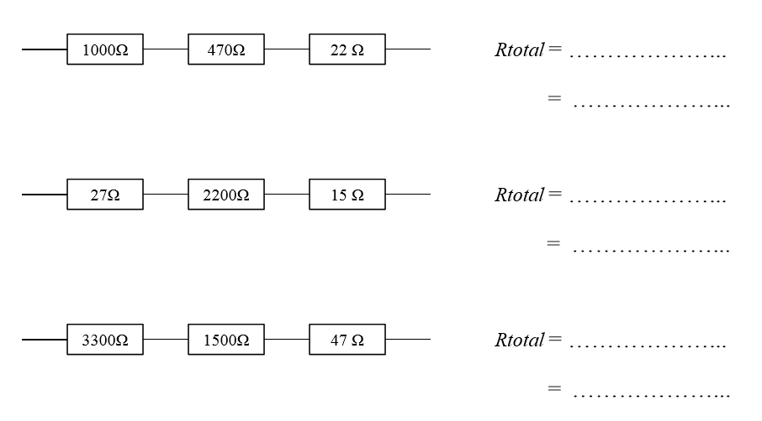
Series Circuits - Resistance (pg 55)
Calculate the total resistance in each circuit
1000 + 470 + 22
Answers
1492 Ω
27 + 2200 + 15
2042 Ω
3300 + 1500 + 47
4847 Ω

Slide 137
Parallel Circuits (pg 56)
How are circuits connected in parallel?
What can be said about potential difference in each branch of a parallel circuit?
What happens to the current as it reaches a junction in a parallel circuit?
What happens to the current when the loops of the circuit re-join?
Explain why adding more resistors into a parallel circuit decreases the overall resistance.

Slide 138
Parallel Circuits (pg 56)
How are circuits connected in parallel?
In more than one loop
What can be said about potential difference in each branch of a parallel circuit?
The potential difference is the same in each branch of a parallel circuit
What happens to the current as it reaches a junction in a parallel circuit?
It splits
What happens to the current when the loops of the circuit re-join?
The current joins back up again
Explain why adding more resistors into a parallel circuit decreases the overall resistance.
There are more branches of the circuit so there are more routes that the current can take so the resistance decreases

Slide 139
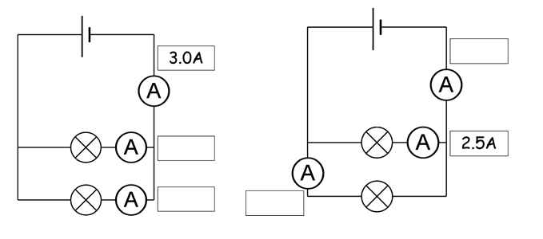
Parallel Circuits - Current (pg 56)
Complete the missing current values on the diagrams. Assume the bulbs are identical.
5.0 A
1.5 A
1.5 A
2.5 A

Slide 140
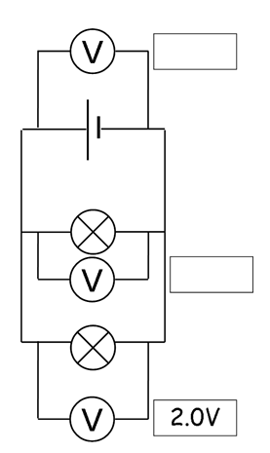
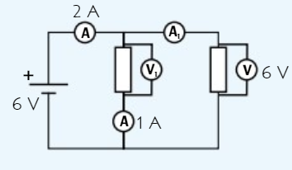
Parallel Circuits - Potential Difference (pg 57)
Complete the missing potential difference values on the diagrams.
2 V
2 V
V₁ = ____
6 V

Slide 141
Rules of Circuits Summary (pg 58)
Resistors in series add up
Resistors in parallel have a lower resistance
Voltage is shared in series
Voltage is not shared in parallel. It is the same in each loop
Current is the same everywhere in series
Current splits between loops in parallel, then joins up again

Slide 142
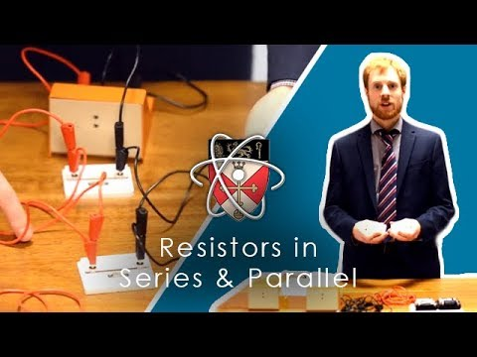
Resistors in Series and Parallel (RP) (pg 58)
What is the purpose of the
experiment?
How many loops are there in a
series circuit?
How do we connect the
voltmeter in the circuit?
How do we calculate the resistance?
How do we calculate the total resistance in a series circuit?
How many loops are there in a parallel circuit?
If you have 2 identical resistors in parallel, what happens to the total resistance?
Notes:
1. What is the purpose of the experiment? – How series and parallel circuits compare with each other
2. How many loops are there in a series circuit? – 1
3. How do we connect the voltmeter in the circuit? – parallel
4. How do we calculate the resistance? – potential difference / current
5. How do we calculate the total resistance in a series circuit? – add up the resistance of each component
6. How many loops are there in a parallel circuit? – at least 2
7. If you have 2 identical resistors in parallel, what happens to the total resistance? – it halves
8.

Slide 143
Resistors in Series and Parallel (RP) (pg 58)
What is the purpose of the experiment?
How series and parallel circuits compare with each other
How many loops are there in a series circuit?
one
How do we connect the voltmeter in the circuit?
In parallel
How do we calculate the resistance?
resistance = potential difference ÷ current
How do we calculate the total resistance in a series circuit?
add up the resistance of each component
How many loops are there in a parallel circuit?
At least 2
If you have 2 identical resistors in parallel, what happens to the total resistance?
It will halve
Notes:
1
6. How many loops are there in a parallel circuit? – at least 2
7. If you have 2 identical resistors in parallel, what happens to the total resistance? – it halves
8.

Slide 144
P2: Circuit electricity
Complete the exam questions on pages 24-33 of the exam question booklet

Slide 145
Electricity in the Home (pg 59)
What is an alternating current?
What is a direct current?
What is the potential difference of the UK mains electricity supply?
What is the frequency of the UK mains electricity supply?
What type of current does the UK mains supply?
Name something which provides a direct current.
How are most appliances connected to the mains?
Why are the wires covered in plastic?
Why are all the wires different colours?

Slide 146
Electricity in the Home (pg 59)
What is an alternating current?
A current which is constantly changing direction
What is a direct current?
A current which flows in the same direction
What is the potential difference of the UK mains electricity supply?
230 V
What is the frequency of the UK mains electricity supply?
50 Hz
What type of current does the UK mains supply?
Alternating current

Slide 147
Electricity in the Home (pg 59)
Name something which provides a direct current.
A cell or a battery
How are most appliances connected to the mains?
Three-core cables in plugs
Why are the wires covered in plastic?
To insulate them and prevent an electric shock
Why are all the wires different colours?
So you can tell the difference between each different wire

Slide 148
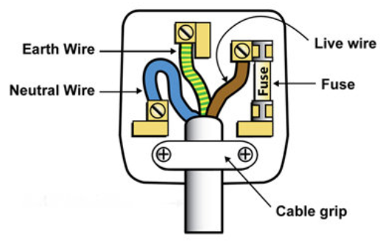
Wires in a Plug (pg 60)
Label the plug and under each wire label, state the colour of that wire.

Slide 149
Electricity in the Home (pg 60)
What colour is the live wire?
What is the purpose of the live wire?
What is the potential difference of the live wire?
What colour is the neutral wire?
What is the purpose of the neutral wire?
What is the potential difference of the neutral wire?
What colour is the earth wire?
What is the purpose of the earth wire?
What is the potential difference of the earth wire?

Slide 150
Electricity in the Home (pg 60)
What colour is the live wire?
brown
What is the purpose of the live wire?
Provides the alternating potential difference from the mains supply. This is where the current flows into the appliance
What is the potential difference of the live wire?
230V
What colour is the neutral wire?
blue
What is the purpose of the neutral wire?
It completes the circuit

Slide 151
Electricity in the Home (pg 60)
What is the potential difference of the neutral wire?
0 V
What colour is the earth wire?
Green and yellow stripes
What is the purpose of the earth wire?
A safety wire which stops the appliance becoming live as the current can flow away towards the ground, down the earth wire.
What is the potential difference of the earth wire?
0V

Slide 152
Live and Earth Wires (pg 61)
If you touch the live wire (which is at _______V), then a ___________ will flow through your body (which is at _____ V).
This can give you an ___________ ____________, even if the switch is turned off. It can also cause a __________.
The earth wire is a safety feature because it takes the current to the _____________, instead of going through the ___________.
230
current
0
electric
shock
fire
ground
body

Slide 153

Electrical Energy Transfer (pg 62)
Complete the energy transfer diagram for the kettle
electrical
thermal
When a ___________ moves round a circuit, it does ________ against the ________________of the circuit. This means that appliances (such as kettles) transfer _______________ when a current flows.
A kettle transfers energy from the _______________ pathway to the _______________ energy store of the heater in the kettle.
charge
work
resistance
energy
electrical
thermal

Slide 154

Electrical Energy Transfer (pg 62)
Complete the energy transfer diagram for the fan
chemical
kinetic
When a ___________ moves round a circuit, it does ________ against the ________________of the circuit. This means that appliances (such as battery operated fans) transfer _______________ when a current flows.
A fan transfers energy from the _______________ energy store of the battery to the _______________ energy store of the motor in the fan.
charge
work
resistance
energy
chemical
kinetic

Slide 155
Energy, Charge Flow and Potential Difference (pg 63)
Energy Transferred = charge flow x potential difference
E = QV
Energy
E
joules
J
E
Charge flow
Q
coulombs
C
Q
V
Potential difference
V
volts
V

Slide 156

Energy, Charge Flow and Potential Difference (pg 63)
Common Conversions:
kilovolts
volts
megajoules
x 1,000,000
joules
÷ 1,000,000

Slide 157
Energy, Charge Flow and Potential Difference (pg 64)
A charge of 3C passes a point in a circuit with a 1.5V cell. How much energy is transferred?
A charge of 15C passes a point in a circuit connected to the UK mains supply. How much energy is transferred?
Calculate the charge passing a point in a circuit with a potential difference of 12V when 80 J of energy is transferred
Calculate the energy transferred in a circuit with a potential difference of 200V when 10000 C of charge flows.
Calculate the charge passing a point in a circuit with a potential difference of 0.5 kV when 3 MJ of energy is transferred

Slide 158
Energy, Charge Flow and Potential Difference (pg 64)
A charge of 3C passes a point in a circuit with a 1.5V cell. How much energy is transferred?
E = QV
E = 3 x 1.5
E = 4.5 J
A charge of 15C passes a point in a circuit connected to the UK mains supply. How much energy is transferred?
UK mains supply = 230V
E = QV
E = 15 x 230
E = 3450 J

Slide 159
Energy, Charge Flow and Potential Difference (pg 64)
Calculate the charge passing a point in a circuit with a potential difference of 12V when 80 J of energy is transferred
Q = E ÷ V
Q = 80 ÷ 12
Q = 6.7 C (2sf)
Calculate the energy transferred in a circuit with a potential difference of 200V when 10000 C of charge flows.
E = QV
E = 10000 x 200
E = 2000000 J (or 2 MJ)

Slide 160
Energy, Charge Flow and Potential Difference (pg 64)
Calculate the charge passing a point in a circuit with a potential difference of 0.5 kV when 3 MJ of energy is transferred
Conversion: 0.5 kV = 500 V
Conversion: 3 MJ = 3000000 J
V = E ÷ Q
V = 3000000 ÷ 500
V= 6000 V

Slide 161
Power, Current and Potential Difference (pg 65)
Power = current x potential difference
P = IV
Power
P
watts
W
P
Current
I
amps
A
I
V
Potential Difference
V
volts
V

Slide 162

Power, Current and Potential Difference (pg 65)
Common Conversions:
amps
milliamps
kilowatts
watts

Slide 163
Power, Current and Potential Difference (pg 66)
A current of 0.5A flows through a bulb with a potential difference of 6V what is the power rating of the bulb?
A current of 250 mA flows in a circuit containing a 1.5V cell. What is the power of the circuit?
A microwave has a power rating of 800W. When plugged into the UK mains supply, what current flows? [HINT: you will need to remember the PD of the UK mains supply)
What current flows through a 2W bulb connected to a 12V battery?
A kettle has a power rating of 1.8 kW. When plugged into the UK mains supply, what current flows?

Slide 164
Power, Current and Potential Difference (pg 66)
A current of 0.5A flows through a bulb with a potential difference of 6V what is the power rating of the bulb?
P = I x V
P = 0.5 x 6
P = 3 W
A current of 250 mA flows in a circuit containing a 1.5V cell. What is the power of the circuit?
Conversion: 250 mA = 0.250 A
P = I x V
P = 0.250 x 1.5
P = 0.375 W

Slide 165
Power, Current and Potential Difference (pg 66)
A microwave has a power rating of 800W. When plugged into the UK mains supply, what current flows? [HINT: you will need to remember the PD of the UK mains supply]
I = P ÷ V
I = 800 ÷ 230
I = 3.5 A (2sf)
What current flows through a 2W bulb connected to a 12V battery?
I = P ÷ V
I = 2 ÷ 12
I = 0.17 A (2sf)

Slide 166
Power, Current and Potential Difference (pg 66)
A kettle has a power rating of 1.8 kW. When plugged into the UK mains supply, what current flows?
UK mains supply = 230 V
Conversion: 1.8 kW = 1800 W
I = P ÷ V
I = 1800 ÷ 230
I = 7.8 A (2sf)

Slide 167
Power, Current and Resistance (pg 67)
Power = current² x resistance
P = I²R
Power
P
watts
W
P
Current
I
amperes
A
I²
R
Resistance
R
ohms
𝛀

Slide 168

Power, Current and Resistance (pg 67)
Common Conversions:
kilowatts
watts
amps
milliamps

Slide 169
Power, Current and Resistance (pg 68)
A bulb with a resistance of 12 Ω is connected to a circuit with a current of 2 A. Calculate the power of the bulb.
A current of 340 mA flows through a mobile phone circuit with a resistance of 10 Ω. Calculate the power of the appliance.
Calculate the resistance of a circuit component with a 40W power rating when a current of 3A flows
Calculate the current flowing through a 800W appliance with a resistance of 200Ω.
Calculate the current flowing through a 1.6kW appliance with a resistance of 0.4 kΩ.

Slide 170
Power, Current and Resistance (pg 68)
A bulb with a resistance of 12 Ω is connected to a circuit with a current of 2 A. Calculate the power of the bulb.
P = I² x R
P = 2² x 12
P = 48 W
A current of 340 mA flows through a mobile phone circuit with a resistance of 10 Ω. Calculate the power of the appliance.
Conversion: 340 mA = 0.340 A
P = I² x R
P = 0.340² x 10
P = 1.2 W (2sf)

Slide 171
Power, Current and Resistance (pg 68)
Calculate the resistance of a circuit component with a 40W power rating when a current of 3A flows
R = P ÷ I²
R = 40 ÷ 3²
R = 4.4 Ω
Calculate the current flowing through a 800W appliance with a resistance of 200Ω.
I² = P ÷ R
I² = 800 ÷ 200
I² = 4
I = √4
I = 2A

Slide 172
Power, Current and Resistance (pg 68)
Calculate the current flowing through a 1.6kW appliance with a resistance of 0.4 kΩ.
Conversion: 1.6 kW = 1600 W
Conversion: 0.4 kΩ = 400 Ω
I² = P ÷ R
I² = 1600 ÷ 400
I² = 4
I = √4
I = 2 A

Slide 173
National Grid (pg 69)
What is the National Grid?
Suggest when peak energy demand occurs in a day.
Why can’t power stations operate at maximum capacity?
Why is it a bad idea to transmit electricity with a high current?
How does increasing the potential difference of the electricity make the National Grid more efficient?
What is used to make changes to the potential difference of the electricity supply?

Slide 174
National Grid (pg 69)
What is the National Grid?
The system of cables and transformers which transmits electricity across the UK
Suggest when peak energy demand occurs in a day.
When people get up in the morning or arrive home after school or work
Why can’t power stations operate at maximum capacity?
They need to be able to increase their power if needed, to cope with the extra demand for electricity at peak times.

Slide 175
National Grid (pg 69)
Why is it a bad idea to transmit electricity with a high current?
Current has a heating effect on the wires so more energy is dissipated to the thermal store of the surroundings. This is a waste of energy
How does increasing the potential difference of the electricity make the National Grid more efficient?
Electricity transmitted at a high potential difference will have a lower current which means that less heating will happen and less energy is wasted. This is more efficient.
What is used to make changes to the potential difference of the electricity supply?
Transformers. Step up increases potential difference, step down decreases potential difference

Slide 176

National Grid (pg 70)
Label each stage of the National Grid.
power station
factories
homes
Answers
pylons
Step up transformer
Step down transformer

Slide 177
National Grid (pg 70)
When electricity leaves the power station, the potential difference needs to be ______________. This is to lower the __________because current has a ___________ effect which means energy would be _____________ by heating the cables.
To increase the potential difference, we use a _________ _________ ______________________.
When the electricity reaches our homes, the potential difference needs to be ____________to a _______ level.
To decrease the potential difference, we use a _________ _________ ______________________.
increased
current
heating
wasted
step
up
transformer
reduced
safe
step
down
transformer

Slide 178
P2: Domestic electricity supply and safety
Complete the exam questions on pages 34-45 of the exam question booklet

Slide 179
Topic 3: The Particle Model
Topic | Slide number | Booklet page number | Revision guide page
The particle model and particle motion | 180-183 | 71-72 | 193
Density (RP) | 184-195 | 73-76 | 194
Internal energy and temperature changes | 196-198 | 77-78 | 195
State changes and latent heat | 199-213 | 79-84 | 195-196

Slide 180




States of Matter (pg 71)
Strong bonds between particles hold them tightly together, so the shape of the substance cannot change
There is no space between the particles so the particles cannot move closer together
There is no space between the particles so the particles cannot move closer together
The bonds between particles are weaker, so the particles can move past each other and the shape of the substance can change
There is no space between the particles so the particles cannot move closer together
There are no bonds between particles so the particles can move in any random direction at different speeds
There is space between the particles so they can be moved closer together

Slide 181

Gas Pressure (pg 72)
How do particles in gas cause pressure?
What does the temperature of a gas depend on?
As you heat a gas up, what happens to the average kinetic energy of the particles?
Describe the movement of particles in hotter gases
Why do hotter gases cause more pressure?
Explain the highlighted section of the deodorant can warning label.

Slide 182
Gas Pressure (pg 72)
How do particles in gas cause pressure?
When they collide with the sides of the container, they put a force on the container which is gas pressure
What does the temperature of a gas depend on?
The average energy in the kinetic stores of the particles
As you heat a gas up, what happens to the average kinetic energy of the particles?
It increases
Describe the movement of particles in hotter gases
Particles, on average, move faster

Slide 183
Gas Pressure (pg 72)
Why do hotter gases cause more pressure?
They will hit the sides of the container harder and more often. This puts more force on the container
Explain the highlighted section of the deodorant can warning label.
The can is under pressure. If any remaining particles of gas are exposed to high temperatures, they will have more energy, move faster and hit the walls of the container more often, which could cause the can to explode.

Slide 184
Density (pg 73)
What does density measure?
What does the density of an object depend on?
Describe the arrangement of particles in a dense solid like copper
List the different states of matter in order of decreasing density

Slide 185
Density (pg 73)
What does density measure?
The amount of mass in a certain volume
What does the density of an object depend on?
What the object is made of and how its particles are arranged
Describe the arrangement of particles in a dense solid like copper
Particles are packed closely together
List the different states of matter in order of decreasing density
Solid, liquid, gas

Slide 186
Density (pg 74)
density = mass ÷ volume
𝞺 = m ÷ V
density
𝞺
grams per centimetre cubed
g/cm³
density
𝞺
kilograms per metre cubed
kg/m³
m
mass
m
grams/ kilograms
g or kg
𝞺
V
volume
V
Centimetres cubed/ metres cubed
cm³ or m³

Slide 187


Density (pg 74)
Common Conversions:
kilograms
grams
m³
cm³

Slide 188
Density (pg 75)
A student measures the mass of an 8cm³ block of brown sugar to be 32g. What is the density of the brown sugar?
A chef fills 50 cm³ container with 250 g of cooking oil. What is the density of the oil?
A piece of cork has a mass of 24g and a density of 6g/cm³. What is the volume of the piece of cork?
A box has a volume of 55 cm³ and a density of 5g/cm³. What is the mass of the box?
An ice block measuring 5cm by 5 cm by 5cm has a density of 5g/cm³. What is the mass of the ice block?
A wooden cylinder has a density of 4 g/cm³ and a mass of 0.048kg. What is the volume of the wooden cylinder?

Slide 189
Density (pg 75)
A student measures the mass of an 8cm³ block of brown sugar to be 32g. What is the density of the brown sugar?
𝞺 = m ÷ V
𝞺 = 32 ÷ 8
𝞺 = 4 g/cm³
A chef fills 50 cm³ container with 250 g of cooking oil. What is the density of the oil?
𝞺 = m ÷ V
𝞺 = 250 ÷50
𝞺 = 5 g/cm³

Slide 190
Density (pg 75)
A piece of cork has a mass of 24g and a density of 6g/cm³. What is the volume of the piece of cork?
V = m ÷ 𝞺
V = 24 ÷ 6
V = 4 cm³
A box has a volume of 55 cm³ and a density of 5g/cm³. What is the mass of the box?
m = 𝞺 x V
m = 55 x 5
m = 275 g

Slide 191
Density (pg 75)
An ice block measuring 5cm by 5 cm by 5cm has a density of 5g/cm³. What is the mass of the ice block?
Volume of block = 5 x 5 x 5 = 125 cm³
m = 𝞺 x V
m = 5 x 125
m = 625 g
A wooden cylinder has a density of 4 g/cm³ and a mass of 0.048kg. What is the volume of the wooden cylinder?
Conversion: 0.048 kg = 48g
V = m ÷ 𝞺
V = 48 ÷ 4
V = 12 cm³

Slide 192

Density (RP) (pg 76)
What are regular objects?
What is density?
How do we calculate density?
What is the unit of mass?
What is the unit of volume?
What is the unit of density?
Why do we “tare” or “zero” the scales before finding the mass?
How do we find the volume of a regular object?
How can we find the volume of an irregular object?
Why do slowly drop the object into the water? Why do we “zero” the scale after putting the measuring cylinder on?
Notes:
What are regular objects? – measure the dimensions and calculate volume
What is density? – how heavy the object is
How do we calculate density? – mass/volume
What is the unit of mass – grams or kg
What is the unit of volume – cm³ or m³
What is the unit of density – g/cm³
Why do we “tare” or “zero” the scales before finding the mass? – so to get an accurate mass reading
How do we find the volume of an object? – length x width x height
How can we find the volume of an irregular object? – use a eureka can, the amount of water displaced tells us the volume of the object
Why do slowly drop the object into the water? – to prevent splashes so not to displace too much water
Why do we “zero” the scale after putting the measuring cylinder on? – to only find the mass of the water not the measuring cylinder.
How do we convert cm³ to dm³? – x 1000

Slide 193
Density (RP) (pg 76)
What are regular objects?
Objects where you can measure the dimensions to calculate the volume (eg a cuboid)
What is density?
The amount of mass in a certain volume
How do we calculate density?
density = mass ÷ volume
What is the unit of mass?
g or kg
What is the unit of volume?
cm³ or m³
What is the unit of density?
g/cm³ or kg/m³

Slide 194
Density (RP) (pg 76)
Why do we “tare” or “zero” the scales before finding the mass?
So to get an accurate mass reading
How do we find the volume of an object?
length x width x height
How can we find the volume of an irregular object?
Use a eureka can (also called a displacement can) and fill with water up to the spout. Put the object in. The amount of water displaced tells us the volume of the object
Why do slowly drop the object into the water?
To prevent splashes so not to displace any extra water
Why do we “zero” the scale after putting the measuring cylinder on?
To only find the mass of the water not the measuring cylinder

Slide 195
P3: Particle Model and Density
Complete the exam questions on pages 46-53 of the exam question booklet

Slide 196
Internal Energy (pg 77)
How is energy stored in a system?
Name the 2 stores where energy is found in particles.
What is the definition of internal energy?
Why does heating an object increase its internal energy?
What 2 things can happen when you increase the internal energy of an object?
The size of the change in temperature depends on 3 things. What are they?
Which equation do we use to find the change in temperature?
When does a change of state happen?
Why do we say a change of state is a physical change?
Why is the mass of a substance the same before and after a change of state?

Slide 197
Internal Energy (pg 77)
How is energy stored in a system?
Energy is stored in a system by its particles
Name the 2 stores where energy is found in particles.
Kinetic energy stores and potential energy stores
What is the definition of internal energy?
Internal energy of a system is the total energy that all its particles have in their kinetic and potential energy stores.
Why does heating an object increase its internal energy?
Heating an object transfers energy to its particles. This increases the system’s internal energy.
What 2 things can happen when you increase the internal energy of an object?
Change in temperature or a change of state
The size of the change in temperature depends on 3 things. What are they?
Mass of the system, the specific heat capacity and how much energy is transferred to it.

Slide 198
Internal Energy (pg 77)
Which equation do we use to find the change in temperature?
𝚫𝛉 = E
m c
When does a change of state happen?
Happens when the particles have enough energy in their kinetic energy store to break the bonds holding them together
Why do we say a change of state is a physical change?
You don’t end up with a new material, the particles are just arranged in a different way.
Why is the mass of a substance the same before and after a change of state?
Mass is conserved, no particles are added or taken away.

Slide 199

Changes of State (pg 79)
Complete the diagram with the names of each change of state.

Slide 200
Changes of State (pg 79)
When energy is transferred to a material, the material will either _______________ in temperature or will change ________________.
During a change of state, the ___________________ of the material does not change. This is because the _____________ is being used to ____________ the bonds between the particles, not to raise the temperature. Once the change of state is finished, the temperature will _______________ again.
During ________________, energy is transferred away from a material. When a material ________________ or freezes, energy is released as ______________ form, but the __________________ does not change.
increase
state
temperature
energy
break
increase
cooling
condenses
bonds
temperature

Slide 201

Heating Graphs (pg 80)
Describe what is happening at each stage of the graph. What state is the water in? Is it getting hotter? Is a change of state happening? If so, which one? Is anything happening to the bonds between particles?

Slide 202

Heating Graphs (pg 80)
The material is in a solid state
Energy is being used to heat up the material so the temperature increases
The material is melting from solid to liquid
Energy is being used to break the bonds between the particles so the temperature stays the same
The material is in a liquid state
Energy is being used to heat up the material so the temperature increases
The material is boiling from a liquid to a gas
Energy is being used to break the bonds between the particles so the temperature stays the same
The material is a gas
Energy is being used to heat up the material so the temperature increases

Slide 203

Cooling Graphs (pg 81)
Describe what is happening at each stage of the graph. What state is the water in? Is it getting colder? Is a change of state happening? If so, which one? Is anything happening to the bonds between particles?

Slide 204
Cooling Graphs (pg 81)
The material is a gas
Energy is being transferred away from the material so the temperature decreases
The material is condensing from a gas to a liquid
Bonds between particles are being made which releases energy so the temperature stays the same.
The material is a liquid
Energy is being transferred away from the material so the temperature decreases
The material is freezing from a liquid to a solid
Bonds between particles are being made which releases energy so the temperature stays the same.
The material is a solid
Energy is being transferred away from the material so the temperature decreases

Slide 205
State Changes (pg 82)
What is the name for the energy transferred during a change of state?
During heating, is energy gained or released?
During cooling, is energy gained or released?
What is the definition of specific latent heat?
What is the name for the specific latent heat for changing between a solid and a liquid?
What is the name for the specific latent heat for changing between a liquid and a gas?

Slide 206
State Changes (pg 82)
What is the name for the energy transferred during a change of state?
Latent heat
During heating, is energy gained or released?
Gained
During cooling, is energy gained or released?
Released
What is the definition of specific latent heat?
The amount of energy needed to change the state of 1 kg of a material, without changing its temperature
What is the name for the specific latent heat for changing between a solid and a liquid?
Specific latent heat of fusion
What is the name for the specific latent heat for changing between a liquid and a gas?
Specific latent heat of vaporisation

Slide 207
Calculations during state changes (pg 83)
Energy = mass x specific latent heat
E = m x L
Energy
E
joules
J
E
mass
m
kilograms
kg
m
L
Specific latent heat
L
joules per kilogram
J/kg

Slide 208

Calculations during state changes (pg 83)
Common Conversions:
kilograms
grams
kilojoules
joules

Slide 209
Specific Latent Heat Calculations (pg 84)
How much energy is needed to melt 6kg of lead? Lead has a specific latent heat of fusion of 22400 J/kg
How much energy is needed to boil 750g of water? Water has a specific latent heat of vaporisation of 2260000 J/kg
When 5g of oxygen condenses, 213000 J of energy is released. What is the specific latent heat of vaporisation of oxygen?
The specific latent heat of fusion of water is 334000J/kg. How much energy is needed to melt 3kg of ice
The specific latent heat of fusion of copper is 205000 J/kg. How much energy is needed to melt 20g of copper

Slide 210
Specific Latent Heat Calculations (pg 84)
How much energy is needed to melt 6 kg of lead? Lead has a specific latent heat of fusion of 22400 J/kg
E = mL
E = 6 x 22 400
E = 134 400 J
How much energy is needed to boil 750 g of water? Water has a specific latent heat of vaporisation of 2260000 J/kg
Conversion: 750g = 0.75 kg
E = mL
E = 0.75 x 2260000
E = 1 695 000 J

Slide 211
Specific Latent Heat Calculations (pg 84)
When 5 g of oxygen condenses, 213000 J of energy is released. What is the specific latent heat of vaporisation of oxygen?
Conversion: 5 g = 0.005 kg
L = E ÷ m
L = 213000 ÷ 0.005
L = 42 600 000 J/kg
The specific latent heat of fusion of water is 334000 J/kg. How much energy is needed to melt 3 kg of ice
E = mL
E = 3 x 334000
E = 1 002 000 J

Slide 212
Specific Latent Heat Calculations (pg 84)
The specific latent heat of fusion of copper is 205000 J/kg. How much energy is needed to melt 20 g of copper
Conversion: 20 g = 0.02 kg
E = mL
E = 0.02 x 205000
E = 4 100 J

Slide 213
P3: State changes and latent heat
Complete the exam questions on pages 54-63 of the exam question booklet

Slide 214
Topic 4: Atomic Structure
Topic | Slide number | Booklet page number | Revision guide page
Atoms and Isotopes | 215-227 | 85-89 | 104, 197-198
Nuclear radiation | 228-230 | 90 | 198
Decay equations and half life | 231-247 | 91-96 | 199-200
Contamination and irradiation | 248-252 | 97-98 | 201

Slide 215

History of the atom (page 85)
Match up the model with the scientist responsible for its discovery
John Dalton
Thought atoms were solid spheres
Discovered electrons.
Came up with the plum pudding model - thought atoms were balls of positive charge with negative electrons scattered throughout the ball
JJ Thomson

Slide 216

History of the atom (page 85)
Match up the model with the scientist responsible for its discovery
Did the alpha particle scattering experiment. Discovered that most mass was at the centre of an atom (the nucleus)
Ernest Rutherford
Niels Bohr
Discovered that electrons orbited in shells at fixed distances from the nucleus

Slide 217

History of the atom (page 85)
Match up the model with the scientist responsible for its discovery
James Chadwick
Discovered neutrons

Slide 218

The Plum Pudding Model (page 86)
Label the diagram of the Plum Pudding Model
Describe the plum pudding model in words.

Slide 219

The Plum Pudding Model (page 86)
Label the diagram of the Plum Pudding Model
Describe the plum pudding model in words.
The plum pudding model says that an atom is a ball of positive charge with electrons scattered throughout the ball.

Slide 220

Alpha Particle Scattering (page 86)
In this experiment, ___________ particles were passed through thin gold foil. Most passed straight through, some _________ back and some were _______________.
This showed that most of the atom was _______ ____________ but there must be something making some of the particles reflect back. This was the _____________.
The nucleus was also deflecting some particles, making their paths __________.
alpha
reflected
deflected
empty space
nucleus
bend
This experiment showed that the _______ _____________ model was wrong as this model could not explain why some particles reflected back.
plum pudding

Slide 221
Models of the Atom (pg 87)
What is the name of the current model of the atom which we use?
What is the radius of an atom?
Where is most of the mass of an atom found?
What subatomic particles are found in the nucleus?
Explain why a nucleus is positively charged.
What are energy levels?
Explain why atoms have no overall charge

Slide 222
Models of the Atom (pg 87)
What is the name of the current model of the atom which we use?
The nuclear model
What is the radius of an atom?
1 x 10⁻¹⁰ m
Where is most of the mass of an atom found?
In the nucleus
What subatomic particles are found in the nucleus?
Protons and neutrons
Explain why a nucleus is positively charged.
Protons are positively charged and neutrons are neutral
What are energy levels?
Shells where the electrons are found orbiting the nucleus
Explain why atoms have no overall charge
They have the same number of protons (positively charged) and electrons (negatively charged)

Slide 223

Energy Levels (pg 88)
If an electron is in an energy level which is further from the nucleus, it will have __________ energy.
Electrons can move up to higher energy levels by ____________________ electromagnetic radiation.
Electrons can move to lower energy levels by ____________________ electromagnetic radiation.
If an electron in the outer shell of an atom absorbs radiation, it can _______________ the atom and the atom will become an ______________.
more
absorbing
releasing
leave
ion

Slide 224

Isotopes (pg 88)
What is an isotope?
What does the atomic number of an atom tell you?
What does the mass number of an atom tell you?
What is the definition of an element?
Compare these two isotopes of carbon:
What can happen if an isotope is unstable?
What is this process called?
There are 4 types of nuclear radiation. Name them.

Slide 225
Isotopes (pg 88)
What is an isotope?
An atom of the same element with the same number of protons and a different number of neutrons
What does the atomic number of an atom tell you?
The number of protons in the atom
What does the mass number of an atom tell you?
The number of protons and neutrons in an atom
What is the definition of an element?
A substance containing only 1 type of atom
Compare these two isotopes of carbon:
They have the same number of protons (six) but different numbers of neutrons. Carbon-13 has 7 neutrons and Carbon-14 has 8 neutrons

Slide 226
Isotopes (pg 88)
What can happen if an isotope is unstable?
It can give out radiation from its nucleus to make it more stable
What is this process called?
Nuclear radiation
There are 4 types of nuclear radiation. Name them.
Alpha particles
Beta particles
Gamma rays
Neutrons

Slide 227
P4: Atoms and Isotopes
Complete the exam questions on pages 64-67 of the exam question booklet

Slide 228
Nuclear radiation (pg 90)
What is ionising radiation?
Radiation that can knock electrons off atoms and turn them into ions
Write the symbol for the 3 types of ionising radiation.
Alpha - 𝝰
Beta - 𝞫
Gamma - γ
What does ionising power mean?
How easily electrons can be knocked off atoms.

Slide 229

Nuclear radiation (pg 90)
2 protons and 2 neutrons
strong
A few centimetres
A sheet of paper
Fast moving electron from the nucleus
moderate
A few metres
A sheet of aluminium
Waves of electromagnetic radiation from the nucleus
weak
A long distance
Thick sheets of lead or metres of concrete

Slide 230
P4: Nuclear radiation
Complete the exam questions on pages 68-71 of the exam question booklet

Slide 231
Alpha Radiation (α) (pg 91)
What is Alpha decay?
What is an Alpha particle?
Why is it true to say that an alpha particle is the same as a helium nucleus?
What happens to the atomic number of a nucleus when it emits an alpha particle?
What happens to the mass number of a nucleus when it emits an alpha particle?
How can we write the alpha particle in a nuclear equation?

Slide 232

Alpha Radiation (α) (pg 91)
What is Alpha decay?
When an alpha particle is emitted from a radioactive nucleus
What is an Alpha particle?
2 protons and 2 neutrons
Why is it true to say that an alpha particle is the same as a helium nucleus?
A helium nucleus is also made of 2 protons and 2 neutrons
What happens to the atomic number of a nucleus when it emits an alpha particle?
It decreases by 2 (as 2 protons have gone)
What happens to the mass number of a nucleus when it emits an alpha particle?
It decreases by 4 (as 4 particles with mass have gone - 2 protons and 2 neutrons)
How can we write the alpha particle in a nuclear equation?

Slide 233
Examples of Alpha Radiation (α) (pg 91)
226
Ra
222
Rn
4
+
He
88
86
2
228
Th
224
4
Ra
+
He
90
88
2
211
Bi
207
4
Tl
+
He
83
81
2
204
Po
200
4
Pb
+
He
84
82
2

Slide 234
Beta Radiation (𝛽) (pg 92)
What is beta decay?
What changes take place in the nucleus during beta decay?
What happens to the electron which is made?
What happens to the atomic number of a nucleus during beta decay?
What happens to the mass number of a nucleus during beta decay?
How can we write the beta particle in a nuclear equation?

Slide 235

Beta Radiation (𝛽) (pg 92)
What is beta decay?
When a beta particle is emitted from a nucleus
What changes take place in the nucleus during beta decay?
A neutron will turn into a proton and an electron. The electron is the particle which is emitted, the proton stays in the nucleus
What happens to the electron which is made?
It is emitted as a beta particle
What happens to the atomic number of a nucleus during beta decay?
It increases by 1 (the extra proton)
What happens to the mass number of a nucleus during beta decay?
Stays the same (because a neutron and a proton have the same mass
How can we write the beta particle in a nuclear equation?

Slide 236
Examples of Beta Radiation (β) (pg 92)
14
14
0
C
N
e
+
6
7
-1
18
18
0
O
F
e
+
8
9
-1
3
3
0
H
He
e
+
1
2
-1
209
209
0
Pb
Bi
e
+
82
83
-1

Slide 237
Half Life (pg 93)
What is meant by the ‘activity’ of the source?
What equipment is needed to measure the activity?
What is the count-rate of a sample?
What unit do we use to measure activity?
Nuclear decay is random. What does this mean for predicting which nuclei will decay?
What is the ‘half-life’ of a sample?
The half life of one sample of carbon-14 is 5700 years. What would the half life of a different sample be?

Slide 238
Half Life (pg 93)
What is meant by the ‘activity’ of the source?
The rate at which it decays - how many unstable nuclei decay every second
What equipment is needed to measure the activity?
A Geiger-Muller tube
What is the count-rate of a sample?
The number of decays measured every second
What unit do we use to measure activity?
Becquerels (Bq)

Slide 239
Half Life (pg 93)
Nuclear decay is random. What does this mean for predicting which nuclei will decay?
It means it is impossible to predict exactly which nucleus will decay next
What is the ‘half-life’ of a sample?
The time taken for the number of radioactive nuclei in a sample to halve
The half life of one sample of carbon-14 is 5700 years. What would the half life of a different sample be?
5700 years. The half life is the same for different samples made of the same material

Slide 240

Calculating Half Life (pg 94)
Use the graphs to calculate the half lives of each sample.

Slide 241

Half Life from Graphs (pg 94)
Use the graph to calculate the half life of the sample.
Half life = 10 seconds

Slide 242

Half Life from Graphs (pg 95)
Use the graph to calculate the half life of the sample.
Half life = 60 seconds

Slide 243

Half Life from Graphs (pg 95)
Use the graph to calculate the half life of the sample.
Half life = 60 000 years

Slide 244

Calculating Half Life (pg 96)
A 50.0 g sample of N-16 decays to 12.5 g in 14 seconds. What’s the half-life?
A sample of strontium-90 has an activity of 5000 Bq. After 120 years the activity has fallen to 625 Bq. What is the half-life of strontium-90?
A sample of cobalt-60 has an activity of 2000 Bq. What will the activity be after 10 years? Cobalt-60 has a half-life of 5 years.
How much of a 100.0g sample of Au-198 is left after 8 days if its half-life is 2 days?

Slide 245
Calculating Half Life (pg 96)
A 50.0 g sample of N-16 decays to 12.5 g in 14 seconds. What’s the half-life?
After 1 half life, mass will be 25 g
After 2 half lives, mass will be 12.5 g
Half life = total time for decay ÷ number of half lives
Half life = 14 seconds ÷ 2
Half life = 7 seconds
A sample of strontium-90 has an activity of 5000 Bq. After 120 years the activity has fallen to 625 Bq. What is the half-life of strontium-90?
After 1 half life, activity will be 2500 Bq
After 2 half lives, activity will be 1250 Bq
After 3 half lives, activity will be 625 Bq
Half life = total time for decay ÷ number of half lives
Half life = 120 years ÷ 3
Half life = 40 years

Slide 246
Calculating Half Life (pg 96)
A sample of cobalt-60 has an activity of 2000 Bq. What will the activity be after 10 years? Cobalt-60 has a half-life of 5 years.
1 half life = 5 years
2 half lives = 10 years.
After 1 half life, the activity will be half of 2000 Bq = 1000 Bq
After 2 half lives, the activity will be half of 1000 Bq = 500 Bq
So activity after 10 years = 500 Bq
How much of a 100.0g sample of Au-198 is left after 8 days if its half-life is 2 days?
1 half life = 2 days, so 4 half lives = 8 days.
So 4 half lives pass in 8 days
After 1 half life - 50 g decay, 50 g are left
After 2 half lives - 25 g decay, 25 g are left
After 3 half lives - 12.5 g decay, 12.5 g are left
After 4 half lives - 6.25 g decay, 6.25 g are left

Slide 247
P4: Decay equations and half life
Complete the exam questions on pages 72-80 of the exam question booklet

Slide 248
Contamination and Irradiation (pg 97)
Why do you need to protect yourself when working with sources of radiation?
What does it mean when we say an object has been irradiated?
How can you reduce the level of irradiation?
What does it mean when we say an object has been contaminated?
Why is contamination often more dangerous than irradiation?
How can you stop contamination?

Slide 249
Contamination and Irradiation (pg 97)
Why do you need to protect yourself when working with sources of radiation?
Radiation can enter living cells and ionise the atoms in them. This can damage cells and kill them or cause cancer
What does it mean when we say an object has been irradiated?
Radiation from a radioactive source has hit the object
How can you reduce the level of irradiation?
Move away from the radioactive source, store sources in lead lined boxes, stand behind barriers when using radiation.
What does it mean when we say an object has been contaminated
Radioactive atoms have got onto or into an object
Why is contamination often more dangerous than irradiation?
The radiation can be carried for a longer time so it can do more damage
How can you stop contamination?
Wear gloves and other protective clothing and use tongs to handle the radioactive source

Slide 250
Contamination and Irradiation (pg 98)
Justify which is the most dangerous type of radiation. In your answer, consider the following:
How far can each type of radiation travel?
How easy is it to stop?
Does it matter whether the radiation source is inside or outside the body?

Slide 251
Justify which is the most dangerous type of radiation:
In many ways, alpha particles are the least dangerous type of radiation as they cannot penetrate the skin to damage internal cells and organs. Even a few centimetres of air can stop alpha particles. If alpha particles are ingested though and contaminate the body, they are the most damaging radiation as they are the most ionising.
Gamma radiation can penetrate the body most easily to reach internal organs as it is difficult to stop. However, a lot of radiation will pass through the body without being absorbed and it is the least likely radiation to cause damage as it is the least ionising.
Beta radiation is able to penetrate the body and is more likely than gamma to be absorbed by internal organs and cells. It is also moderately ionising so can cause more damage than gamma rays.
In conclusion, I think that beta particles are the most dangerous as, even though they are not as damaging as alpha particles, they are able to penetrate inside the body to reach internal organs.

Slide 252
P4: Contamination and irradiation
Complete the exam questions on pages 81-86 of the exam question booklet

