Slide 1
Revision Guidance Year 10 GCSE Business Edexcel
June 2024 Mock

Slide 2
Exam Structure
Three sections
90 marks in total
1 hour 45 mins

Slide 3
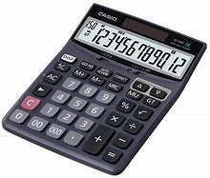
Don’t forget your calculator!

Slide 4
Assessment Objectives
Marks are awarded for different skills:
A01 – Knowledge and Understanding
A02 – Application - You MUST answer in context (refer to the case study) for Sections B and C
A03a - Analysis
A03b - Evaluation

Slide 5
Section A (35 marks)
A mix of questions that are multiple-choice or use the following command verbs:
Explain
Calculate
Discuss (6 marks: knowledge and understanding 3 marks, analysis 3 marks)

Slide 6
Section B (30 marks)
Questions relating to a case study about a small business that use the following command verbs:
State
Outline
Calculate
Analyse (6 marks: application 3 marks, analysis 3 marks)
Justify (9 marks: application 3 marks, analysis 3 marks, evaluate 3 marks)

Slide 7
Section C (25 marks)
Questions relating to a case study about a different small business that use the following command verbs:
State
Identify
Outline
Justify (9 marks: application 3 marks, analysis 3 marks, evaluate 3 marks)
Evaluate (12 marks: knowledge and understanding 3 marks, application 3 marks, analysis 3 marks, evaluate 3 marks)

Slide 8
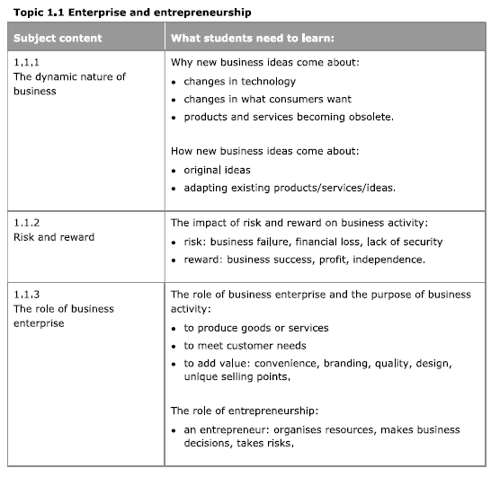
Topic 1.1
Enterprise and entrepreneurship

Slide 9
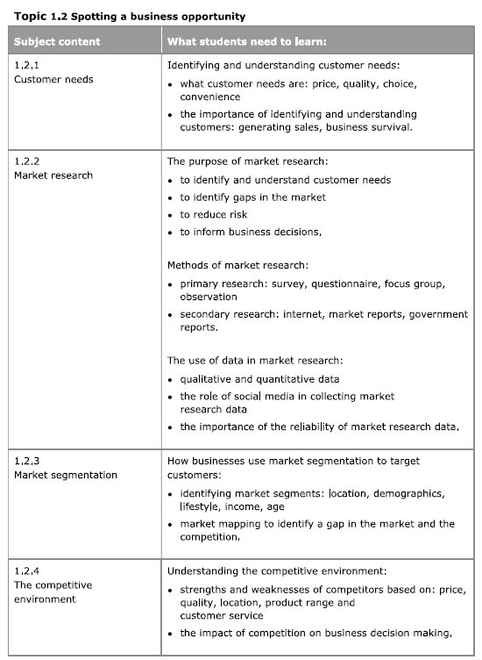
Topic 1.2
Spotting a business opportunity

Slide 10
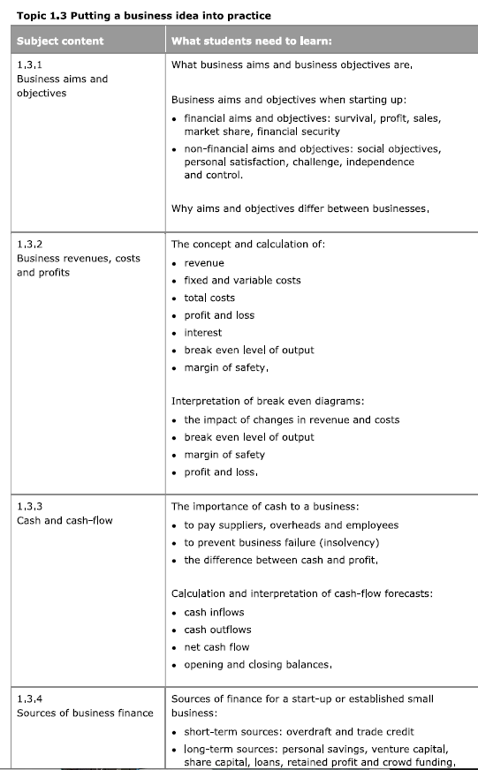
Topic 1.3
Putting a business idea into practice

Slide 11
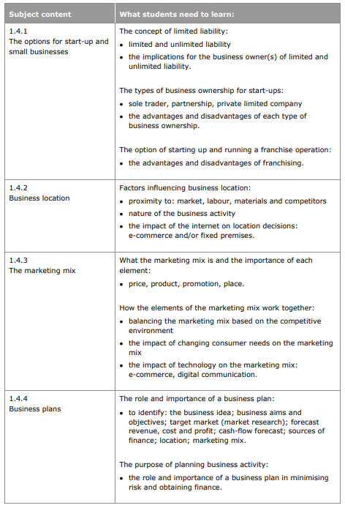
Topic 1.4
Making the business effective

Slide 12
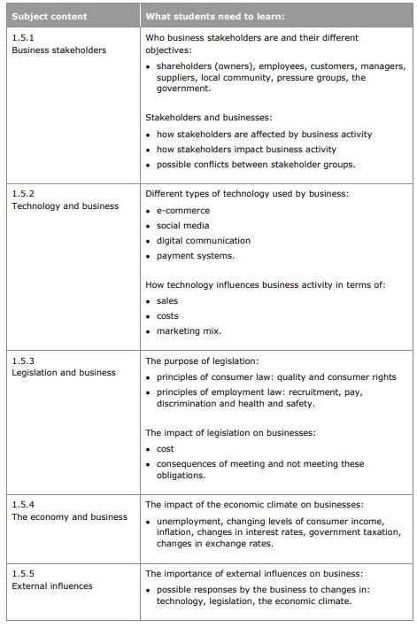
Topic 1.5
Understanding external influences on business

Slide 13
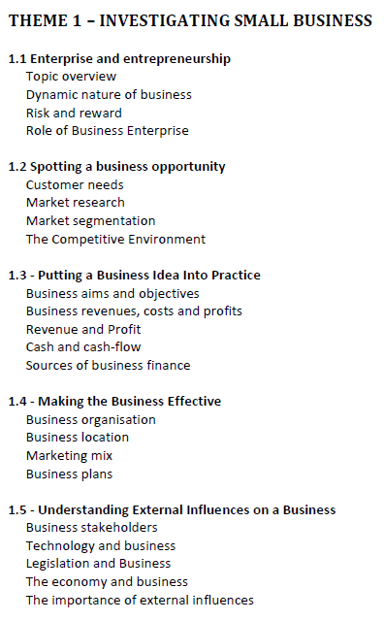
Course Companion p1-p70
Refer back to your Theme 1 booklet and your revision notes that you have made from your pre-reading for 1.1-1.5 as well as your notes and questions answered in class and for homework.

Slide 14
Seneca
Revise online with Seneca. Access set assignments via Teams.
All the theme 1 assignments should now be complete. However, you can do them again and new questions will come up.

Slide 15
Key terms
Use your glossary of terms to learn all the definitions of key terms we have covered this year.

Slide 16
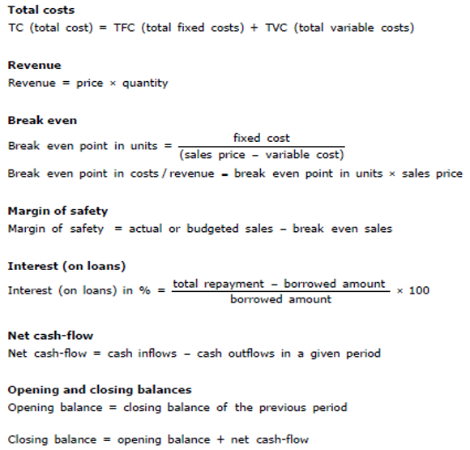
Formulae
Learn all the formulae we have covered this year.

Slide 17
Useful Websites
GCSE Business - Edexcel - BBC Bitesize
BusinessEd - Edexcel (9-1) (From 2017)

Slide 18
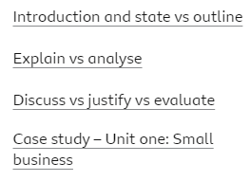
GCSE Business - Edexcel - BBC Bitesize
EXAM ST https://www.bbc.co.uk/bitesize/examspecs/z98snbk

Slide 19
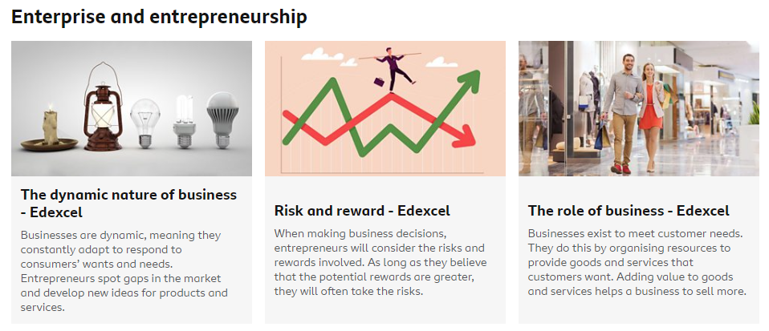
GCSE Business - Edexcel - BBC Bitesize
EXAM ST https://www.bbc.co.uk/bitesize/examspecs/z98snbk

Slide 20
GCSE Business - Edexcel - BBC Bitesize
EXAM ST https://www.bbc.co.uk/bitesize/examspecs/z98snbk

Slide 21
GCSE Business - Edexcel - BBC Bitesize
EXAM ST https://www.bbc.co.uk/bitesize/examspecs/z98snbk

Slide 22
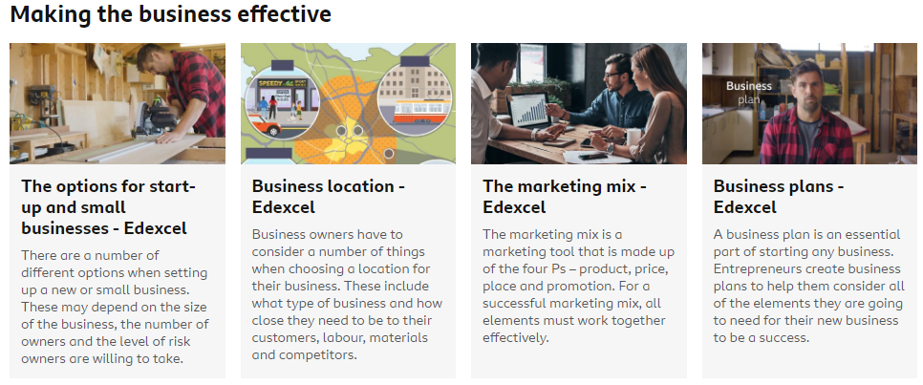
GCSE Business - Edexcel - BBC Bitesize
EXAM ST https://www.bbc.co.uk/bitesize/examspecs/z98snbk

Slide 23
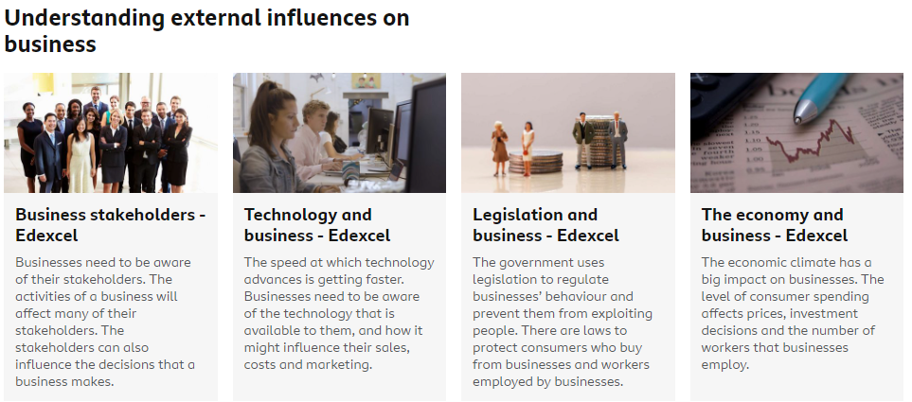
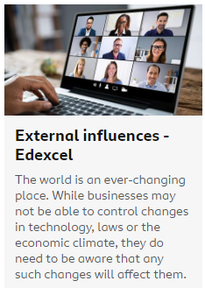
GCSE Business - Edexcel - BBC Bitesize
EXAM ST https://www.bbc.co.uk/bitesize/examspecs/z98snbk

Slide 24
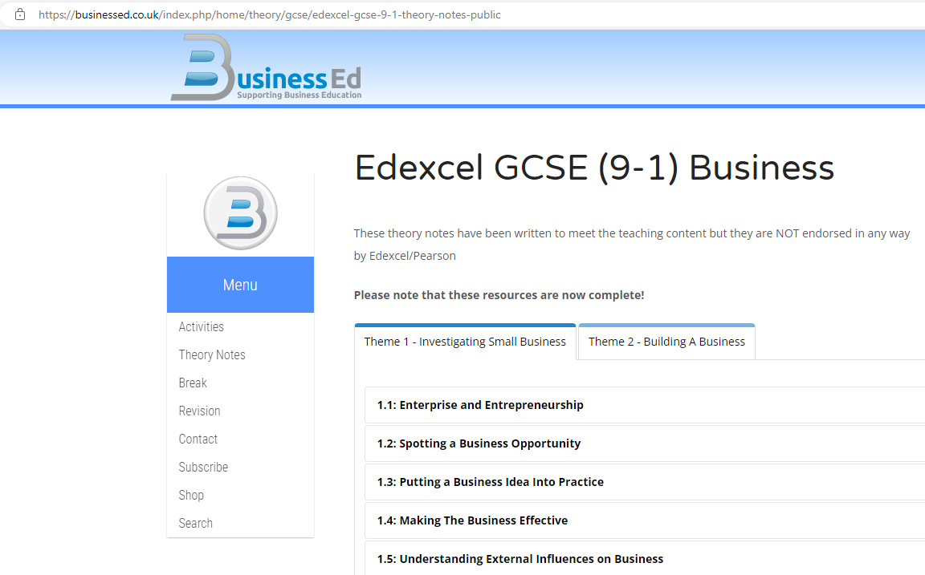
BusinessEd
This link takes you to the correct page
BusinessEd - Edexcel (9-1) (From 2017)
Click on the Theme 1 topic you are revising

Slide 25
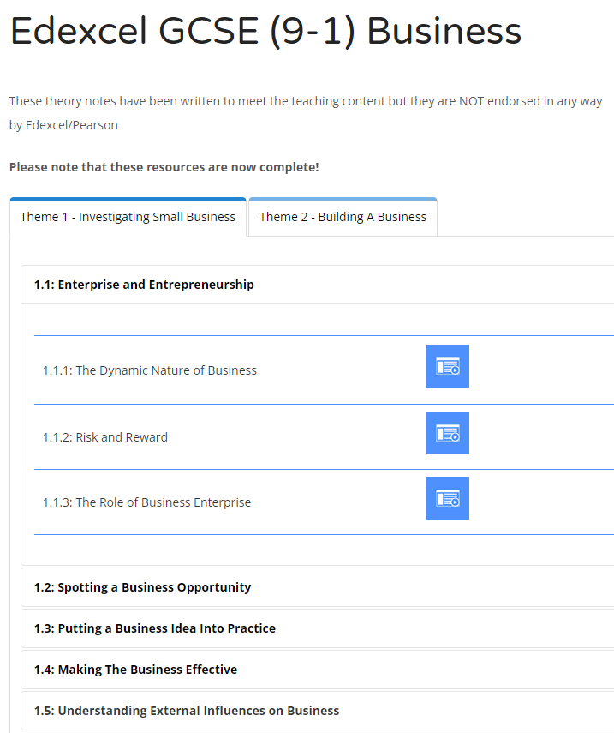
BusinessEd
Each topic has a series of slides
Click on the blue box to view

