Slide 1
Creative iMedia Revision
Guide
R093: Creative iMedia in the media industry
Section A

Slide 2
Topic Area 1
The media industry

Slide 3
1.1 Media industry sectors and products
Sectors in the media industry
1.1a
Activity
Using the media sectors provided on the right, identify whether they are examples of new or traditional media.
Traditional media
A media sector that existed before the World Wide Web.
New media
A media sector that existed after the World Wide Web.
Media sectors
Computer games
Digital publishing
Film
Interactive media
Internet
Print publishing
Radio
TV

Slide 4
1.1 Media industry sectors and products
Sectors in the media industry
1.1b
Activity
Identify which media sector the following products are associated with.
A series broken down into six episodes.
A role-playing video game such as Final Fantasy.
A kiosk style ordering system used in restaurants.
A video tutorial uploaded to YouTube
Video-on-demand streaming services like Netflix.
A new horror movie
A new video games magazine sold in shops.
An audio-only based product.

Slide 5
1.1 Media industry sectors and products
Sectors in the media industry
1.1c
Activity
Each description explains how a media sector has evolved, name the correct media sector by completing the gaps.
Sector:
Sector:
Sector:
Sector:
This sector has evolved with the introduction of Video on Demand services, which allow users to stream and download content whenever they want. This has expanded to include additional services such as simulcasting and timeshifting, catering to an audience whose needs and preferences have changed.
This sector has evolved by making itself accessible via an app. It has also introduced podcasting, allowing listeners to access content whenever they want. The introduction of DAB (Digital Audio Broadcasting) has improved signal quality and provided listeners with more choices.
This sector optimised their websites and content for mobile devices, recognizing the growing trend of accessing news and articles on smartphones and tablets. E-book publishing and digital magazine formats offered a different reading experience on e-readers and mobile devices.
This sector offered multiplayer gaming options as the internet evolved. The introduction of smart devices and immersive technologies, such as Virtual Reality (VR) and Augmented Reality (AR), has served to provide a more interactive experience for users.

Slide 6
1.1 Media industry sectors and products
Products in the media industry
1.1d
Activity
Match up each media product to the correct description.
Audio |  | A) Creating harmonious or rhythmic sounds using instruments, voices, or electronic means.
Video |  | B) Integration of various forms of media, such as text, images, audio, and video
Music |  | C) Sound-related content, such as music, speech, or sound effects, often used in various media forms.
Animation |  | D) Digital versions of printed books that can be read on e-readers, tablets, or computers.
5) e-books |  | E) Visual medium that captures moving images and can include audio.
6) Multimedia |  | F) The illusion of movement by displaying a series of still images or frames in rapid succession

Slide 7
1.1 Media industry sectors and products
Products in the media industry
1.1e
Activity
Using the mind map below, identify other media products (not mentioned on the previous slide).
Media products

Slide 8
1.2 Job roles in the media industry
Creative job roles
1.2a
Activity
Using the list of job roles on the right, select the ones that match up to each job description below.
Job title: ………………………………..
To develop and produce various types of content for a specific audience or platform.
To produce content such as: writing articles, shooting videos, recording podcasts and designing graphics.
Job roles:
animator
content creator
copy writer
graphic designer
illustrator/graphic artist
Photographer
script writer
web designer
Job title: ………………………………..
To create written content that persuades, informs, or engages an audience with the goal of promoting a product, service, idea, or brand.
To create various types of written content, including advertising copy, website content, product descriptions, blog posts, social media posts, brochures and email campaigns.

Slide 9
1.2 Job roles in the media industry
Technical job roles
1.2b
Activity
Identify the job role based on the descriptions provided. You can use a job role more than once.
Operating cameras and capturing video footage.
A deep understanding of camera techniques, including shot types, camera movements and shot transitions.
Job roles:
camera operator
games programmer/developer
sound editor
audio technician
video editor
web developer
Build websites from scratch or work with existing templates to create web pages.
Operate mixing consoles to ensure the best possible sound quality during recording sessions.
Review and select the best clips or shots from raw video footage and various sources.

Slide 10
1.2 Job roles in the media industry
Senior job roles
1.2c
Activity
Match up each job description to a job role listed on the right.
Job description | Job role
To oversee the logistical and operational aspects of a project's production.
To oversee the artistic and technical aspects of a production.
Review and refine various forms of content, including written, audio, or visual materials.
Responsible for overseeing the creative aspects of a project.
To plan, execute, and oversee marketing campaigns and strategies.
Job roles:
campaign manager
creative director
director
editor
production manager

Slide 11
1.2 Job roles in the media industry
Phases of production
1.2d
Activity
Using the table below, tick one or more boxes per row to identify the phases of production each job role is predominantly involved in.
Job role | Pre-production Before the production of a media product. | Production During the production of a media product. | Post-production After the production of a media product.
Animator
Illustrator/graphics artist
Director
Camera operator
Audio technician
Campaign manager
Script writer
Video editor

Slide 12
Topic Area 2
Factors influencing product design

Slide 13
2.1 How style, content and layout are linked to the purpose
Purpose
2.1a
Activity
Using the partially completed mind map below, identify different types of purpose.
Advertise
Types of purpose

Slide 14
2.1 How style, content and layout are linked to the purpose
Purpose
2.1b
Activity
Identify the different types of purpose using the examples provided.
A public service announcement encourages people to support a charitable cause by donating to a nonprofit organisation or volunteering their time.
An educational YouTube channel creates videos that explain complex scientific concepts in simple terms, helping students and enthusiasts grasp these ideas more easily.
A news website or a newspaper reports on current events, such as politics, sports, or international affairs, to inform readers about what is happening in the world.
A television commercial for a new smartphone model showcases its features and highlights a limited-time discount.
A comedy TV show, like "Friends" or a stand-up comedy performance, is intended to make people laugh and enjoy themselves.
Entertain

Slide 15
2.1 How style, content and layout are linked to the purpose
Style, content and layout
2.1c
Activity
Complete the gaps below to reveal the different factors that can affect the style, content and layout of a media product.
_ _ lour
conventions of ge _ _e
formal/_ _ formal language
_ _ sitioning of elements
style of a _ _ _ o representation
style of v _ _ _ _ l representation
T _ _ e of language

Slide 16
2.2 Client requirements and how they are defined
Client requirements
2.2a
Activity
Using the keywords provided on the right, complete the missing headings on the client brief.
Client Brief
……………………..: A mobile app for fitness and wellness tracking.
…………………..: To help users set and achieve their fitness and wellness goals by tracking their exercise, nutrition, and overall health.
………………….: Health-conscious individuals of all ages, from beginners to fitness enthusiasts.
…………………..: A company dedicated to promoting a healthy and active lifestyle, prioritizing user-friendly design, and personalised guidance.
………………..: The app should include features for tracking workouts, meal planning, health metrics, and provide educational content on fitness and nutrition.
………………...: Health and Fitness.
…………………: Modern, clean, and user-friendly with a focus on intuitive user interface design.
……………….: The theme should be centred around vitality, with vibrant colours and imagery conveying energy, health, and well-being.
………………..: The client aims for a launch within six months, with ongoing updates and improvements planned.
Headings
Audience
Client ethos
Content
Genre
Purpose
Style
Theme
Timescales
Type of product

Slide 17
2.2 Client requirements and how they are defined
Client brief formats
2.2b
Activity
Using the partially completed mind map below, identify different client brief formats.
Client brief formats
Informal

Slide 18
2.2 Client requirements and how they are defined
Client brief formats
2.2c
Activity
Using the descriptions provided below, identify different client brief formats.
Company hires another company to work on the project for them.​
Both the client and the company discuss the needs of the product to produce a shared view of the final product.​
The company will arrange meetings/discussions with the client to discuss the requirements.​
This might not include a written brief and details might be agreed in meetings/discussions with no set deadlines.​

Slide 19
2.3 Audience demographics and segmentation
Audience segmentation
2.3a
Activity
Using the space around the outside of the pie chart, identify the different segments used to define the target audience.

Slide 20
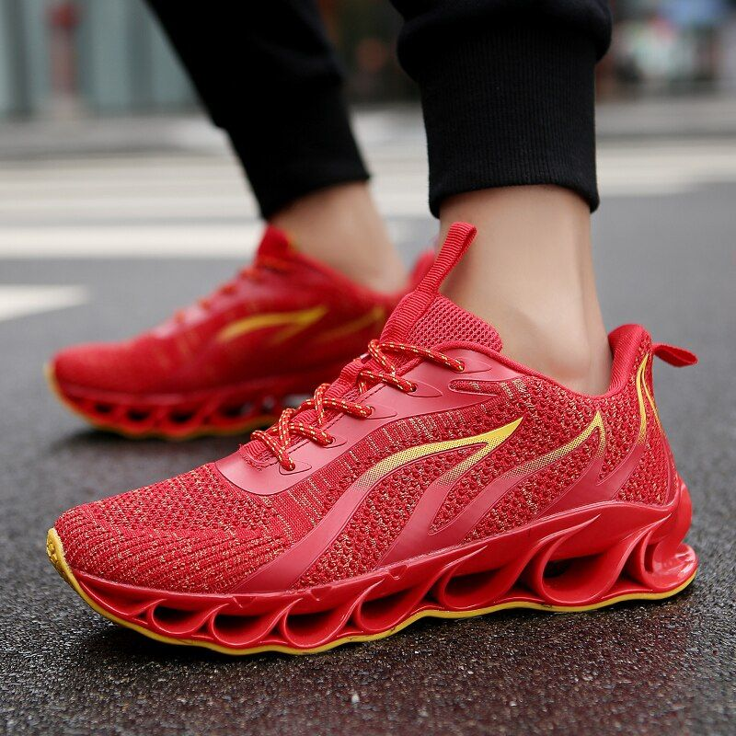
2.3 Audience demographics and segmentation
Audience segmentation
2.3b
Activity
For the scenario below, identify the segments that have been described.
…………….
Target younger consumers with trendy designs and older individuals with comfort and support features.
Running shoes
………………..
Promote waterproof running shoes in rainy regions and lightweight, breathable shoes in hot climates.
………………
Offer both male and female-specific shoe lines with designs and features tailored to each gender's preferences.
………………
Market to fitness enthusiasts with high-performance features and to casual runners with comfort and durability in mind.

Slide 21
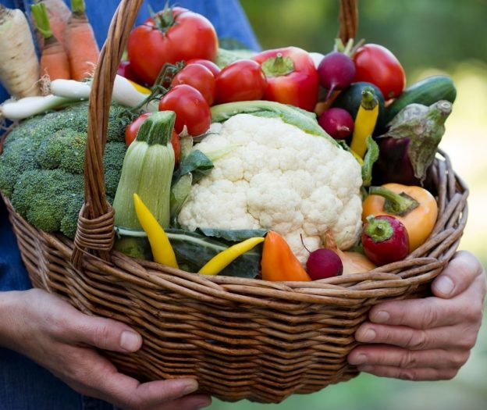
2.3 Audience demographics and segmentation
Audience segmentation
2.3c
Activity
For the scenario below, identify the segments that have been described.
……………
Promote baby food products to young parents and premium organic ingredients to health-conscious adults.
Organic food product
……………..
Offer affordable organic options for budget-conscious consumers and gourmet organic products for higher-income individuals.
……………
Emphasise locally sourced organic foods in campaigns for consumers who prioritise sustainability and support for local farmers.
……………..
Target eco-friendly consumers with an emphasis on sustainable packaging and farming practices.

Slide 22
2.3 Audience demographics and segmentation
Audience segmentation
2.3d
Activity
For the scenario below, identify the segments that have been described.
……………
Create family-friendly content recommendations for parents and edgy, original content for young adults.
Video streaming service
……………….
Offer tiered subscription options, including affordable plans for students and premium plans for high-income users.
………………
Promote local content libraries and regional shows to subscribers in different countries.
…………………
Market to busy professionals with on-the-go streaming options and binge-watchers with personalised recommendations.

Slide 23
2.4 Research methods, sources and types of data
Primary and secondary research
2.4a
Activity
Tick one box per row to identify whether each of these research methods is primary or secondary.
Research method | Primary | Secondary
Books and journals
Focus groups
Internet sites/research
Interviews
Magazines and newspapers
Online surveys
Questionnaire
Television

Slide 24
2.4 Research methods, sources and types of data
Research data
2.4b
Activity
Identify whether each description card is relating to quantitative or qualitative data.
Closed questions such as Yes or No, Agree/Disagree, Select age.
Research data based on numbers and statistical analysis.
Comments from a focus group.
Research data based on what people think or feel about something.
An open question on a survey to suggest improvements on a product.

Slide 25
2.5 Media codes used to convey meaning, create impact and/or engage audiences
Media codes
2.5a
Activity
Using the key provided on the right, identify which type of media code is being described in each box. The first one has been done as an example.
Storytelling in a comic strip.
Dialogue in a movie.
S | Symbolic This is how something is represented.
T | Technical This is how the equipment is used.
W | Written This is the use of language and how it’s written.
W
The use of camera shots and angles.
Actors body language.
Mise en scene
Environment/scene setting
Use of lighting
Audio editing techniques
Audio recording
Colour theory

Slide 26
2.5 Media codes used to convey meaning, create impact and/or engage audiences
Media codes
2.5b
Activity
In the table below list as many techniques and/or examples as possible. The first one in each case has been done as an example.
Mise en scene | Camerawork | Audio
Costumes | Camera shots | Dialogue

Slide 27
Topic Area 3
Pre-production planning

Slide 28
3.1 Work planning
Components of a work plan
3.1a
Activity
Using the keyword bank below, fill in the missing gaps.
Initial | Plan | Timescales | Write
Features | Moments | Milestones | Final
The purpose of a work plan is to:
To …………. out what order the tasks need to happen in.
To allow the project to meet the ……………. deadline by using ………………… to stay on track.
To provide ……………………… for parts so that you don’t spend too long on one thing.

Slide 29
3.1 Work planning
Components of a work plan
3.1b
Activity
Match up each work plan component to the correct description.
Activity |  | A. A plan put in place to deal with any unexpected events.
Contingency |  | B. A list of what is needed to complete each activity.
Dependencies |  | C. A measurement of how long each activity will take.
Milestone |  | D. A significant achievement within the project.
Resources |  | E. When an activity cannot start until a previous one is completed.
Task |  | F. The sequence/order in which the activities are carried out.
Time |  | G. The main parts of the project that need to be completed.
8. Workflow |  | H. A task within a task – known as a sub-tasks.

Slide 30
3.1 Work planning
Resources
3.1c
Activity
In the table below, identify hardware, software and people required to create a media product. A media product could be a film, video game, digital graphic etc…
Hardware | Software | People
Notes:
This list is NOT exhaustive, other examples should be accepted due to wide variety of possible answers.

Slide 31
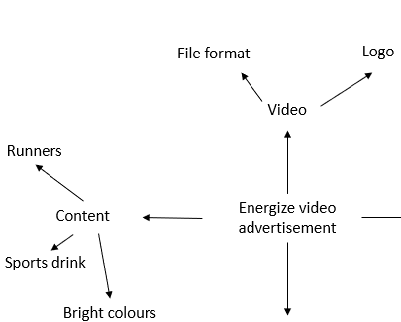
3.2 Documents used to support ideas generation
Mind maps
3.2a
Purpose
A mind map is a visual representation of ideas and concepts that stem from a central theme or concept
Activity A
Using the numbers provided, identify the three main conventions.
3
1
2
3
2
Activity B
Name up to three other components that might be included in a mind map.
1

Slide 32
3.2 Documents used to support ideas generation
Mind maps
3.2b
Activity A
Name three types of hardware that could be used to view/create a mind map.
3
2
Activity B
Name three types of software that could be used to create a mind map.
1
Notes:
Other reasonable answers can be accepted.

Slide 33
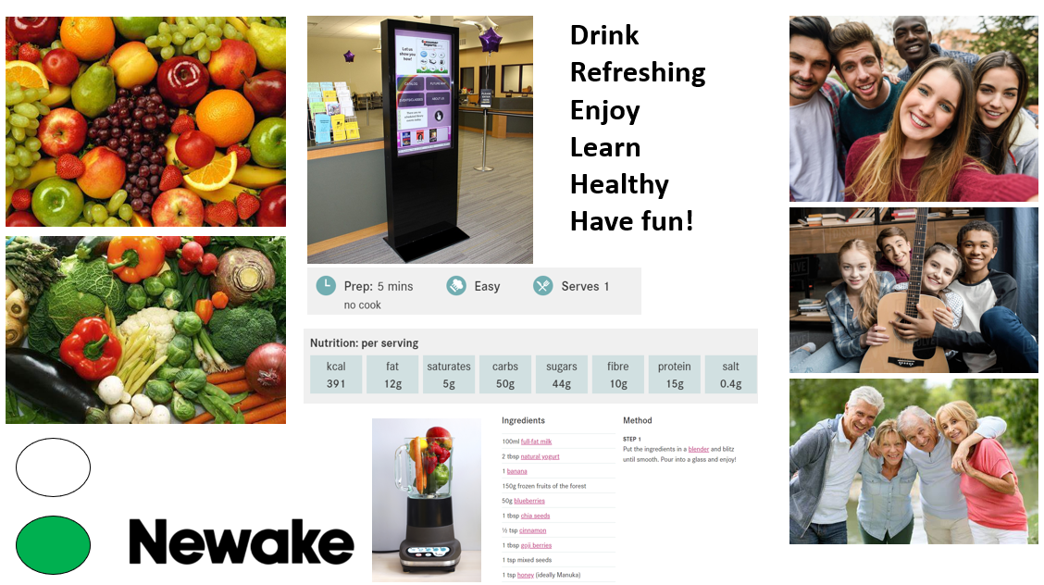
3.2 Documents used to support ideas generation
Moodboard
3.2c
Purpose
The purpose of a moodboard is to generate ideas and provide a visual feel for a product
1
4
Activity A
Using the numbers provided, identify the four components found on the moodboard.
1
2
3
4
2
3

Slide 34
3.2 Documents used to support ideas generation
Moodboard
3.2d
Activity
Tick one box per row to identify whether each of these components would be included on a physical (hand-drawn) moodboard or a digital moodboard.
Component | Physical (Hand-drawn) | Digital
Audio |  | ✓
Drawings | ✓
Video |  | ✓
Text | ✓
Animations |  | ✓
Colours | ✓
Textures | ✓
Fabrics | ✓

Slide 35
3.2 Documents used to support ideas generation
Moodboard
3.2e
Activity A
Name three types of hardware that could be used to view/create a moodboard.
Activity B
Name three types of software that could be used to create a moodboard.
Notes:
Other reasonable answers can be accepted.

Slide 36
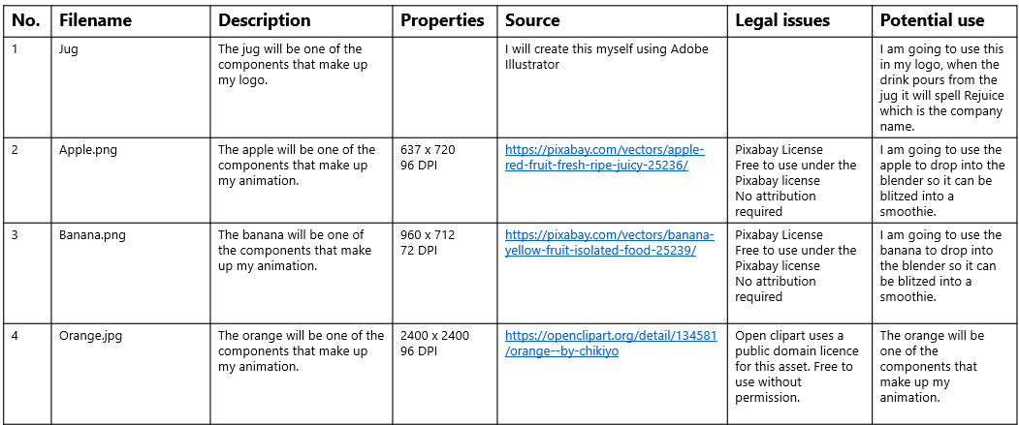
3.3 Documents used to design and plan media products
Asset log
3.3a
Purpose
The purpose of an asset log is to store all the assets sourced in preparation for the creation of a media product.
Activity A
Name three conventions of an asset log.
Activity B
Name three types of software that could be used to create an asset log.

Slide 37
3.3 Documents used to design and plan media products
Flow charts
3.3b
Activity A
Using the options on the right, identify different what each flow chart symbol represents.
Decision
Input/Output
Process
Start/Stop
Activity B
Name three types of software that could be used to create a flow chart.

Slide 38
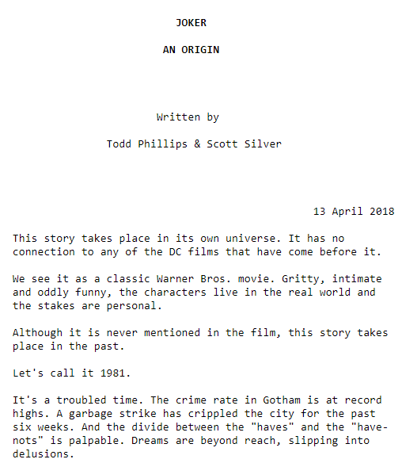
3.3 Documents used to design and plan media products
Script
3.3c
Activity A
Identify three components that could be included in a script.
Activity B
Identify the most appropriate type of software to use when creating a script.

Slide 39
3.3 Documents used to design and plan media products
Script
3.3d
Activity
Below are snippets of the script from the Black Panther movie. Using the list provided on the right, identify the different components. The first one has been done for you.
Direction
Character names
Timings
Location
Dialogue
Shot types
EXT DEEP SPACE
EXT. LAKE MERRITT APARTMENT
INT. COMMAND
The meteorite hits Africa and we see plant life and animals affected by vibranium.
Location
The camera moves, startling the children who quickly flee the hut.
NAKIA
T'CHALLA
OKOYE
T'Challa and Nakia sit close , silently . Nakia reaches out and touches his hand. He looks at her and smiles

Slide 40
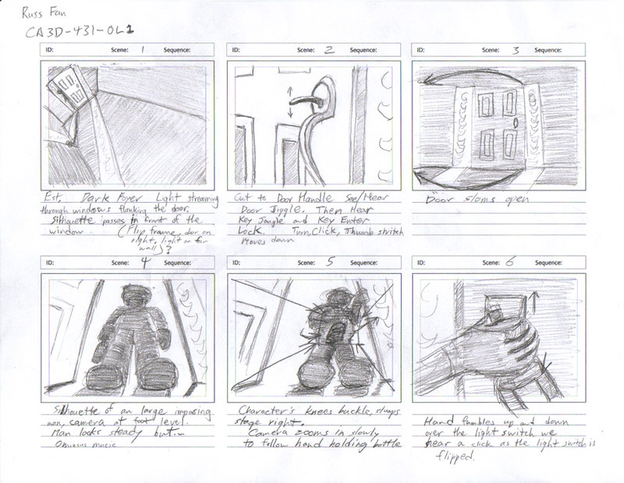
3.3 Documents used to design and plan media products
Storyboard
3.3e
Activity A
Identify three components you could find in a storyboard.
Activity B
Name three types of software that could be used to create a storyboard.

Slide 41
3.3 Documents used to design and plan media products
Storyboard
3.3f
Activity
Below are descriptions of the different components used in a storyboard. Using the list provided on the right, identify the different components. The first one has been done for you.
Camerawork
Scene content
Timings
Camera type
Lighting
Location
This is the actual scene, this could in the form of a drawing/image or a description of the scene.
Denotes how long each scene will last, this helps to keep track of the duration of the recording.
Scene content
This could be a description of the location or the use of INT (Interior shots) or EXT (Exterior shots)
Whether it’s the use of a standard video camera or a virtual camera for 3D animation.
This could be the use of certain camera shots, movements and angles.

Slide 42
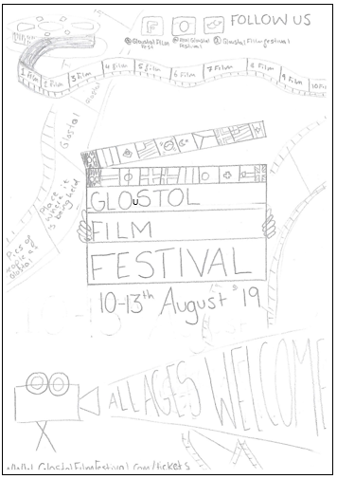
3.3 Documents used to design and plan media products
Visualisation diagram
3.3g
Activity A
Identify three components you could find in a visualisation diagram.
Activity B
Name three types of software that could be used to create a visualisation diagram.

Slide 43
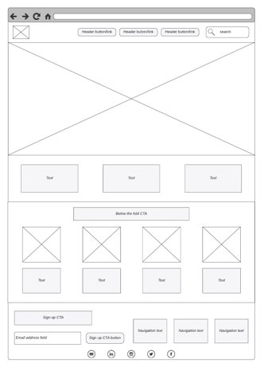
3.3 Documents used to design and plan media products
Wireframe layout
3.3h
Activity A
Identify three components you could find in a wireframe layout.
Activity B
Name three types of software that could be used to create a wireframe.

Slide 44
3.3 Documents used to design and plan media products
Pre-production planning
3.3i
Activity
Match up each pre-production planning document with the correct description.
1) Asset log |  | A) A timeline that is designed to illustrate a sequence of events for content that requires movement.
2) Flow chart |  | B) A planning document that will show how pages/screens are linked together.​
3) Script |  | C) To provide a visual representation of the sequence of events that may occur in a media product.
4) Storyboard |  | D) To provide the lines for the characters so they know what to say and to provide direction for the crew.
5) Visualisation diagram |  | E) To plan the layout of a media product and to show how the final product might look.
6) Wireframe layout |  | F) A document used to store all the assets sourced in preparation for the creation of a media product.

Slide 45
3.3 Documents used to design and plan media products
Pre-production planning
3.3j
Activity
Using the media product examples, identify which pre-production documents they would use. You can use an answer more than once.
Script | Storyboard | Visualisation diagram | Wireframe layout
Audio
Video
Digital games
Animation
e-books
Websites
Apps
Comic book
Graphic novel
Multimedia
Notes:
Answers will vary as there is lots of overlap. (e.g. script could be used to create voiceovers for characters in video games)

Slide 46
3.4 The legal issues that affect media
Legal considerations to protect individual
3.4a
Activity
Using the list on the right, identify the legal issues/considerations for each scenario. Write your answer using the numbers provided for each option.
Scenario | Legal issue/consideration
To ensure users data is kept secure, up-to-date and fit for purpose.
Filming a new movie in a public car park.
Filming a scene inside someone's house.
A false spoken (defamatory) statement with the intention of damaging a person’s reputation.
A false written (defamatory) statement with the intention of damaging a person’s reputation.
The use of employee images so they can be published on the company website.
People making unkind comments on a gaming forum.
1 | Slander
2 | Recording images/taking photographs in public places
3 | Publishing and commercial use of images and photographs taken.
4 | Data Protection Act
5 | Libel
6 | Recording images/taking photographs on private property
7 | Harassment and/or invasion of privacy

Slide 47
3.4 The legal issues that affect media
Intellectual property rights
3.4b
Activity
Using the descriptions provided, identify the different types of intellectual property.
Protects the creators original work and allows them control how it can be used.
Allows the creator to protect their invention for a period of time and prevent it from being imitated.
Allows the creator to have full ownership of the brand and anything that is associated with it.

Slide 48
3.4 The legal issues that affect media
Using copyrighted materials
3.4c
Activity
There are four different types of creative commons license – can you identify them? The first one has been done for you.
1. No derivative works |  | A) Material can be copied and use but it cannot be modified.
2. Share-alike |  | B) Material can be copied, modified and used as long as there is no intention to make money from it.
3. Non-commercial |  | C) Material can be copied, modified and used. However, the original creator must be given credit.
4. Attribution |  | D) Material can be modified and used but must be covered by a similar license.

Slide 49
3.4 The legal issues that affect media
Using copyrighted materials
3.4d
Activity
Answer the following questions below to identify other ways of using copyrighted material.
Fair dealing | Permissions, fees and licenses | Watermark symbol
Provide an example of what could be considered as ‘fair use’? | How can permission be obtained to use an asset that is protected? | Why are watermark symbols added to photos?
Answer: | Answer: | Answer:

Slide 50
3.4 The legal issues that affect media
Regulation, certification, and classification
3.4e
Activity
There are a range of different media regulators – can you identify them? The first one has been done for you.
BBFC |  | 1. Pan European Game Information |  | a) It regulates a range of communication services including the TV and radio sectors.
ASA |  | 2. British Board of Film Classification |  | b) This is a European video game content rating system.
Ofcom |  | 3. Advertising Standards Authority |  | c) Responsible for the national classification and censorship of films.
PEGI |  | 4. Office of Communications |  | d) Makes sure ads across UK media stick to the advertising rules.

Slide 51
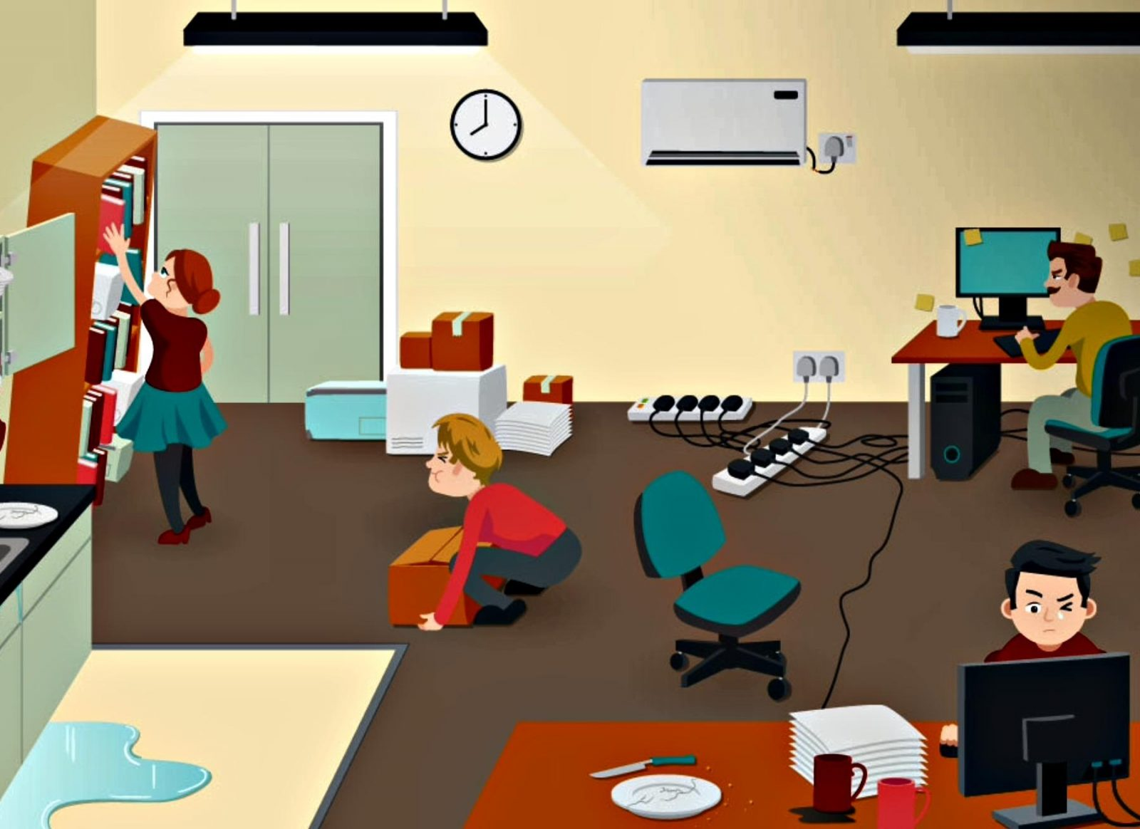
3.4 The legal issues that affect media
Health and safety
3.4f
Activity
Use the image below to identify any hazards you can see. Write them down each side.

Slide 52
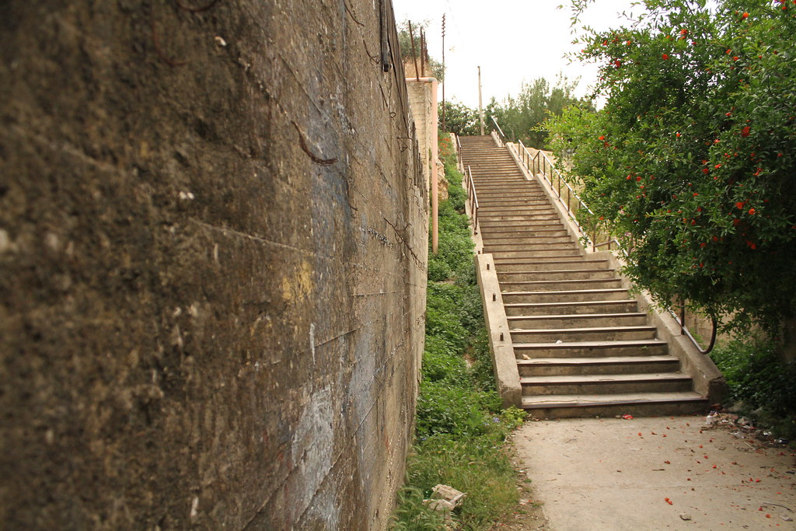
3.4 The legal issues that affect media
Location recces
3.4g
Activity
Part of the risk assessment would require the production team to visit the location first and check not only if it’s suitable for what they’re going to film, but also that it is a safe and secure working environment.
Using the table below, identify different considerations in a location recce. One has been done for you.
1 | Check for any background noise. (e.g. Trains)
2
3
4
5
6
Notes:
Others include:
Ensure you have permission to access – may need to complete a location release form.
Ensure you have all the documentation.

Slide 53
Topic Area 4
Distribution considerations

Slide 54
4.1 Distribution platforms and media to reach audiences
Distribution platforms and media to reach audiences
4.1a
Activity
Using the list provided on the right, identify if it’s an online, physical platform or physical media form of distribution.
Online | Physical platform | Physical media
Apps
CD/DVD
Computer
Interactive TV
Kiosks
Memory stick
Mobile devices
Multimedia
Paper based
Web

Slide 55
4.2 Properties and formats of media files
Static image files
4.2a
Activity
Using the keyword bank provided, complete the missing gaps.
10 | 00 | 10
01 | 11 | 00
01 | 10 | 00
11 | 11 | 00
Every bitmap image is made up a series of …………
Each ………… contains a digit known as a ………… number
This number corresponds and represents a unique ………….
The colour depth of an image is measured in bits per pixel.
The number of bits indicate how many colours are available for each pixel.
For example:
1 bit per pixel represents 2 colours.
2 bits per pixel represents 4 colours.
3 bits per pixel represents …….. colours.
4 bits per pixel represents 16 colours.
Keyword Bank
Pixel(s)
Colour
Metadata
Binary
Bits
8
Any of these keywords can be used more than once!

Slide 56
4.2 Properties and formats of media files
Static image files
4.2b
Activity
Complete the boxes below to describe the impact the change in resolution and colour depth can have on an image.
Keyword:
Resolution
What does it mean?
What happens when resolution is increased?
How does it impact the quality?
How does it impact the size of the file?
Keyword:
Colour depth
What does it mean?
What happens when colour depth is increased?
How does it impact the quality?
How does it impact the size of the file?

Slide 57
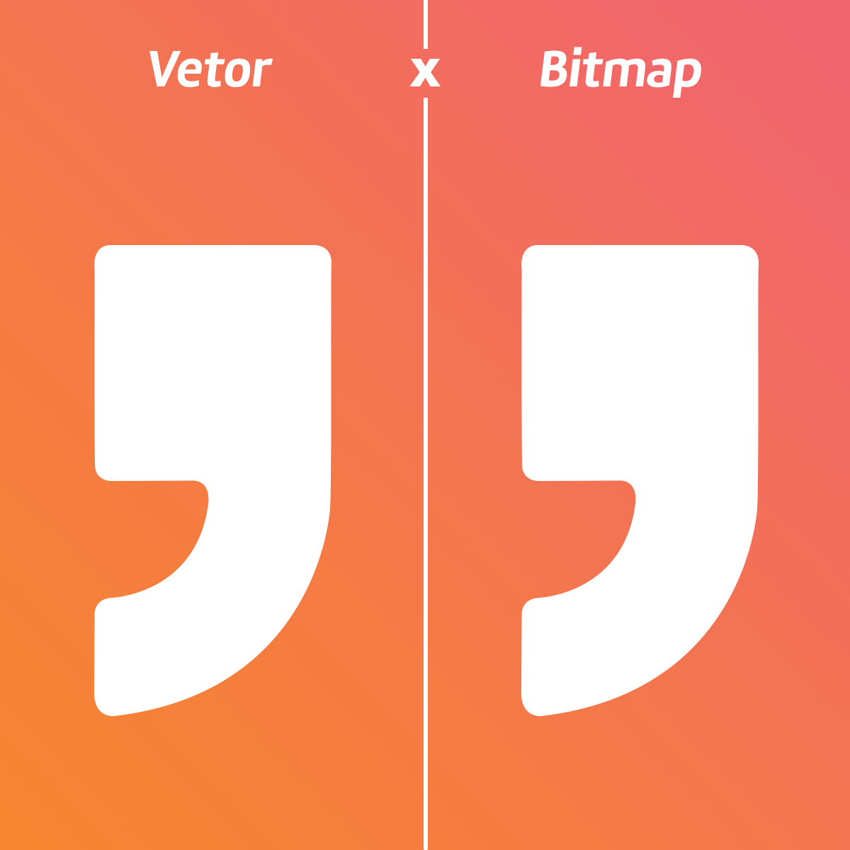
4.2 Properties and formats of media files
Static image files
4.2c
Activity
In the table below, identify up to three similarities and up to three differences between a bitmap image and a vector graphic.
Similarities | Differences
Hints:
What is each made up of?
What is bitmap used for and what is vector used for?
What do they have in common?
Do they share similar features?

Slide 58
4.2 Properties and formats of media files
Static image file formats
4.2d
Activity
In the table below, use the list provided to identify the file format and state whether it stores vector or bitmap images.
File format | Purpose/Description/Characteristic | Vector or Bitmap?
 | Supported by web browsers and uses lossy compression to significantly reduce file size.
 | Supports the use of transparency in digital graphics.
 | The industry standard for storing high-quality print graphics.
 | Used for images, manuals and desktop publishing.
 | Native file format for an Adobe Photoshop document.
 | Native file format for an Adobe Illustrator document.
 | Supports animation and transparency.
 | Scalable file format that is commonly used for creating icons and logos.
File formats:
AI
GIF
JPG/JPEG
PDF
PNG
PSD
SVG
TIFF

Slide 59
4.2 Properties and formats of media files
Audio files
4.2e
Activity
Using the keyword bank provided, complete the missing gaps.
…………………….are created by vibrations in the air. This means the current format of the sound is …………..
When ……………. sound is recorded, it measures the …………………by taking ……………. at ………………….and are then converted into a digital sound which is represented in ………………… form.
Keyword Bank
Sound waves
Bits
Regular intervals
Samples
When ……………… are taken, each one will store a number of ………….. which determines how much detail is in the sample itself.
Binary
Analogue
Any of these keywords can be used more than once!

Slide 60
4.2 Properties and formats of media files
Audio files
4.2f
Activity
Complete the boxes below to describe the impact the change in sample rate and bit depth can have on an audio file.
Keyword:
Sampling
What does it mean?
What happens when sample rate is increased?
How does it impact the quality?
How does it impact the size of the file?
Keyword:
Bit depth
What does it mean?
What happens when bit depth is increased?
How does it impact the quality?
How does it impact the size of the file?

Slide 61
4.2 Properties and formats of media files
Audio file formats
4.2g
Activity
In the table below, use the list provided to identify the file format and state whether it’s a compressed or uncompressed file format.
File format | Purpose/Description/Characteristic | Compressed or Uncompressed?
 | One of the most widely supported audio formats and can be played on a wide range of devices and software.
 | Provides high-quality audio with smaller file sizes. It's considered to offer better sound quality than MP3 at similar bitrates.
 | It retains all the original audio data. This results in high-quality sound but larger file sizes.
 | Preserves all original audio data for high-quality sound.
File formats:
AAC
AIFF
MP3
WAV
©SIMPLY TEACH 2023 | www.mysimplyteach.co.uk | info@mysimplyteach.co.uk

Slide 62
4.2 Properties and formats of media files
Moving image files
4.2h
Activity A
Using the description card, identify the missing key term.
Frame rate
This is the number of frames that recorded for the duration of a moving image file such as an animation.
Activity B
Match up each resolution with the correct description and dimensions.
SD |  | Cinematic quality |  | 1920 x 1080 pixels
HD |  | Ultra-high definition |  | 720 x 480 pixels
UHD |  | Standard definition |  | 3840 x 2160 pixels
4K |  | A newer video resolution, better than 4K |  | 4096 x 2160 pixels
8K |  | High-definition |  | 7680 x 4320 pixels

Slide 63
4.2 Properties and formats of media files
Moving image file formats
4.2i
Activity
In the table below, use the list provided to identify the file format and state whether it’s a compressed or uncompressed file format.
File format | Purpose/Description/Characteristic | Compressed or Uncompressed?
 | Provides smaller file sizes for faster loading.
 | Enables high-quality videos over low-bandwidth connections.
 | Widely used for digital files from digital cameras, provided good quality.
 | High quality files often used when editing videos before they’re exported into another format.
 | Supports animation and transparency
File formats:
AVI
GIF
MOV
MPG
MP4

Slide 64
4.2 Properties and formats of media files
File compression
4.2j
Activity
Tick one or more boxes in each row to identify if the statement matches with Lossy or Lossless compression.
Statement | Lossy | Lossless
Reduces the size of the file.
File becomes irreversible, meaning it cannot be edited.
Uses an algorithm to group data together so it can be restored to its original form.
File is reversible and can be edited.
Permanently removes data.

Slide 65
4.2 Properties and formats of media files
File compression
4.2k
Activity
In the mind map below, outline common scenarios where compression may be needed
Where may compression be needed?

