Slide 1
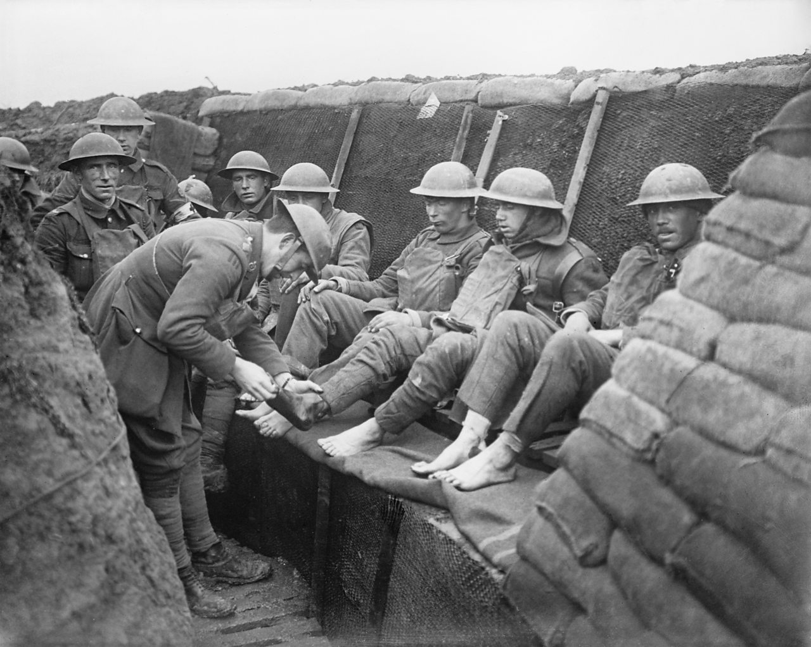
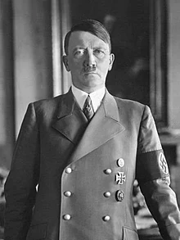
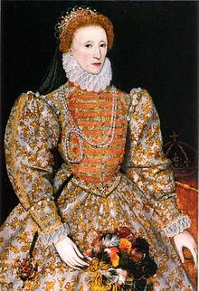
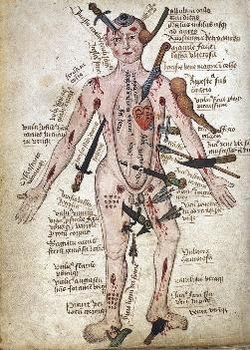
GCSE History 9-1: Exam Technique Guide

Slide 2
Paper 1 – Medicine 1 hour 15 mins, 52 marks, 30% of qualification
Paper 2 – Cold War AND Elizabeth 1 hour 45 minutes, 64 marks, 40% of qualification
Paper 3 – Weimar and Nazi Germany 1 hour 20 minutes, 52 marks, 30% of qualification.
Total marks = 168

Slide 3
Paper 1: Medicine 1250-Present and The Western Front (WW1 medicine) 1914-18
Section A
Section B

Slide 4
Section A
The Western Front 1914-18 (WW1 Medicine)

Slide 5
Q1- 4 mark ‘Describe Two Features’
1) Describe two features of...(4)
Tips
-underline the focus of the Q.
-a feature is something that is important.
-give a precise example in your development.
Point: One feature of…is…
Development: This meant that/This was....
Point: Another key feature of...is…
Development: This meant that/This was....

Slide 6
Q2A- 8 Mark ‘How Useful are Sources’
Content: Source A is useful because it says/shows…(1-2 quotes/features)
Provenance (NOP): The provenance of the source makes it useful because..
This can be seen when it says/shows…
However, the provenance of the source also limits it because…
This can be seen when it says/shows…
Context: When the source says/shows…I know this to be true because...
Repeat for source B
2A) How useful are Sources A and B for an enquiry into...? (8)
Explain your answer, using sources A and B and your knowledge of the historical context.
Tips
-underline the focus of the enquiry. When you are reading the source underline anything that is relevant to the enquiry.
-You do not have to talk about all three of NOP. Pick the one that affects the usefulness of the source and explain why. Do not just describe its NOP.

Slide 7
Q2B- 4 Mark ‘Follow Up Sources’
2B) How could you follow up Source B to find out more about...? (4)
In your answer, you must give the question you would ask and the type of source you would use
Tips
-underline the focus of the follow up and make sure the detail and the question you pick is relevant to this.
-your source should include an individual/organisation and a location if possible.
- make sure all four parts of your answer link to one another.
Details in Source B I would follow up:
‘short quote from the source’ or a description of what is in the picture.
Question I would ask:
A question that you would want to ask that is linked to the detail you have picked out.
What type of source I would look for:
A specific type of source that will help you answer your question.
How might this help me answer my question: ‘
An explanation of why that particular source would help you answer your question.

Slide 8
Section B
Medicine 1250-Present

Slide 9
Q3- 4 Mark ‘Similarity or Difference’
3) Explain one way in which…were similar/different in the...and...centuries (4)
Tips
-identify a precise similarity or difference.
-explain why they were similar/different in both centuries.
Similar
Point: One way in which...were similar was that in both centuries…
Development: This is because…
Different
Point: One way in which...were different was that in the…century….whereas in the ….century…..
Development: This is because…

Slide 10
Q4- 12 Mark ‘Explain Why’
4) Explain why…..(12)
You may use the following in your question:
-Point 1
-Point 2
You must include information of your own.
Tips
-underline the focus of the Q.
- use one point given to you per paragraph and come up with your own point.
-include 2-3 pieces of evidence per paragraph and link back to the question throughout your answer.
Point: One reason why… was ....
Evidence: For example...
Explanation: This meant that…
Link: Therefore this was important because
x 3

Slide 11
Q5- 16+4 SPaG mark ‘How Far do you Agree’
‘Statement’.
How far do you agree? Explain your answer. (16+4 SPaG)
You may use the following in your question:
-Point 1
-Point 2
You must include information of your own.
Essay Structure
Introduction
PEE paragraph agreeing
PEE paragraph agreeing/disagreeing
PEE paragraph disagreeing
Conclusion

Slide 12
Q5- 16+4 SPaG mark ‘How Far do you Agree’
Intro
It can be argued that… However,… Overall I agree/somewhat agree/disagree with the statement because...
Agree
On one hand…
For example…
This meant that…
Disagree
On the other hand…
For example…
This meant that…
REPEAT FOR EITHER AGREE OR DISAGREE
Conclusion
On one hand…On the other hand…Overall I agree/somewhat agree/disagree with the statement because…

Slide 13
Q5 -16+4 SPaG mark ‘How Far do you Agree’
Tips
-You will have a choice of 2 questions. ONLY ANSWER ONE.
-One of the points given will agree with the statement and the other will disagree. You must come up with you own third point that either agrees or disagrees with the statement.
-Say how far you agree with the statement in your introduction.
-Always start by agreeing with the statement. If you do 2X agree paragraphs they must be next to each other eg. agree, agree, disagree. NOT agree, disagree, agree.
-Use 2-3 pieces of evidence per paragraph. These should be dates, policies, events, statistics, individuals, countries, precise facts. Avoid sweeping statements eg ‘ Germ theory was significant because it led to other discoveries’.
-Spend 5 minutes planning, 20 minutes writing at least

Slide 14
Paper 2: Cold War and Elizabeth
Section A
Section B

Slide 15
Section A
Cold War

Slide 16
Q1- 8 Mark ‘Explaining Consequences’
Point: One consequence of...was..
Evidence: For example...
Explanation: As a result…..
X2
Explain two consequences of… (8)
Tips
make sure your consequences are different and don't overlap.
‘increased/decreased tension’ can always be a consequence.

Slide 17
Q2- 8 Mark ‘Narrative Account’
2) Write a narrative account analysing…(8)
You may use the following in your answer:
-Point 1
-Point 2
You must include information of your own
Tips
-The points in the question can be a cause/event/consequence. Work out which one they are to help you structure your answer.
-Link every section: ‘This led to’ ‘as a result’, ‘therefore’ ‘as a consequence’ ‘furthermore’.
Cause: The cause of...was…
Big Events: This led to...
Furthermore…
Consequences:As a consequence...Furthermore..

Slide 18
Q3- 16 Mark ‘Explaining Importance’
Q3) Explain two of the following:
The importance of…. (8 marks)
The importance of ….(8 marks)
The importance of...(8 marks)
Indicate which part you are answering by marking a cross in the box. If you change your mind, put a line through the box and then indicate your new answer with a cross.
Tips
-answer ONLY TWO questions.
-use 2-3 pieces of evidence per paragraph.
Point: The...was important because….
Evidence: For example….
Explanation: This meant that….
X2
REPEAT THIS FOR YOUR SECOND ANSWER

Slide 19
Section B
Elizabeth

Slide 20
Q1- 4 mark ‘Describe Two Features’
1) Describe two features of...(4)
Tips
-underline the focus of the Q.
-a feature is something that is important.
-give a precise example in your development
Point: One feature of…is…
Development: This meant that/This was....
Point: Another key feature of...is…
Development: This meant that/This was....

Slide 21
Q2- 12 Mark ‘Explain Why’
4) Explain why…..(12)
You may use the following in your question:
-Point 1
-Point 2
You must include information of your own.
Tips
-underline the focus of the Q.
- use one point given to you per paragraph and come up with your own point.
-include 2-3 pieces of evidence per paragraph and link back to the question throughout your answer.
Point: One reason why… was ....
Evidence: For example...
Explanation: This meant that...
x 3

Slide 22
Q3- 16+4 SPaG mark ‘How Far do you Agree’
‘Statement’.
How far do you agree? Explain your answer. (16+4 SPaG)
You may use the following in your question:
-Point 1
-Point 2
You must include information of your own.
Essay Structure
Introduction
PEE paragraph agreeing
PEE paragraph disagreeing
PEE paragraph agreeing/disagreeing
Conclusion

Slide 23
Q5- 16+4 SPaG mark ‘How Far do you Agree’
Intro
It can be argued that… However,… Overall I agree/somewhat agree/disagree with the statement because...
Agree
On one hand…
For example…
This meant that…
Disagree
On the other hand…
For example…
This meant that…
REPEAT FOR EITHER AGREE OR DISAGREE
Conclusion
On one hand…On the other hand…Overall I agree/somewhat agree/disagree with the statement because…

Slide 24
Q5 -16+4 SPaG mark ‘How Far do you Agree’
Tips
-You will have a choice of 2 questions. ONLY ANSWER ONE.
-One of the points given will agree with the statement and the other will disagree. You must come up with you own third point that either agrees or disagrees with the statement.
-Say how far you agree with the statement in your introduction.
-Always start by agreeing with the statement. If you do 2X agree paragraphs they must be next to each other eg. agree, agree, disagree. NOT agree, disagree, agree.
-Use 2-3 pieces of evidence per paragraph. These should be dates, policies, events, statistics, individuals, countries, precise facts. Avoid sweeping statements eg ‘ The Religious Settlement was a success because it brought peace’.
-Spend 5 minutes planning, 20 minutes writing at least

Slide 25
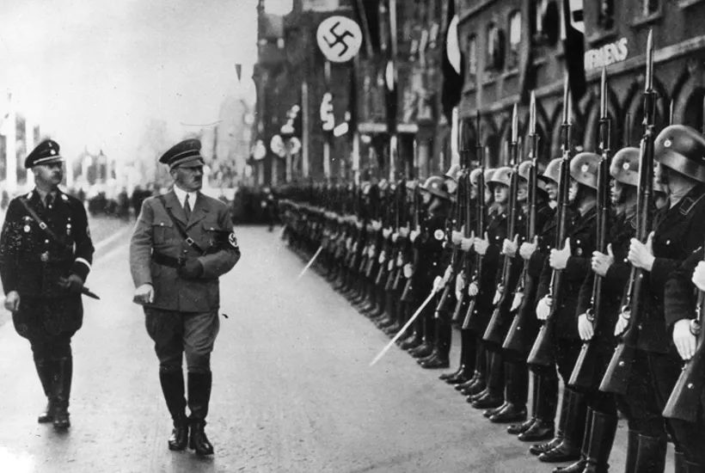
Paper 3
Weimar and Nazi Germany, 1918-39

Slide 26
Paper 3: Weimar and Nazi Germany, 1918-39
You will have….
Source A
Q1
Interpretation 1
Q3b, 3c and 3d
Source B
Interpretation 2
Q3a and 3C
Source C
Source = written from the time
interpretation= a historian’s opinion

Slide 27
Q1- 4 Mark ‘inferences’
1) Give two things you can infer from Source A about ... (4)
Tips
-underline the focus of the Q. When you are rea
-and inference is what the source suggests, not what it says.
Point: One thing I can infer from Source A is that _.
Evidence: The evidence for this is ‘quote’.
Point: Another thing I can infer is _.
Evidence:The evidence for this is ‘quote’.

Slide 28
Q2- 12 Mark ‘Explain Why’
4) Explain why…..(12)
You may use the following in your question:
-Point 1
-Point 2
You must include information of your own.
Tips
-underline the focus of the Q.
- use one point given to you per paragraph and come up with your own point.
-include 2-3 pieces of evidence per paragraph and link back to the question throughout your answer.
Point: One reason why… was ....
Evidence: For example...
Explanation: This meant that...
x 3

Slide 29
Q3A- 8 mark ‘How Useful are Sources’
Content: Source A is useful because it says/shows…(1-2 quotes/features)
Provenance (NOP): The provenance of the source makes it useful because..
This can be seen when it says/shows…
However, the provenance of the source also limits it because…
This can be seen when it says/shows…
Context: When the source says/shows…I know this to be true because...
Repeat for source B
3A) How useful are Sources A and B for an enquiry into...? (8)
Explain your answer, using sources A and B and your knowledge of the historical context.
Tips
-underline the focus of the enquiry. -when you are reading the source underline anything that is relevant to the enquiry.
-You do not have to talk about all three of NOP. Pick the one that affects the usefulness of the source and explain why. Do not just describe its NOP.

Slide 30
3B- 4 Mark ‘Interpretation Difference’
3B) Study Interpretations 1 and 2. They give different views about ....
What is the main difference between the views?
Explain your answer, using details from both interpretations (4)
Tips
Interpretations differ in terms of:
1)what they emphasise/focus on
2)how significant they say something was
3)whether something was positive or negative
4) whether something led to change or not
Point: On one hand, Interpretation 1..
Evidence: For example…
Point: One the other hand, interpretation 2…
Evidence: For example...

Slide 31
3C- 4 Mark ‘Why Interpretations Differ’
3C)Suggest one reason why Interpretations 1 and 2 give different views about... (4)
You may use sources B and C to help explain your answer.
Tip
-you can always write it’s because they use different sources.
-Match the interpretation to the correct source
Point: Interpretations 1 and 2 differ because they use different sources as evidence.
Development: Interpretation 1 uses source…because...
Whereas interpretation 2 uses source... because
Interpretation 1
Source ?
Interpretation 2
Source ?

Slide 32
3D- 16+4 SPaG mark ‘How far do you Agree with Interpretation…’
How far do you agree with interpretation 2 about ….? (16 +4 SPaG marks)
Explain your answer using both interpretations and knowledge of the historical context.
Tips
-always link own knowledge to the interpretations to agree/disagree with them. Don’t tell a story and don't just re-describe what the interpretations say.
-try and find a similarity between the interpretations.
-read the interepations twice and plan your answer before you start writing
Essay Structure
Introduction
PEE paragraph agreeing
PEE paragraph disagreeing
PEE paragraph similarities with the interpretations
Conclusion

Slide 33
Introduction
On one hand interpretation 2 argues...On the other hand interpretation 1 argues…
Ultimately I agree/disagree/somewhat agree with interpretation 2 because….
Section 1- PEE Agree
On one hand I agree with interpretation 2 because it says…(summarise a key point of the interpretation) .
At the time…This is why interpretation 2 says...
This shows that…
(Repeat with another key point from the source)
Section 2 -PEE Disagree
On the other hand, one might disagree with interpretation 2 because interpretation 1
says…
At the time…This is why interpretation 1 says
This meant that….
(Repeat with another key point from the source)
Section 3- PEE Similarities with the interpretations
Nonetheless, both interpretations agree that…
For example..
This meant that...
Conclusion
Interpretation 2 is valid because...However interpretation 2 is disagreeable because as interpretation 1 argues….
Ultimately, I agree/disagree/somewhat agree with interpretation 2 because….

