Slide 1
prayer
Year 10

Slide 2
Prayer
Prayer is communication with God.

Slide 3
We can pray through:
Words
Meditation (mind)
Contemplation (thinking deeply about God)

Slide 4
Prayer includes:
Adoration – adoring God.
Thanking God.
Confession – asking for forgiveness.
Supplication or intercession – asking for something from God.

Slide 5
Write out an example of a prayer and then label it as:
Adoration
Thanking God
Confession
Supplication/Intercession
Explain why your prayer is Adoration or thanksgiving, etc.

Slide 6
The following prayers are examples of set prayers because they are set words:
Our Father
Hail Mary

Slide 7
The Our Father is also known as The Lord’s Prayer and it includes:
Adoration: hallowed be Your name; Your kingdom come, Your will be done.
Confession: Forgive us our sins.
Supplication: Give us today our daily bread; lead us not into temptation; deliver us from the evil one.

Slide 8
What kind of prayer is this? Formal or informal (spontaneous) – give a reason for your answer (2:05)

Slide 9
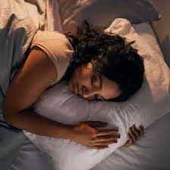
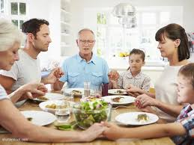
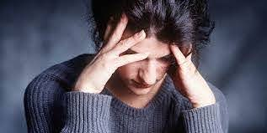
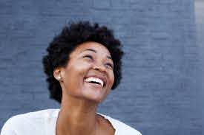
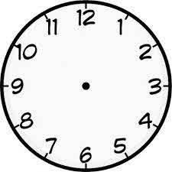
When do Catholics pray?

Slide 10
Why do Christians pray?
They want a ……………………….. With God.
Jesus told His …………………… that they should pray.
The Church says that Christians should pray.
Prayer can bring ………………… peace.
Through prayer we can begin to see life from God’s point of ………………
Soierplatihn llwerofos eivw ernin

Slide 11
Why do Christians pray?
They want a relationship with God.
Jesus told His followers that they should pray.
The Church says that Christians should pray.
Prayer can bring inner peace.
Through prayer we can begin to see life from God’s point of view.

Slide 12
Why is it important to have different types of prayer?
Humans are different and so each prays differently according what suits them best.
Public worship (Holy Mass) allows us to praise God as one body of people – formal prayer.
Praying privately helps us to share our deepest thoughts and emotions with God.
Some Christians prefer informal prayer – made up prayer, because it comes straight from their heart and is genuine and personal to us.

Slide 13
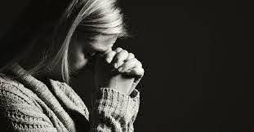
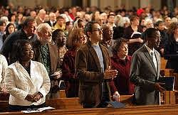
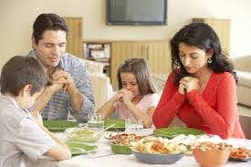
What kinds of prayer might these be?

