Slide 1
Catholic Funeral rite

Slide 2
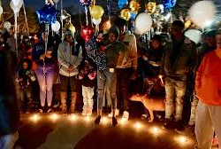
What is this?

Slide 3
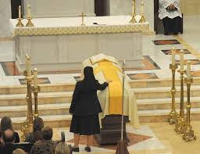
Catholic Funeral Vigil

Slide 4
Part 1: Catholic Funeral Vigil
The evening before the funeral service
Bible: Resurrection
Prayers for the deceased

Slide 5
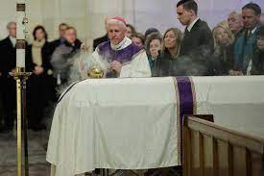
Part 2: Catholic Funeral Service
In church
Bible: Resurrection
Prayers for the deceased to be forgiven of their sins
Sprinkling coffin with holy water (reminds them of baptism)and also incensing

Slide 6
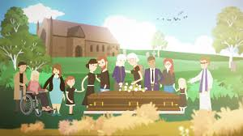
Part 3: Rite of Committal
In cemetery
Bible: Resurrection
Prayers for the deceased and Our Father

Slide 7
The Funeral Liturgy
Why is it called a liturgy?
Where does it take place?
Whose victory do we remember and why is this victory important?
Why do we need to pray for the soul of the deceased person?

Slide 8
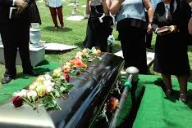
Vigil, Funeral Liturgy OR Rite of Committal?

Slide 9
Why is the Catholic Funeral Liturgy important?
It allows us to remember the deceased person and gives us a chance to celebrate their life.
We can ask God to forgive them of their sins.
It gives us HOPE that there is life after death and that the deceased is now with God and their loved ones.
It gives us HOPE that when we die we can also go to heaven.

