Slide 1
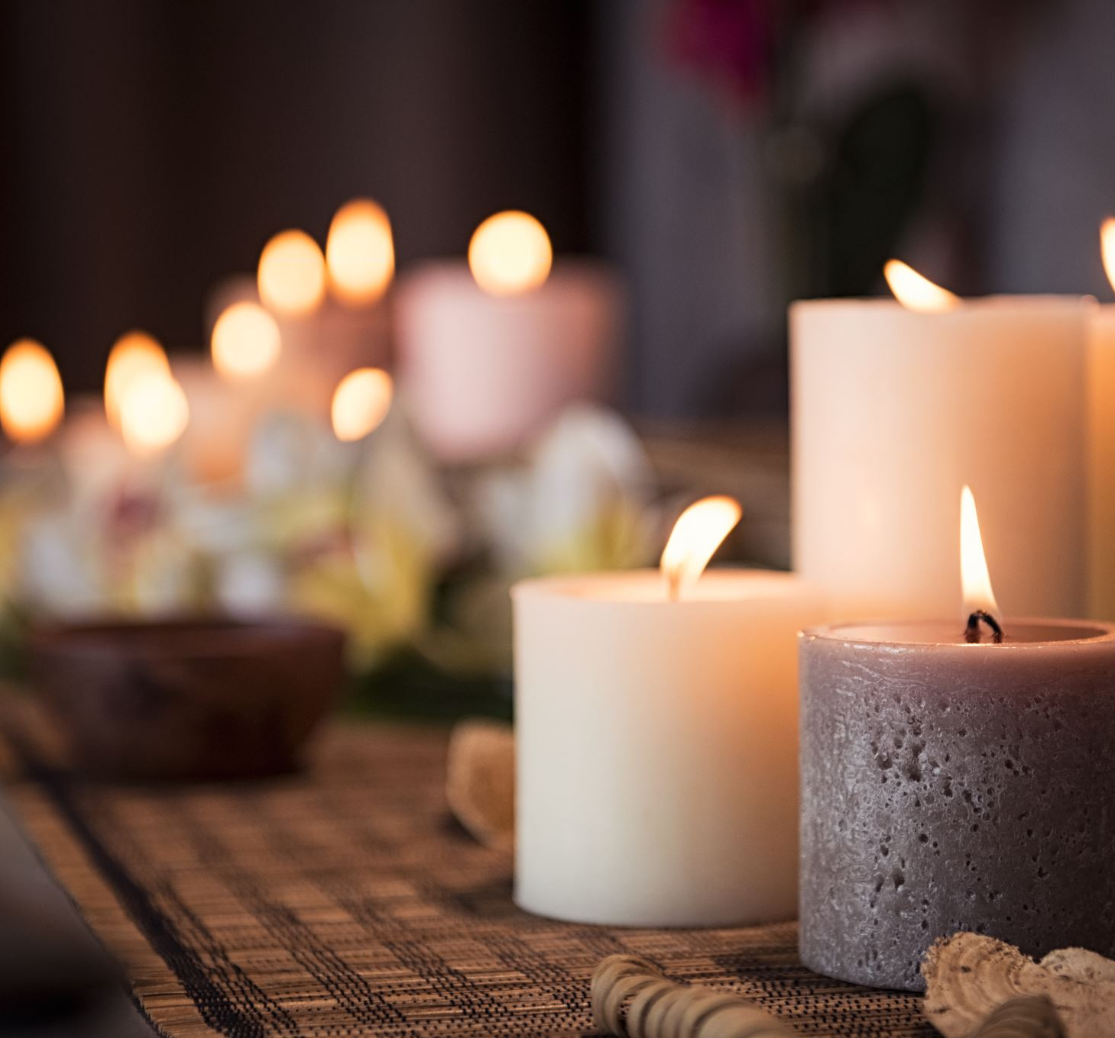
Sacraments
Year 10

Slide 2
How many sacraments are there in the Catholic Church?
3
7
8
7

Slide 3
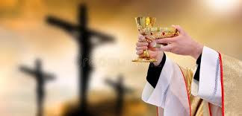
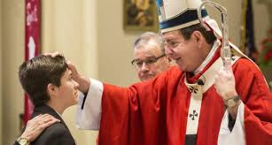
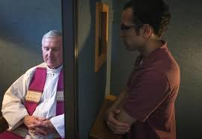
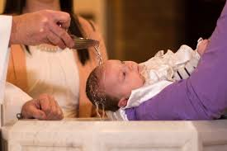
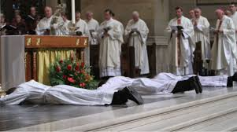
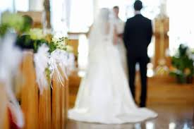
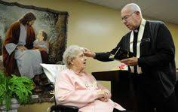
What are the 7 sacraments?

Slide 4
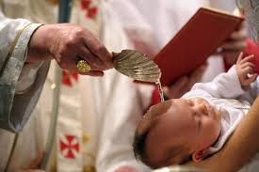
What is a sacrament?
It is a sacred (holy) moment when we can see on the outside that something good from God is going on inside a person. It is a moment when we grow closer to God. We look the same on the outside but inside we have changed.
For example, we can see from the pouring of water (outside) at baptism that something good from God is taking place on the inside – the washing away of original sin.

Slide 5
What about the sacramental nature of reality?
This means that Christians look at the world (outside) but know that God’s presence is hidden within the world (inside).
This means that the world is holy and we should respect it and know that it is a physical sign of God’s presence with us in the world. When we look at the world, we should recognise the power and presence of God’s spirit in the world.

Slide 6
Source of Wisdom and Authority
Christians believe that God is present in all His creation because He made it e.g. the Bible says: The heavens declare the glory of God.

Slide 7
What happens to a person when they receive a sacrament?

Slide 8
7 Sacraments - Worksheet
No notes
Hip. Hip. Hooray!

Slide 9
Into which group do each of the sacraments fall?
Of the 7 sacraments three of them are sacraments of initiation, that means they bring us INTO the Church:
Baptism
Eucharist (Holy Communion)
Confirmation

Slide 10
Into which group do each of the sacraments fall?
Of the 7 sacraments two of them are sacraments of vocation, that means they show that God is calling us to do something with our lives:
Holy Orders
Marriage

Slide 11
Into which group do each of the sacraments fall?
Of the 7 sacraments two of them are sacraments of healing, that means they show that they offer us healing spiritually or even physically:
Reconciliation/Confession
Sacrament of the sick

Slide 12
Do all Christians have sacraments?
The Catholic Church and Orthodox Churches have 7 sacraments because they were all started by Jesus.
Some Protestant Churches will only have baptism and Holy Communion because they say these are the only two Jesus had.
Some Christians don’t have any sacraments because they believe they are no longer relevant and they just focus on reading the Bible and reflecting on it.

