Slide 1
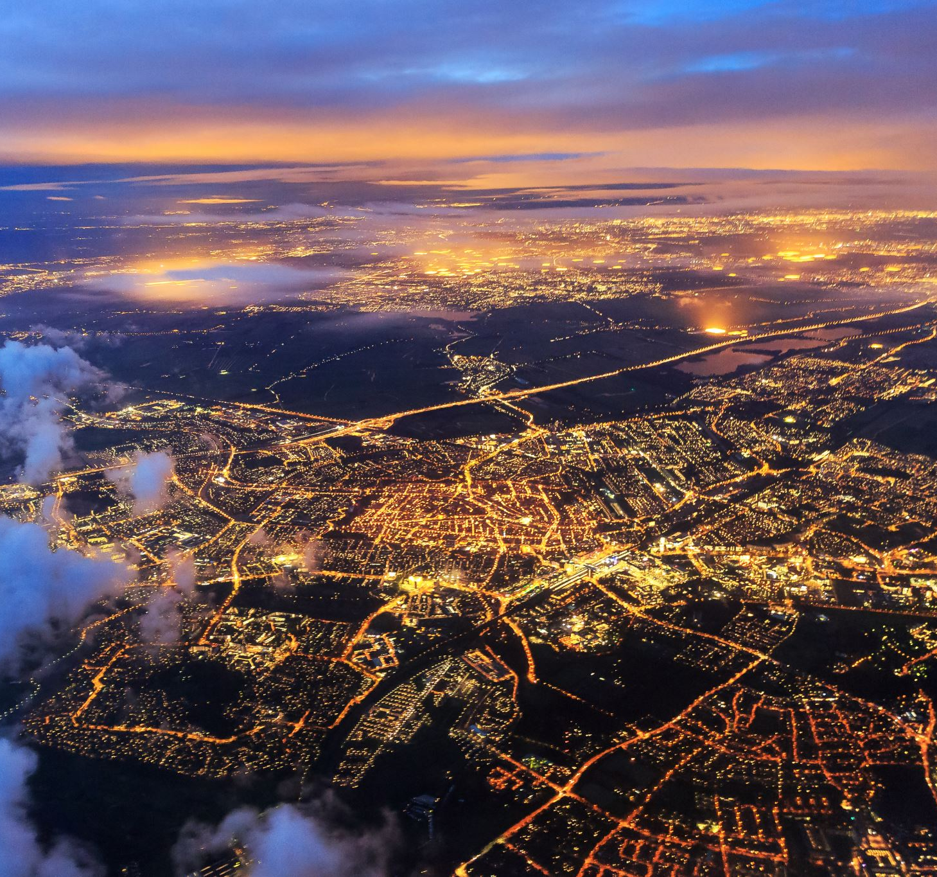
Pilgrimage Revision
Year 10 & 11

Slide 2
Pilgrimage
A journey to a holy place

Slide 3
Pilgrimage – Why?
To develop a closer relationship with God.
To thank God for a prayer that has been answered.
To ask God for a particular favour.
To ask for God’s forgiveness.
To deepen their understanding of their faith.
To ask for healing of body, mind or soul.

Slide 4
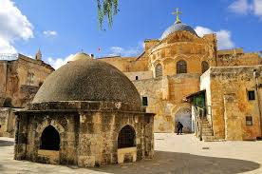
Christian places of Pilgrimage
Jerusalem: Jesus died, buried and rose from the dead.
Via Dolosora – the route where Jesus carried His cross.
Church of the Holy Sepulchre – the crucifixion site and burial.
Garden of Gethsemane.
The place where Jesus rose to heaven.

Slide 5
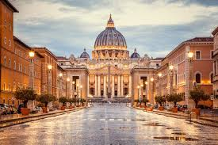
Christian places of Pilgrimage
Rome/The Vatican:
The centre of the Catholic Church.
Tomb of St Peter.
Seeing the Pope.

Slide 6
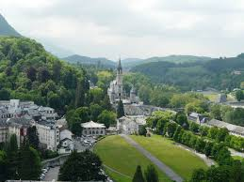
Christian places of Pilgrimage
Lourdes:
St Bernadette had visions of Mary.
There are healing waters.

Slide 7
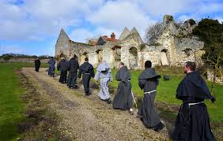
Christian places of Pilgrimage
Walsingham:
Had a replica of the house of Mary.
It is a local place of pilgrimage in England.
It is a place for ALL Christians to visit – encourages unity between Christians.

Slide 8
Christian places of Pilgrimage
Think about what each of the four places of pilgrimage, mentioned in the video, has to offer Christians.
What makes each place unique?
What kinds of Christians might want to visit these places of pilgrimage?

Slide 9
Why would you not go on a pilgrimage?
Too expensive.
Too sick to travel.
God is everywhere, you do not need to visit a holy site.
Some Christians do not wish to visit a religious site linked to Mary.

