Slide 1
Popular piety

Slide 2
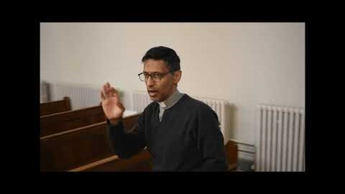
Popular piety
What 3 forms of popular piety can you identify?
Why do Catholics like them?

Slide 3
What is popular piety?
These are prayers and worship that Christians have developed over the years which is not Holy Mass.
Examples would include:
Praying the rosary.
Using the Stations of the Cross to focus on the sufferings of Jesus.
Eucharistic Adoration – praying before the Body of Christ in silence.

Slide 4
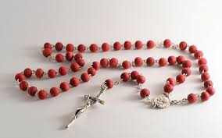
The rosary
This focuses on the life of Jesus and Mary.
Catholics like this form of popular piety because:
It gives them a good focus for their life.
It reminds them what Jesus has done for them.

Slide 5
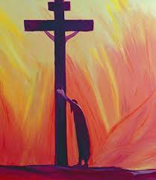
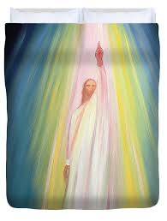
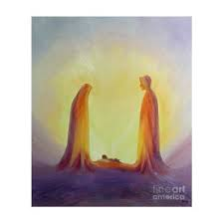
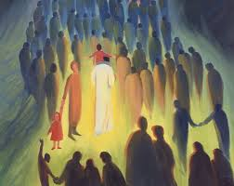
It focuses on FOUR areas of the life of jesus

Slide 6
1. Joyful mysteries: Angel Gabriel visits Mary; Mary visits Elizabeth; Jesus is born; presentation of Jesus in the temple; finding Jesus in the temple. 2. Sorrowful Mysteries: Suffering in the Garden of Gethsemane; being whipped; crowned with thorns; carrying the cross; the crucifixion. 3. Glorious Mysteries Resurrection; ascension; arrival of the Holy Spirit; assumption of Mary; coronation of Mary. 4. Luminous mysteries Baptism of Jesus; wedding at Cana; Jesus proclaiming the Gospel; Transfiguration; The Last Supper

Slide 7
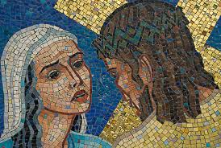
The stations of the cross
This focuses on the suffering and crucifixion of Jesus.
Catholics like this form of popular piety because:
If they are suffering, it helps them to focus on the sufferings of Jesus. It reminds them that He can understand their sufferings.
It reminds them of what Jesus did for us.

Slide 8
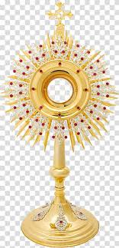
Eucharistic adoration
This focuses on the Body of Jesus.
Catholics like this form of popular piety because:
They feel physically close to Jesus.
They can pray silently without using any set prayer.

Slide 9
Eucharistic adoration
Source of Wisdom and Authority
The Church says:
The world has a great need for Eucharistic Adoration. Jesus waits for us in this sacrament of love. Let us not refuse the time to go to meet him in adoration.

Slide 10
Eucharistic adoration
Source of Wisdom and Authority
The Church says:
Popular piety helps us in our faith, but it
can never replace Holy Mass.

Slide 11
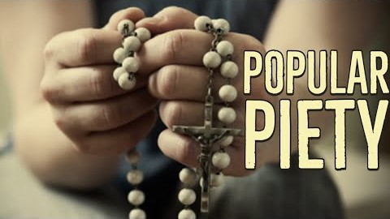
Popular Piety - summary

Slide 12
What do other Christians think?
Some Christians do not agree with popular piety because:
1. We should only focus on the life of Jesus, not Mary.
2. Other Christians do not believe that the bread truly becomes the Body of Jesus and so they disagree with Eucharistic Adoration.
3. Some don’t like the Stations of the Cross because they say not all the stations are in the Bible.

